Slide 1
Variant-calling Workflow

Slide 2
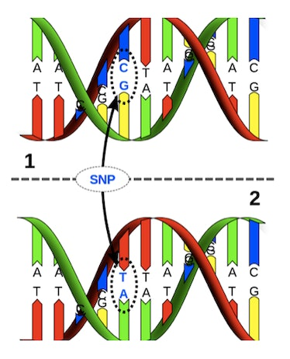
Variant calling: Identify differences in the DNA beween individuals of the same species.

Slide 3
What is a workflow
Intermediary_file_1.txt
Process 2
Intermediary_file_2.csv
input_data.txt
Process 1
Process 3
output.pdf

Slide 4
Overview
Today:
Basic variant calling workflow for one sample
Extend to multiple samples
Tomorrow:
GATK’s Best practices
Notes:
During the course of this talk I hope to explain some core concepts around NGS data such as the basics surrounding what the reference genome, variants and paired-end data is. This will be background information for the main point which is to cover the main concepts of a typical best practice workflow, or as some people call it a “pipeline”, where we take the raw reads in fastq format all the way to variants. I will dive a little deeper into the output from variant calling, the VCFs or Variant Call Format, what joint genotyping is and the principal of annotating and filtering the variants.
As with anything there is more to know about each of these subjects and I encourage you to go deeper as needed.

Slide 5
Example: Basic workflow, one sample
HG00097.bam
VariantCalling
HG00097_1.fastq
HG00097_2.fastq
Alignment
HG00097.vcf
FASTQ files
BAM files
VCF files

Slide 6
Workflow conventions
Create a new output file in each process
Don’t overwrite the input file
Use informative file names
Include information of the process + sample
Correct name extension e.g. .bam, .vcf, ...
Notes:
In order to keep track of all the processes you will run during the exercise it is important to organize your data.
Use good file names. For example “sample.fastq”.
In each analysis step you define an input file and an output file. ALWAYS create a new output file, i.e. do not overwrite the input file.
It is a good practice to include the name of the analysis step (or shortened) in the output file name.

Slide 7
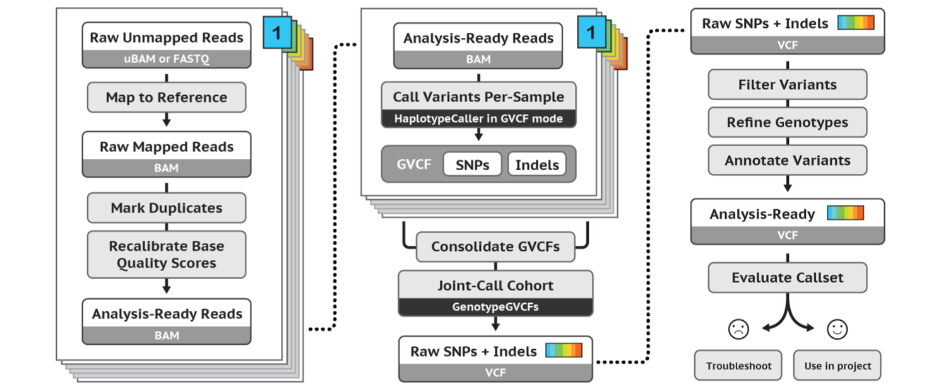
GATK’s best practices workflow for germline short variant discovery
https://software.broadinstitute.org/gatk/best-practices/
Notes:
But before we dive in to alignment I will mention that this is where the recommendations of the Broad institute best practices start. A guide that they have maintained pretty-well for several years where they recommend tools and setting to use for a standard analysis. I recommend that someone setting up a bioinformatics workflow or wanting to compare what has been done with their data and what is currently considered best practice be intimately aware of these recommendations.

Slide 8
Basic Variant Calling in one sample

Slide 9
Alignment
HG00097.bam
HaplotypeCaller
HG00097_1.fastq
HG00097_2.fastq
BWA mem
HG00097.vcf
FASTQ files
BAM files
VCF files

Slide 10
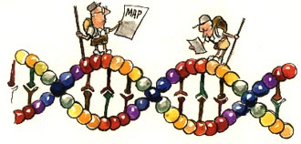
The reference genome
A reference genome is a haploid nucleic acid sequence which represents a species genome.
The first draft of the human genome contained 150,000 gaps.
GRCh37: 250 gaps
We will work with GRCh37 in the lab.

Slide 11
Keep track of the reference version!
The reference genome sequence is used as input in many bioinformatics applications for NGS data:
mapping
variant calling
annotation
You must keep track of which version of the reference genome your data was mapped to.
The same version must be used in all downstream analyses.

Slide 12
Alignment
AACAGGTATATCTTCCCCGCTAGCTAGCTAGCTAGCTAGCTAGCTAGCTACCCTCTTCCTTAGGGACTGTAC
AACAGGTATATCTTCCCCGCTAGCTAGCTAGCTAGCTAGCTAGCTAGCTACCCTCTTCCTTAGGGACTGTAC
GCTAGCTAGCTAGCTACCCT
Notes:
Alignment.
The most commonly used aligner for NGS data at the moment is BWA, or the Burrows-Wheeler Aligner, where Burrows Wheeler transform is used for pattern matching.
What we are trying to do in its simplest form is take one of our reads and fit it to its position on the reference genome. So here we have a read from our sample and the reference genome.

Slide 13
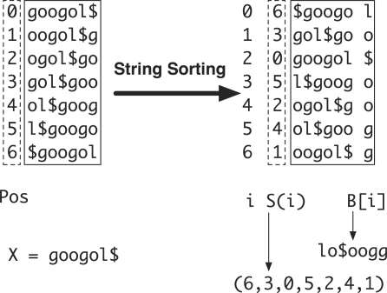
Burrows-Wheeler Aligner
http://bio-bwa.sourceforge.net
Burrows-Wheeler transform of reference genome

Slide 14
Alignment
Coverage or Depth
Notes:
But of course we didn’t have just one read. Here we have a picture with the reference genome at the top and a collection of reads aligned to it. If you have heard of the “coverage” of your sample before this is what is meant.
The coverage is the number of reads aligned to a position. The average coverage of the sample then is the average number of reads covering a position over each genomic position. For example….

Slide 15
Output from mapping - Sam format
HEADER SECTION
@HD VN:1.6 SO:coordinate
@SQ SN:2 LN:243199373
@PG ID:bwa PN:bwa VN:0.7.17-r1188 CL:bwa mem -t 1 human_g1k_v37_chr2.fasta HG00097_1.fq HG00097_2.fq
@PG ID:samtools PN:samtools PP:bwa VN:1.10 CL:samtools sort
@PG ID:samtools.1 PN:samtools PP:samtools VN:1.10 CL:samtools view -H HG00097.bam
ALIGNMENT SECTION
Read_001 99 2 3843448 0 101M = 3843625 278 TTTGGTTCCATATGAACTTT 0F<BFB<FFFBFBFFFBFBB
Read_001 147 2 3843625 0 101M = 3843448 -278 TTATTTCATTGAGCAGTGGT FBBI7IIFIB<BBBB<BBFF
Read_002 163 2 4210055 0 101M = 4210377 423 TGGTACCAAAACAGAGATAT 0IIFBFFFIIIFFIFFFBBF
Read_003 99 2 4210066 0 101M = 4210317 352 CAGAGATATAGATCAATGGA 0IIFFFIFFFIFIFIIIIIF
Start position
Quality
Reference sequence name
Sequence
Read name
(usually more complicated)
Notes:
QNAME: the name of the read.
FLAG: a bitwise number describing information about the read such as mapped/unmapped read, pairing, etc.
RNAME: the reference sequence name. The value of this field is * for unmapped reads.
POS: the left most mapping position of the first matching base. It is set to zero for unmapped reads.
MAPQ: a number to indicate the mapping quality.
CIGAR: a string describing how the read aligns with the reference. It consists of one or more components. Each component comprises an operator and the number of bases which the operator applies to. Operators are: MIDNSHP=X. The following table gives an overview of these operators
MNAME: the name of the mate strand, if it is a paired read. ‘=’ means that the name is the same as RNAME.
MPOS: a number indicating the left most mapping position of the mate.
TLEN: a number set to 0 for single-segment. For paired-segments it is calculated as the number of bases from the left most mapped base to the right most mapped base.
SEQ: the read sequence as the reference. If not ‘*’ then the length of the sequence must be equal the sum of lengths of M/I/S/=/X operations in the CIGAR string.
QUAL: the read quality, same as the quality string in a fastaq format.

Slide 16
File indices
Most large files we work with, such as the reference genome (.fasta) and the aligned reads (.bam) need an index
The index is a small file
Allows efficient access to the large file
Different indices for different file types
BWA index = Burrows-Wheeler transform of reference genome (several files)

Slide 17
Convert to Bam
Bam file is a binary representation of the Sam file

Slide 18
Variant calling
HG00097.bam
HaplotypeCaller
HG00097_1.fastq
HG00097_2.fastq
BWA mem
HG00097.vcf
FASTQ files
BAM files
VCF files

Slide 19
Genetic variation
SNV
Genetic variation = differences in DNA among individuals of the same species
Notes:
Genetic variation range in size from large chunks of the chromosome down to single nucleotides. We will focus on SNVs and short insertions and deletions in todays exercise.

Slide 20
Detecting variants in reads
Reference: ...GTGCGTAGACTGCTAGATCGAAGA...
Sample: ...GTGCGTAGACTGATAGATCGAAGA...
...GTGCGTAGACTGATAGATCGAAGA...
...GTGCGTAGACTGCTAGATCGAAGA...
...GTGCGTAGACTGCTAGATCGAAGA...
...GTGCGTAGACTGATAGATCGAAGA...
...GTGCGTAGACTGATAGATCGAAGA...
...GTGCGTAGACTGCTAGATCGAAGA...
...GTGCGTAGACTGATAGATCGAAGA...
...GTGCGTAGACTGCTAGATCGAAGA...
...GTGCGTAGACTGATAGATCGAAGA...
Notes:
Variant calling is looking for positions where some number of reads disagree with the reference genome. Here for example the reference sample says the position should be a C whereas 6 of the reads say it is an A in the sample. This is also what is meant with the allelic frequency of a variant, out of 10 reads 6 are variant therefore the allelic frequency of A is 60%.
Note that this is not the same as population based allele frequencies that measures the relative frequency of an allele in a population.

Slide 21
HaplotypeCaller
Included in GATK
Widely used tool
Optimised for detecting germline variants in diploid species (human)

Slide 22
Reference- and alternatve alleles
TGGGCTTTTCCAACAGGTATATCTTCCCCGCTAGCTCGCTAGCTACTTCAAATTCCT
Reference allele
AGCTCGCTA
Alternative allele
AGCTAGCTA
Reference allele = the allele in the refence genome
Alternative allele = the allele NOT in the refence genome

Slide 23
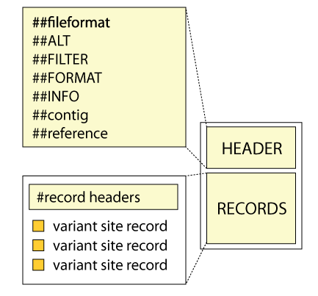
Variant Call Format (VCF)

Slide 24
Variant Call Format (VCF)
##fileformat=VCFv4.2
##FILTER=<ID=LowQual,Description="Low quality">
##FORMAT=<ID=AD,Number=R,Type=Integer,Description="Allelic depths for the ref and alt alleles in the order listed">
##FORMAT=<ID=DP,Number=1,Type=Integer,Description="Approximate read depth (reads with MQ=255 or with bad mates are filtered)">
##FORMAT=<ID=GT,Number=1,Type=String,Description="Genotype">
##INFO=<ID=AC,Number=A,Type=Integer,Description="Allele count in genotypes, for each ALT allele, in the same order as listed">
##INFO=<ID=AF,Number=A,Type=Float,Description="Allele Frequency, for each ALT allele, in the same order as listed">
##INFO=<ID=AN,Number=1,Type=Integer,Description="Total number of alleles in called genotypes">
##contig=<ID=2,length=243199373>
##source=HaplotypeCaller
#CHROM POS ID REF ALT QUAL FILTER INFO FORMAT HG00097
2 136220992 . G GT 30.64 . AC=1;AF=0.500;AN=2 GT:AD:DP 0/1:3,2:5
2 136226814 . GAC G 44.60 . AC=1;AF=0.500;AN=2 GT:AD:DP 0/1:4,2:6
2 136234279 . C T 102.60 . AC=1;AF=0.500;AN=2 GT:AD:DP 0/1:3,4:7
2 136234284 . C T 102.60 . AC=1;AF=0.500;AN=2 GT:AD:DP 0/1:3,4:7
136263277 . T A 148.60 . AC=1;AF=0.500;AN=2 GT:AD:DP 0/1:8,5:13
…
…
Notes:
VCF files, or variant call format files, are divided into two main parts. The top, or head, of the file, with hashtag prefixed lines, is a descriptive part explaining the information given for each variant and each sample, if multiple samples exists. It also gives the date and some information from the variant caller used.
Below this are the actual variants, one line per variant.
On this slide – go through meta data and columns 1-9

Slide 25
Basic variant calling in cohort

Slide 26
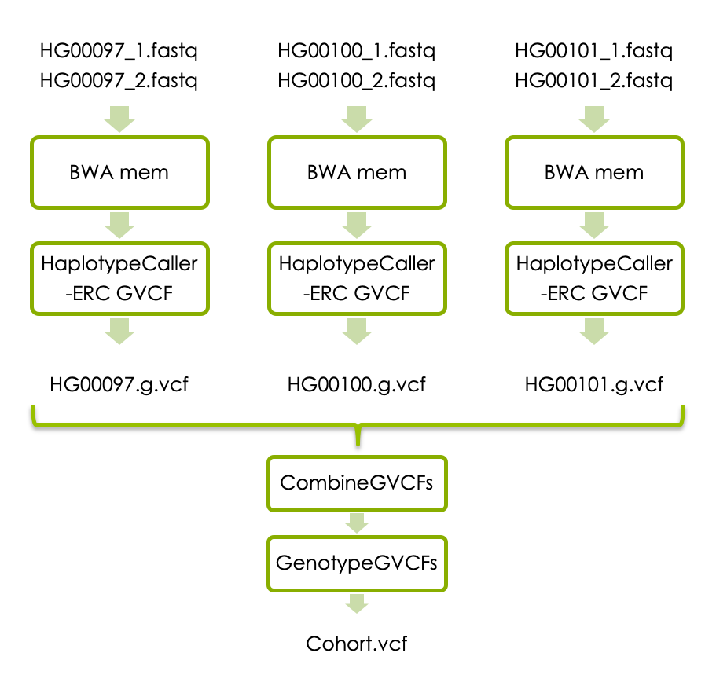
Basic variant calling in cohort

Slide 27
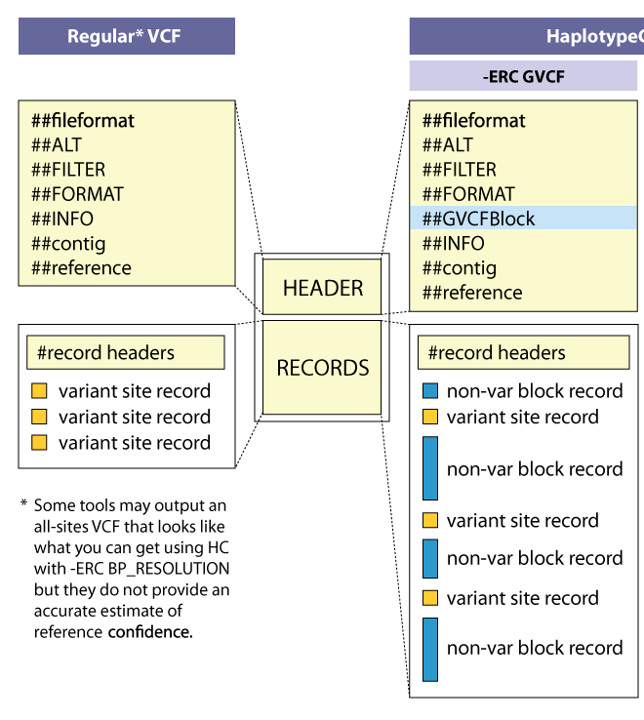
GVCF Files are valid VCFs with extra information
HaplotypeCaller GVCF
GVCF has records for all sites, whether there is a variant call there or not.
The records include an accurate estimation of how confident we are in the determination that the sites are homozygous-reference or not.
Adjacent non-variant sites merged into blocks
Notes:
For joint genotyping projects we use a different kind of VCF file.
A gVCF file has the same format as a VCF file but it has information for all sites, not just variants. There are two kinds of gVCF files, the older ones had individual records for each site but this is space inefficient.
The new ones have individual variant records for variant sites, but the non-variant sites are grouped together into non-variant block records that represent intervals of sites for which the genotype quality (GQ) is within a certain range or band.
http://gatkforums.broadinstitute.org/wdl/discussion/4017/what-is-a-gvcf-and-how-is-it-different-from-a-regular-vcf
In the so-called GVCF mode used for scalable variant calling in DNA sequence data, HaplotypeCaller runs per-sample to generate an intermediate genomic gVCF (gVCF), which can then be used for joint genotyping of multiple samples in a very efficient way, which enables rapid incremental processing of samples as they roll off the sequencer, as well as scaling to very large cohort sizes (e.g. the 92K exomes of ExAC).

Slide 28
Basic variant calling in cohort

Slide 29
Variant Call Format (VCF)
##fileformat=VCFv4.2
##ALT=<ID=NON_REF,Description="Represents any possible alternative allele at this location">
##FILTER=<ID=LowQual,Description="Low quality">
##FORMAT=<ID=AD,Number=R,Type=Integer,Description="Allelic depths for the ref and alt alleles in the order listed">
##FORMAT=<ID=DP,Number=1,Type=Integer,Description="Approximate read depth (reads with MQ=255 or with bad mates are filtered)">
##FORMAT=<ID=GT,Number=1,Type=String,Description="Genotype">
##INFO=<ID=AC,Number=A,Type=Integer,Description="Allele count in genotypes, for each ALT allele, in the same order as listed">
##INFO=<ID=AF,Number=A,Type=Float,Description="Allele Frequency, for each ALT allele, in the same order as listed">
##INFO=<ID=AN,Number=1,Type=Integer,Description="Total number of alleles in called genotypes">
##contig=<ID=2,length=243199373>
##source=CombineGVCFs
##source=GenotypeGVCFs
##source=HaplotypeCaller
#CHROM POS ID REF ALT QUAL FILTER INFO FORMAT HG00097 HG00100 HG00101
2 136045826 . G A 167.26 . AC=1;AF=0.167;AN=6 GT:AD:DP 0/0:8,0:8 0/0:13,0:13 0/1:1,5:6
2 136046443 . CGT C 129.27 . AC=3;AF=0.500;AN=6 GT:AD:DP 0/0:8,0:8 0/1:3,1:4 1/1:0,4:4
2 136047387 . T C 186.27 . AC=1;AF=0.167;AN=6 GT:AD:DP 0/0:6,0:6 0/0:16,0:16 0/1:4,6:10
2 136048649 . C G 127.26 . AC=1;AF=0.167;AN=6 GT:AD:DP 0/0:13,0:13 0/0:9,0:9 0/1:1,4:5
2 136052318 . C T 107.26 . AC=1;AF=0.167;AN=6 GT:AD:DP 0/0:7,0:7 0/0:13,0:13 0/1:3,3:6
Notes:
VCF files, or variant call format files, are divided into two main parts. The top, or head, of the file, with hashtag prefixed lines, is a descriptive part explaining the information given for each variant and each sample, if multiple samples exists. It also gives the date and some information from the variant caller used.
Below this are the actual variants, one line per variant.
Now let´slook at each part a little closer.

Slide 30
ReadGroups
A tag that mark which sample each read comes from
Needed for correct variant calling of a cohort
Make sure to update read group info when processign a new sample!

Slide 31
Today’s lab

Slide 32
1000 Genomes data
Low coverage WGS data
3 samples
Small region on chromosome 2
About the samples:
https://www.internationalgenome.org/data-portal/sample

Slide 33
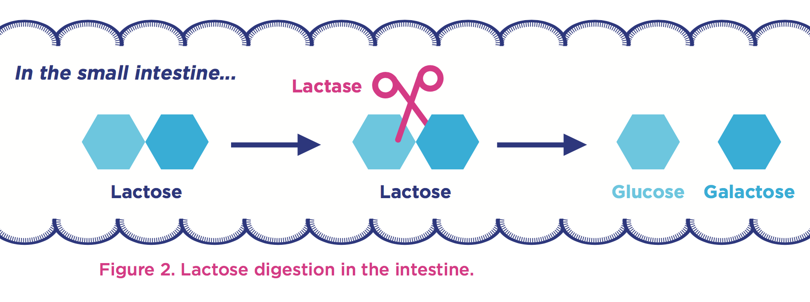
The Lactase enzyme
All mammals produce lactase as infants
Some human produce lactase in adulthood
Genetic variation upstream of the LCT gene cause the lactase persistent phenotype (lactose tolerance)
Notes:
Most people are born with the ability to digest lactose, the major carbohydrate in milk and the main source of nutrition until weaning.
Lactase is an enzyme expressed in the small intestine.
Cuts the lactose molecule into one glucose and one galactose molecule.
Lactase is encoded by the LCT gene, located on chromosome 2.

Slide 34
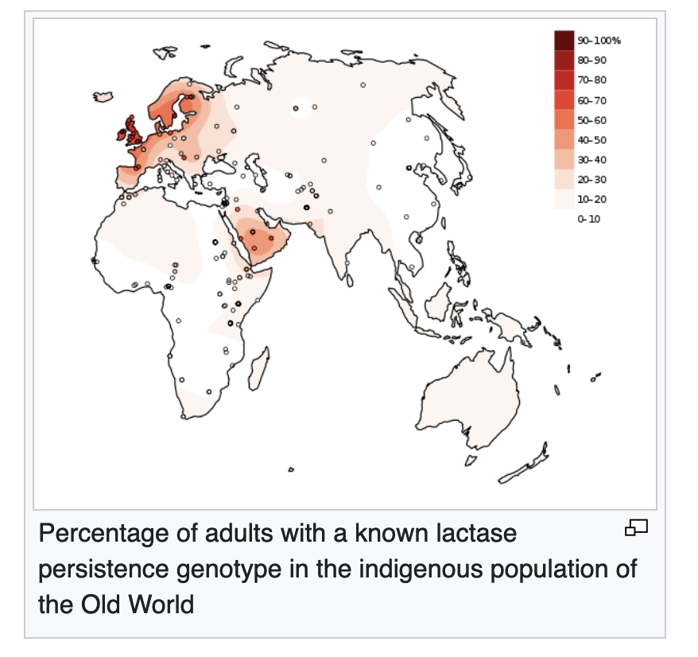
The Lactase enzyme
Notes:
Most people are born with the ability to digest lactose, the major carbohydrate in milk and the main source of nutrition until weaning.
Lactase is an enzyme expressed in the small intestine.
Cuts the lactose molecule into one glucose and one galactose molecule.
Lactase is encoded by the LCT gene, located on chromosome 2.

Slide 35
Part 1: Variant calling in one sample

Slide 36
Basic variant calling in one sample
HG00097.bam
HaplotypeCaller
HG00097_1.fastq
HG00097_2.fastq
BWA mem
HG00097.vcf
FASTQ files
BAM files
VCF files

Slide 37
Part 2: Variant calling in cohort

Slide 38
Joint variant calling workflow

Slide 39
Workflow conventions
Create a new output file in each process
Don’t overwrite the input file
Use informative file names
Include information of the process + sample
Correct name extension e.g. .bam, .vcf, ...
Notes:
In order to keep track of all the processes you will run during the exercise it is important to organize your data.
Use good file names. For example “sample.fastq”.
In each analysis step you define an input file and an output file. ALWAYS create a new output file, i.e. do not overwrite the input file.
It is a good practice to include the name of the analysis step (or shortened) in the output file name.

Slide 40
Part 3: Follow GATK best practices for short variant discovery

Slide 41
https://gatk.broadinstitute.org

Slide 42
GATK’s best practices workflow for germline short variant discovery
https://software.broadinstitute.org/gatk/best-practices/
Notes:
But before we dive in to alignment I will mention that this is where the recommendations of the Broad institute best practices start. A guide that they have maintained pretty-well for several years where they recommend tools and setting to use for a standard analysis. I recommend that someone setting up a bioinformatics workflow or wanting to compare what has been done with their data and what is currently considered best practice be intimately aware of these recommendations.
//A recent change has been made where they no longer recommend indel realignment, as it is performed on the fly at the variant calling stage. It is good to note that this resource exists, as it is definitely something you should be looking at when running a variant calling pipeline as it is needed in some cases.

Slide 43
Mark Duplicates
Notes:
But before we dive in to alignment I will mention that this is where the recommendations of the Broad institute best practices start. A guide that they have maintained pretty-well for several years where they recommend tools and setting to use for a standard analysis. I recommend that someone setting up a bioinformatics workflow or wanting to compare what has been done with their data and what is currently considered best practice be intimately aware of these recommendations.
//A recent change has been made where they no longer recommend indel realignment, as it is performed on the fly at the variant calling stage. It is good to note that this resource exists, as it is definitely something you should be looking at when running a variant calling pipeline as it is needed in some cases.

Slide 44
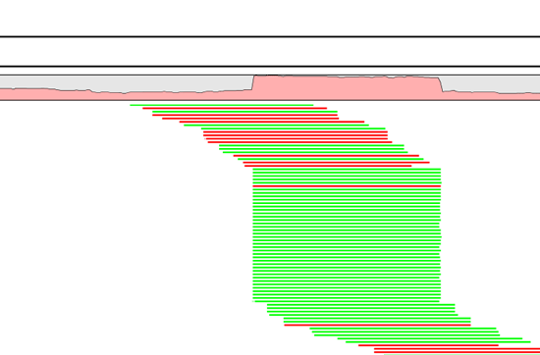
Duplicate reads
PCR duplicates - library preparation
Optical duplicates - sequencing
Don’t add unique information
Gives false allelic ratios of variants
Should be removed/marked
Notes:
One tool for this is picards MarkDuplicates.
Occur PCR
Copies same fragment goto different flowcells
High library complexity is good
Don’t add information
Optical duplicates
Less talked about
One flowcell cluster
Incorrectly identified on several cells
Amplicon
Duplicates typically arise during PCR amplification of the fragments with adapters. We are intentionally creating multiple copies of each original genomic DNA molecule so that you have enough of them. The PCR duplicates occur when two copies of the same original molecule get onto different areas of the flowcell. A greater amount of starting material, often termed as having a high complexity library, is a good indicator of not having a big problem with duplicates.
And duplicates don’t give any additional information, as you can see here, what we want is reads slightly off from eachother, so we know that they are adding new information. You can also choose to just mark the duplicates rather than remove them entirely as many variant callers can ignore reads marked as duplicates. This gives you the option later to perform variant calling with and without duplicates and compare the results.
Finally, during some kinds of sequencing, such as amplicon sequencing, you tend to recommend not removing duplicates as there will be many duplicates by design. So keep that in mind.
“optical duplicates are sequences from one flow cell cluster, that are (incorrectly) identified by software to be from multiple adjacent clusters. ”

Slide 45
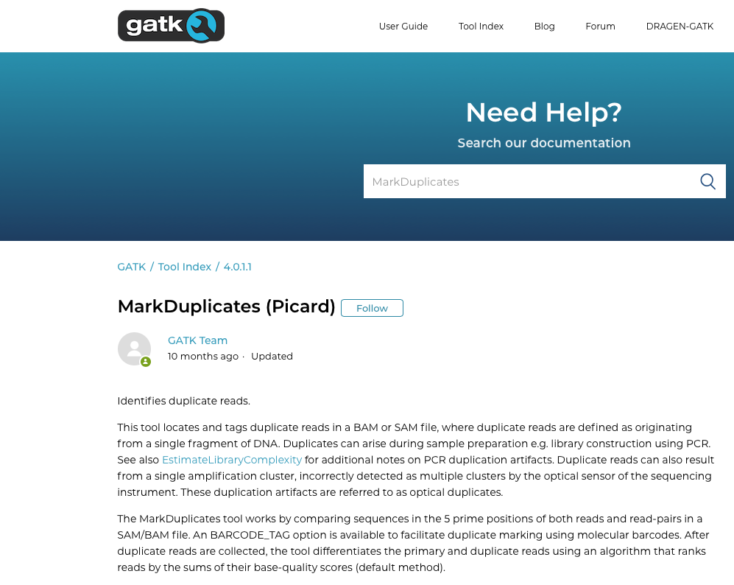

Slide 46
Base Quality Score Recalibration (BQSR)
Notes:
But before we dive in to alignment I will mention that this is where the recommendations of the Broad institute best practices start. A guide that they have maintained pretty-well for several years where they recommend tools and setting to use for a standard analysis. I recommend that someone setting up a bioinformatics workflow or wanting to compare what has been done with their data and what is currently considered best practice be intimately aware of these recommendations.
//A recent change has been made where they no longer recommend indel realignment, as it is performed on the fly at the variant calling stage. It is good to note that this resource exists, as it is definitely something you should be looking at when running a variant calling pipeline as it is needed in some cases.

Slide 47
Base Quality Score Recalibration (BQSR)
During base calling, the sequencer estimates a quality score for each base. This is the quality scores present in the fastq files.
Systematic (non-random) errors in the base quality score estimation can occur.
due to the physics or chemistry of the sequencing reaction
manufacturing flaws in the equipment
etc
Can cause bias in variant calling
Base Qualtiy Score Recalibration helps to calibrate the scores so that they correspond to the real per-base sequencing error rate (phred scores)
Notes:
Base Quality Score Recalibration basically detects systematic errors made by the sequencer when it estimates the quality score of each base call, which is basically how confident the machine was that the called base is correct.
Some of these errors are due to the physics or the chemistry of how the sequencing reaction works, and some can be due to manufacturing flaws in the equipment.
The tool checks the covariation between Reported quality score, the position within the read and the preceding and current nucleotide observed by the sequencing machine to find non-random discrepancies that lead to the score being adjusted.
These systematic technical errors, leading to over- or under-estimated base quality scores in the data.

Slide 48
Filter variants
https://software.broadinstitute.org/gatk/best-practices/
Germline short variant discovery (SNPs + Indels)
Notes:
But before we dive in to alignment I will mention that this is where the recommendations of the Broad institute best practices start. A guide that they have maintained pretty-well for several years where they recommend tools and setting to use for a standard analysis. I recommend that someone setting up a bioinformatics workflow or wanting to compare what has been done with their data and what is currently considered best practice be intimately aware of these recommendations.
//A recent change has been made where they no longer recommend indel realignment, as it is performed on the fly at the variant calling stage. It is good to note that this resource exists, as it is definitely something you should be looking at when running a variant calling pipeline as it is needed in some cases.

Slide 49
Variant Call Format (VCF)
##fileformat=VCFv4.2
##ALT=<ID=NON_REF,Description="Represents any possible alternative allele at this location">
##FILTER=<ID=LowQual,Description="Low quality">
##FORMAT=<ID=AD,Number=R,Type=Integer,Description="Allelic depths for the ref and alt alleles in the order listed">
##FORMAT=<ID=DP,Number=1,Type=Integer,Description="Approximate read depth (reads with MQ=255 or with bad mates are filtered)">
##FORMAT=<ID=GT,Number=1,Type=String,Description="Genotype">
##INFO=<ID=AC,Number=A,Type=Integer,Description="Allele count in genotypes, for each ALT allele, in the same order as listed">
##INFO=<ID=AF,Number=A,Type=Float,Description="Allele Frequency, for each ALT allele, in the same order as listed">
##INFO=<ID=AN,Number=1,Type=Integer,Description="Total number of alleles in called genotypes">
##contig=<ID=2,length=243199373>
##source=CombineGVCFs
##source=GenotypeGVCFs
##source=HaplotypeCaller
#CHROM POS ID REF ALT QUAL FILTER INFO FORMAT HG00097 HG00100 HG00101
2 136045826 . G A 167.26 . AC=1;AF=0.167;AN=6 GT:AD:DP 0/0:8,0:8 0/0:13,0:13 0/1:1,5:6
2 136046443 . CGT C 129.27 . AC=3;AF=0.500;AN=6 GT:AD:DP 0/0:8,0:8 0/1:3,1:4 1/1:0,4:4
2 136047387 . T C 186.27 . AC=1;AF=0.167;AN=6 GT:AD:DP 0/0:6,0:6 0/0:16,0:16 0/1:4,6:10
2 136048649 . C G 127.26 . AC=1;AF=0.167;AN=6 GT:AD:DP 0/0:13,0:13 0/0:9,0:9 0/1:1,4:5
2 136052318 . C T 107.26 . AC=1;AF=0.167;AN=6 GT:AD:DP 0/0:7,0:7 0/0:13,0:13 0/1:3,3:6
Notes:
VCF files, or variant call format files, are divided into two main parts. The top, or head, of the file, with hashtag prefixed lines, is a descriptive part explaining the information given for each variant and each sample, if multiple samples exists. It also gives the date and some information from the variant caller used.
Below this are the actual variants, one line per variant.
Now let´slook at each part a little closer.

Slide 50
Filtering
Variant quality score recalibration (VQSR):
For large data sets ( >1 WGS or >30WES samples)
GATK has a machine learning algorithm that can be trained to recognise ”likely false” variants
We do recommend to use VQSR when possible!
Hard filters:
For smaller data sets
Hard filters on information in the VCF file
For example: Flag variants with ”Q < 40.0”
Notes:
A typical scenario requiring manual filtration is small cohort callsets, e.g. less than thirty exomes.

Slide 51
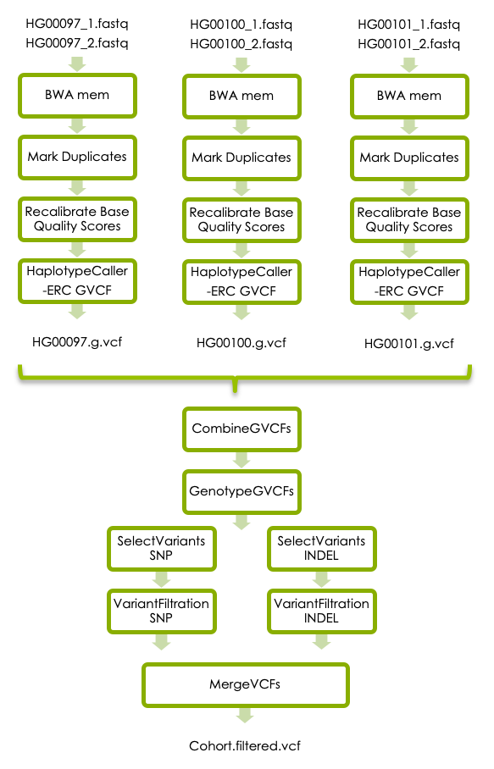
GATK’s best practises

Slide 52
https://gatk.broadinstitute.org

Slide 53
