Slide 1
NGS: technologies and challenges
Olga Vinnere Pettersson, PhD
Project Coordinator
NGI/SciLifeLab, Uppsala Node
@OlgaVPettersson
Version 8.2

Slide 2
Outline
INTRO
Sequencing service at NGI-SciLifeLab
NGS general knowledge:
Current technologies
NGS Challenges:
Sequencing artefacts
NGS sample quality requirements
Philosophical reflection upon NGS analysis

Slide 3
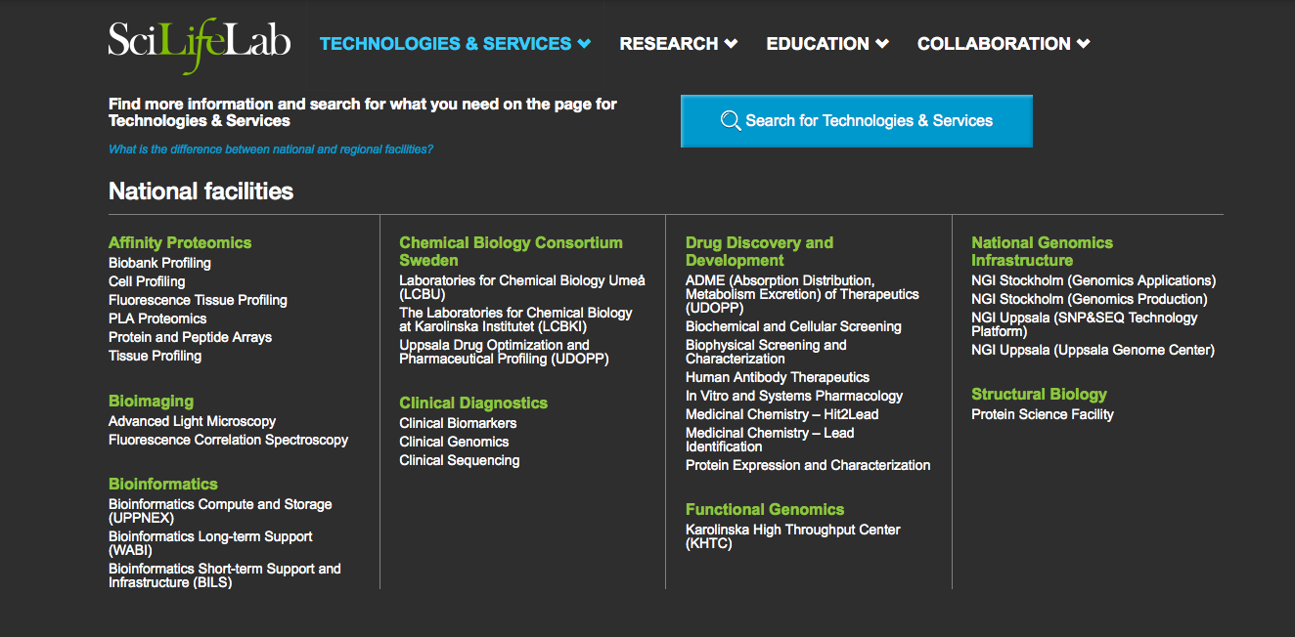

Slide 4
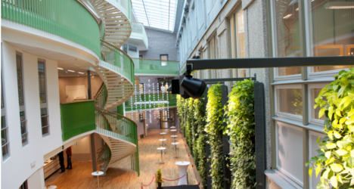
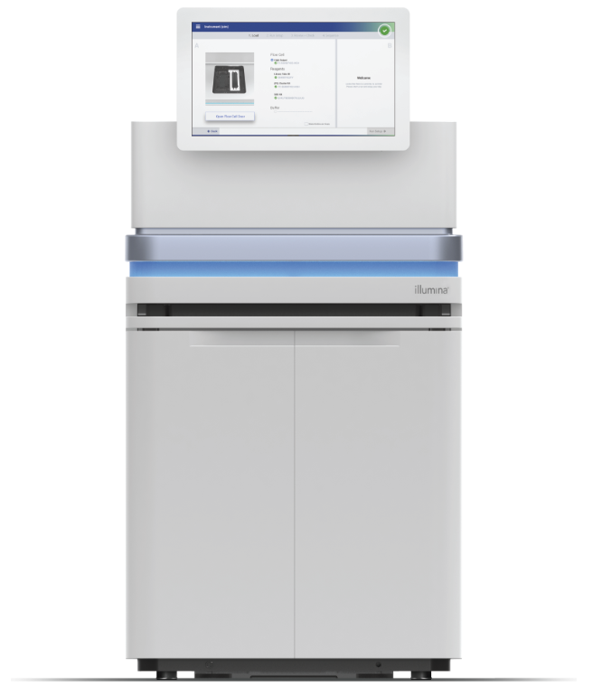
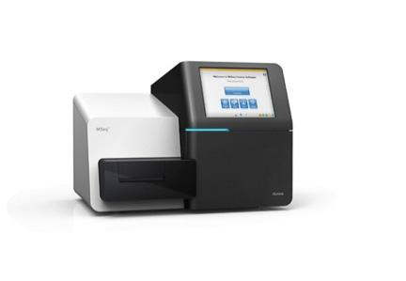
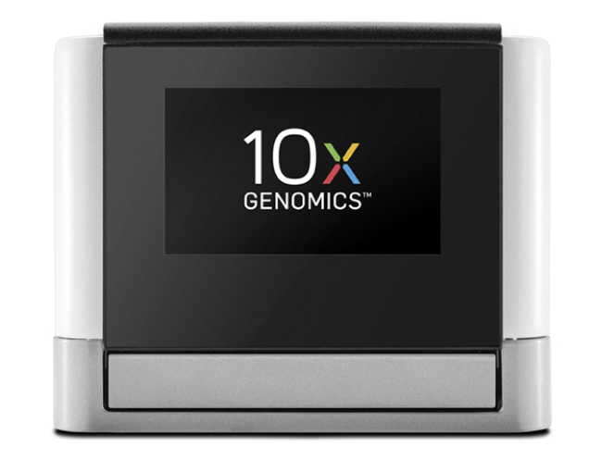
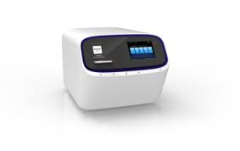
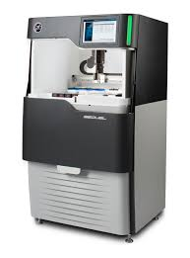
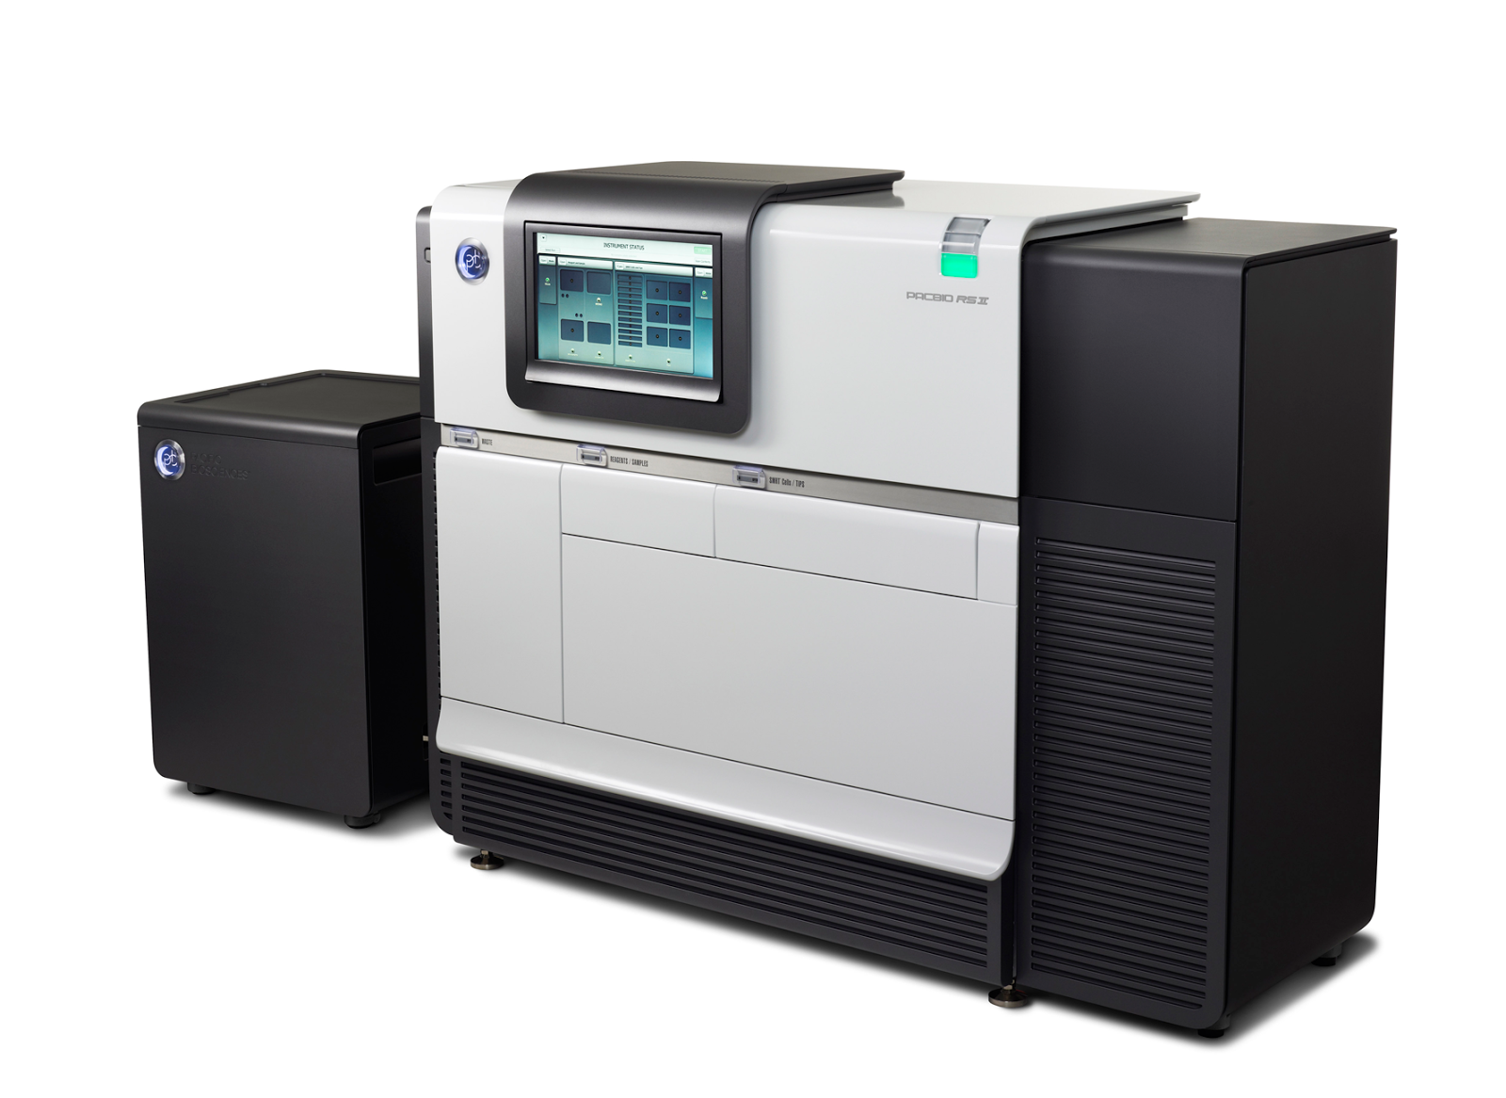
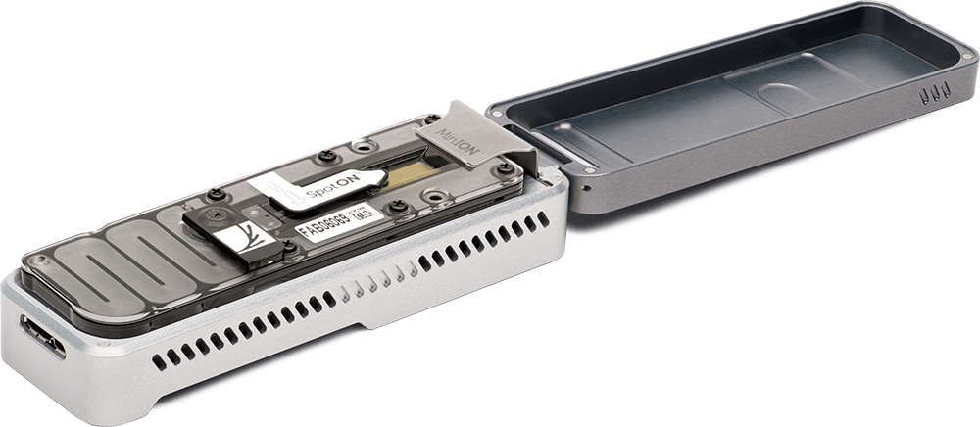
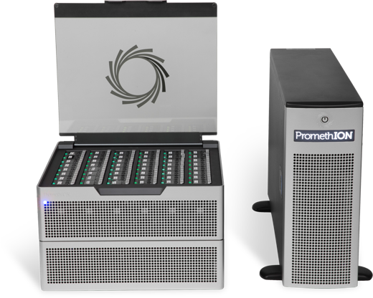

Slide 5
We are non-profit
We have technology and knowledge
We want to help you to do GREAT research
We do not want co-authorship
Let us help YOU

Slide 6
Current Technologies

Slide 7
Current leader on the NGS market
Instrument | Run time | Max output | Max reads/run | Max read length
iSeq | 9.5 – 19 hrs | 1.2 Gb | 4 mln | PE 150
MiniSeq | 4-24 hrs | 7.5 Gb | 25 mln | PE 150
MiSeq | 4-55 hours | 15 Gb | 25 mln | PE 300
NextSeq series | 12-48 hours | 120-300 Gb | 0.4 – 1 bln | PE 150
NovaSeq 6000 | 13-44 hours | 6 Tb | 20 bln | PE 250
RIP: HiSeq 2500 & HiSeq X
Used for everything

Slide 8
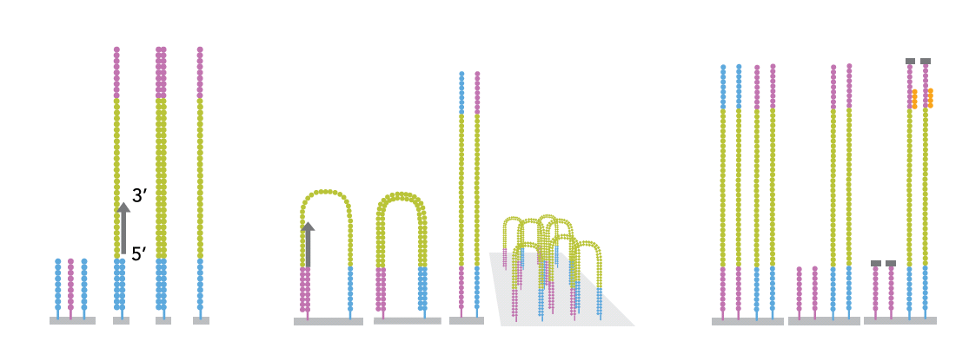
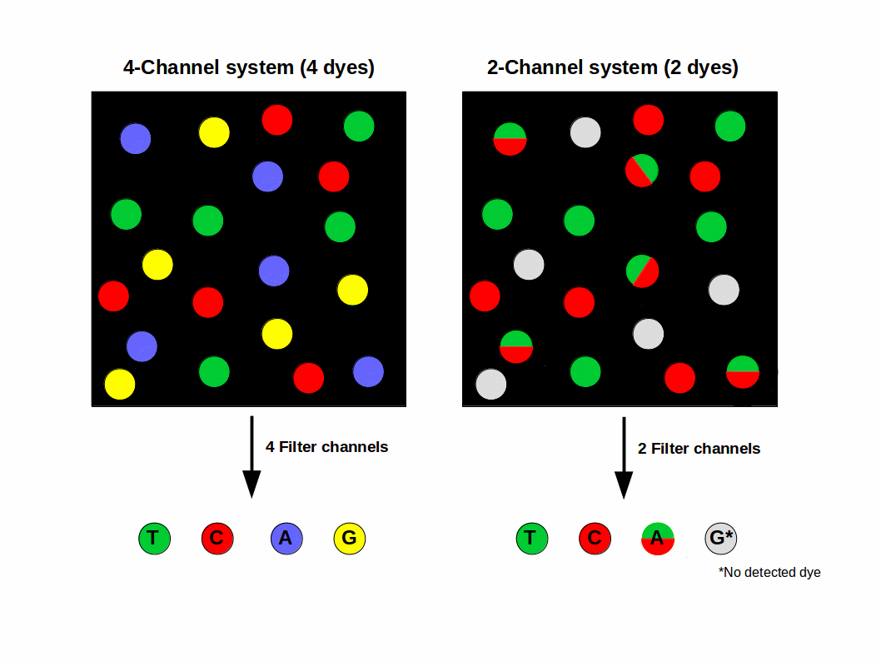
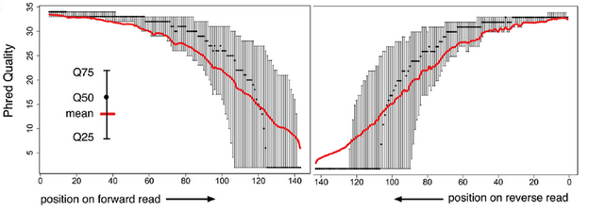
Illumina: bridge amplification
Notes:
De fragment som ska sekvensera amplifiera I flödescellen för att möjliggöra detektion av signalerna från sekvensningen. Detta sker I en så kallad klulstergenerering, där de fragment som ska sekvenseras kopieras ca 1000x på en liten delyta och varje fragment då bildar ett sk klluster.
Förenklad bild, sker samtidigt för ca 200M fragment per lane I flödescellen.
Adaptern på sekvensningsbiblioteken binder till komplementära sekvenser på ytan I flödescellen. Den komplementära sekvensen fungerar

Slide 9
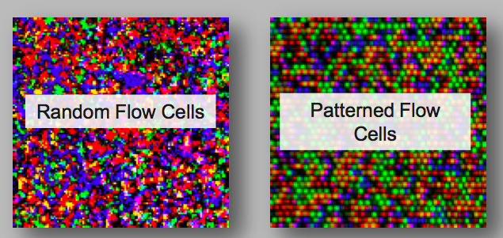
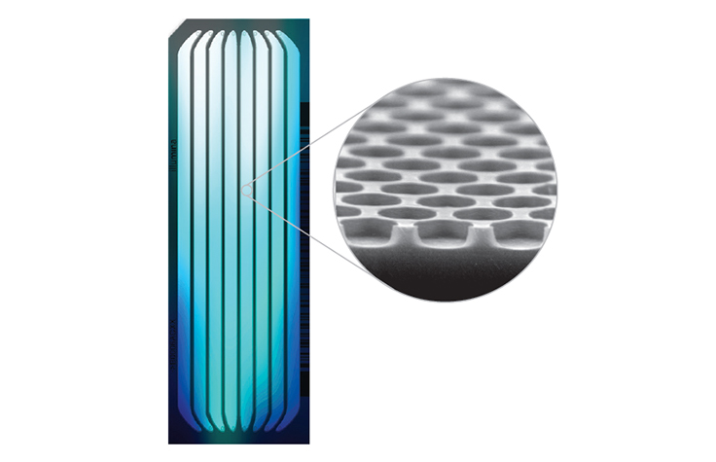
Illumina sequencing: before vs now
Patterned flow cells introduced on HiSeq X and NextSeq systems
MiSeq flow cells still do not have a patterm

Slide 10
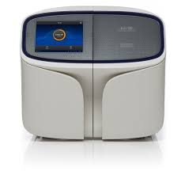
Ion S5 XL
Chip: | Run time | Output | Max reads/run | Max read length
510 | 2.5-4 hrs | 0.3 - 0.5 Gb | 2-3 mln | SE 400 bp
520 | 2.5-4 hrs | 0.6-2 Gb | 3-6 mln | SE 600 bp
530 | 2.5-4 hrs | 3-8 Gb | 15-20 mln | SE 600 bp
540 | 2.5-4 hrs | 10-15 Gb | 60-80 mln | SE 400 bp
550 | 2.5-4 hrs | 18-20 Gb | 100-130 mln | SE 200 bp
RIP: IonTorrent PGM, IonProton
Clinical applications mainly
Standard analysis directly on the instrument
Multiplex-PCR panels

Slide 11
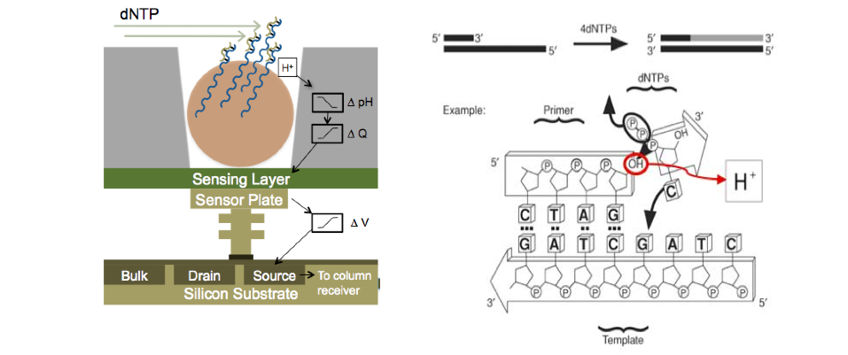
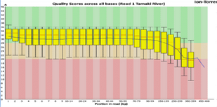
Ion Torrent: H⁺ ion-sensitive field effect transistors
bead

Slide 12
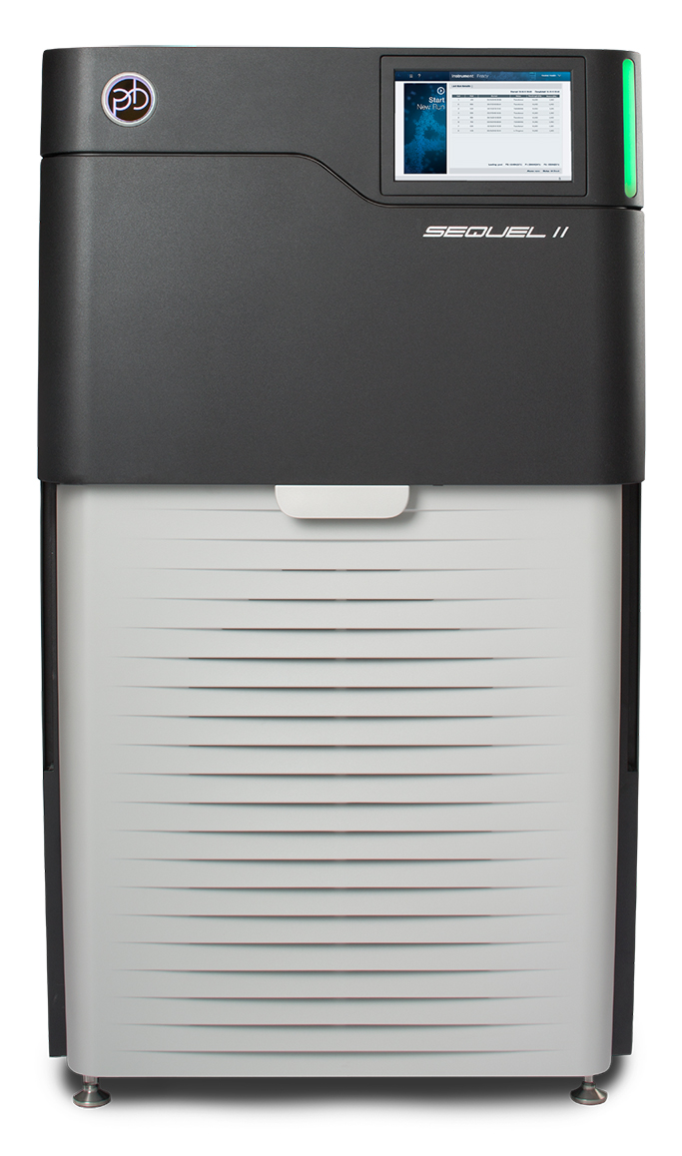
Instrument | Run time /SMRT | Output /SMRT | Max reads /SMRT | Max read length*
RSII | 30 min – 6 hrs | 500 Mb – 2 Gb | 50 000 | 40 kb
Sequel | 30 min – 20 hrs | 2 – 35 Gb | 200 000 | 60 kb
Sequel II
HiFi | 30 hrs | 320 Gb | 4 mln | 20 kb
CLR | 15 hrs | 300 Gb | 3 mln | 120 kb
Single Molecule Real Time sequencing: SMRT

Slide 13
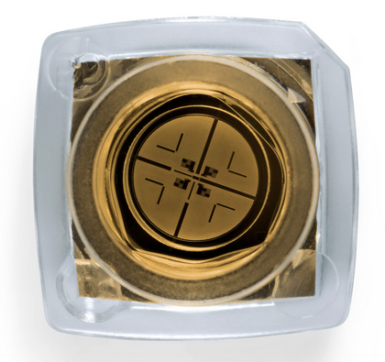
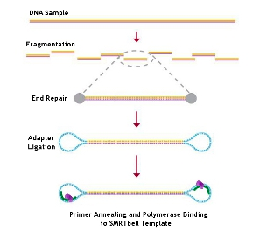
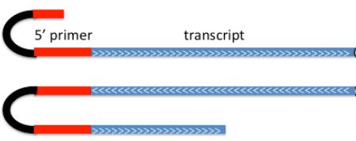
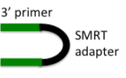
PacBio: SMRT - technology
CLR: circular long read
HiFi = CCS: circular consensus read

Slide 15
PacBio
Qv 20+

Slide 16
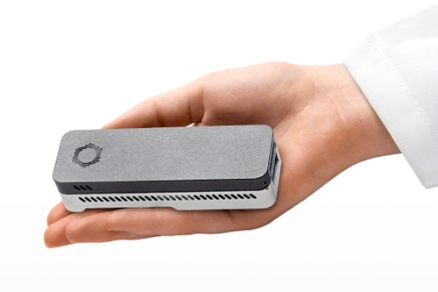
Instrument | Run time /FC | Output / FC | Nr of pores | Max read length
Flongle | 16 hrs | 1 Gb | 126 | 1 Mb
MinION | 24 hrs | 2-15 Gb | 512 | 1 Mb
GridION | 24 hrs | 2-15 Gb | 512 | 1 Mb
PromethION | 72 hrs | 10 – 150 Gb | 3 000 | 2 Mb
Q&A: ”It depends”…

Slide 17
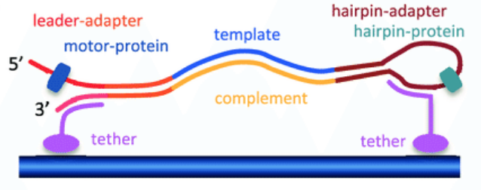
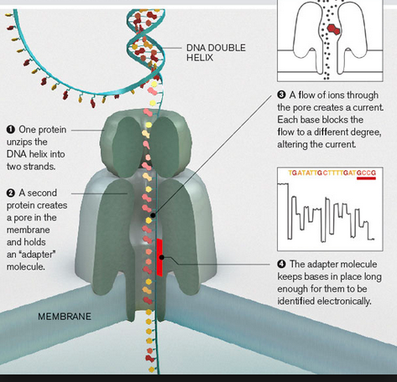
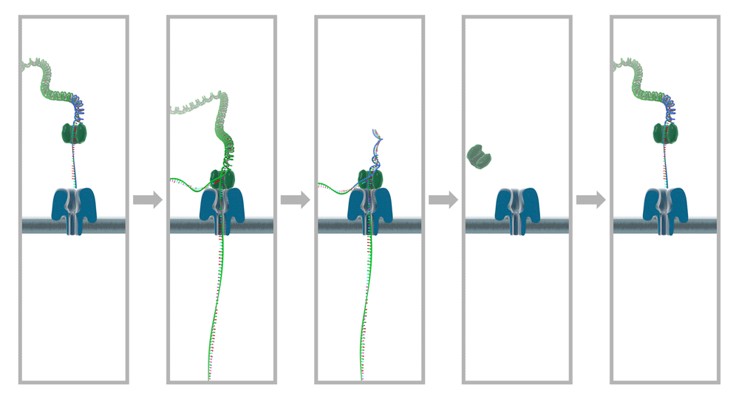
ONT: DNA + Motor + Pore

Slide 18
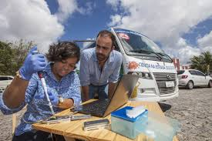
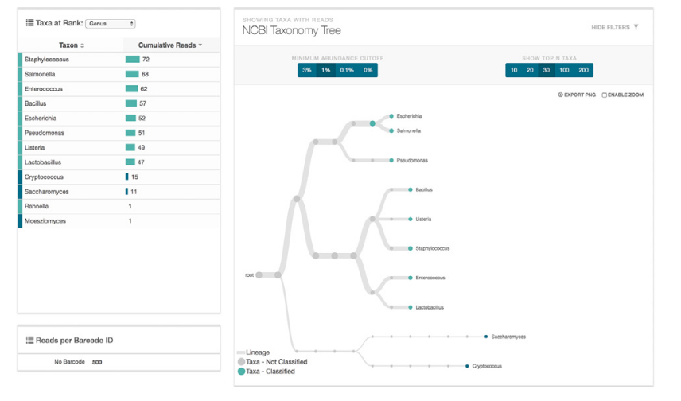
Main advantages of ONT: SPEED and PORTABILITY

Slide 19
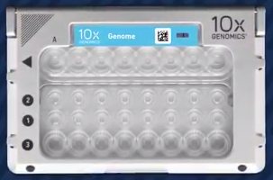
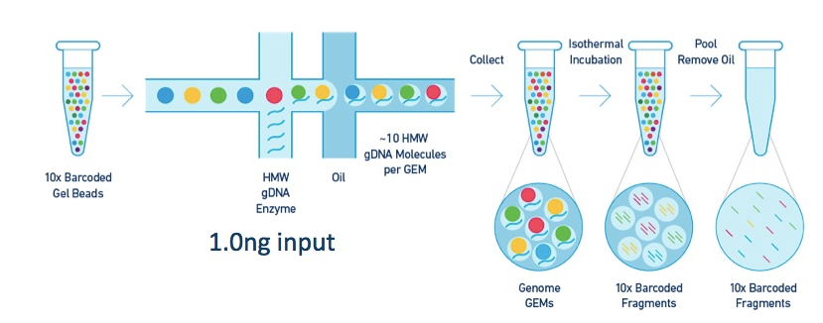
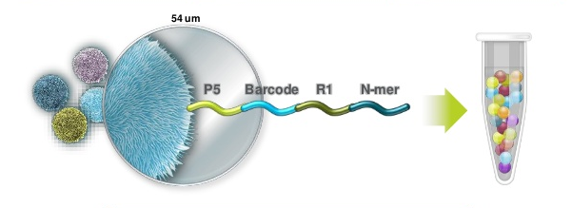
10x Genomics (Chromium)
Fragment length: 50 kb – 100+ Kb

Slide 20
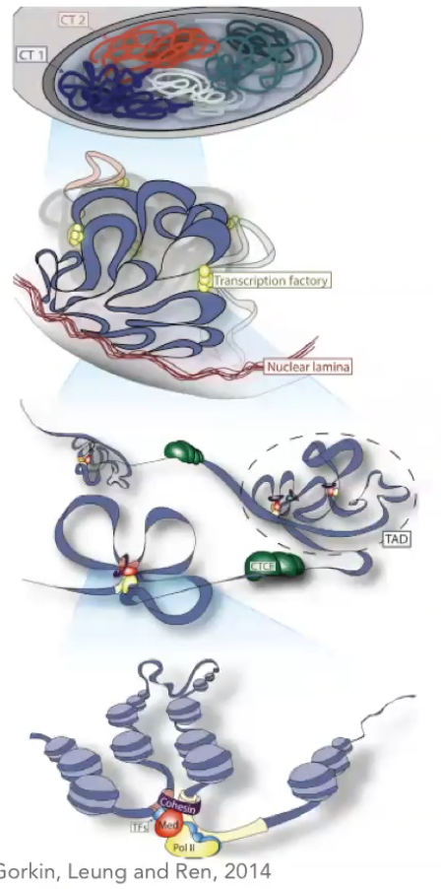
Hi-C: linking reads to chromosomes
Start with a tissue!
Capture DNA bound to the same nucleosome
Make a library and sequence on Illumina NovaSeq

Slide 21
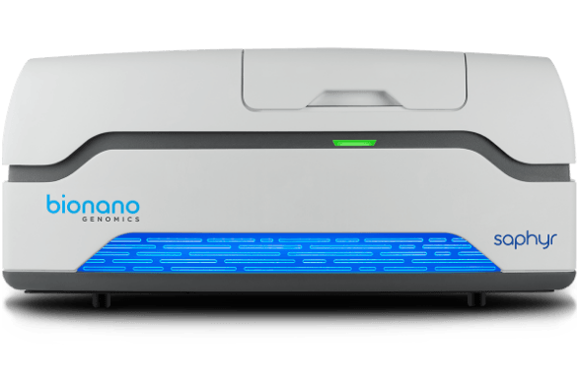
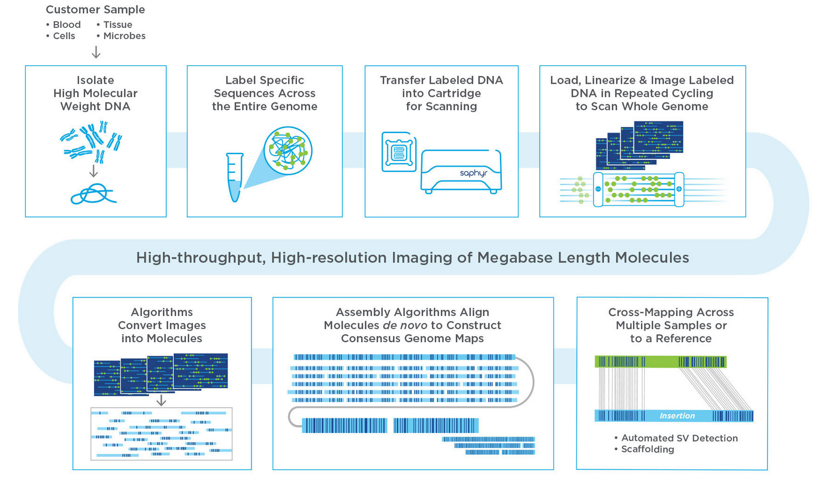
BioNano: optical mapping

Slide 22
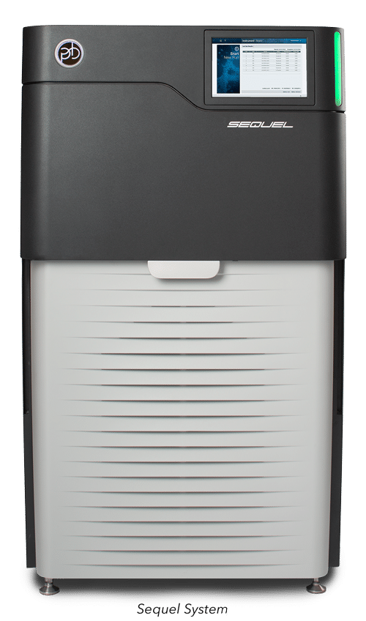
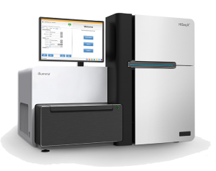
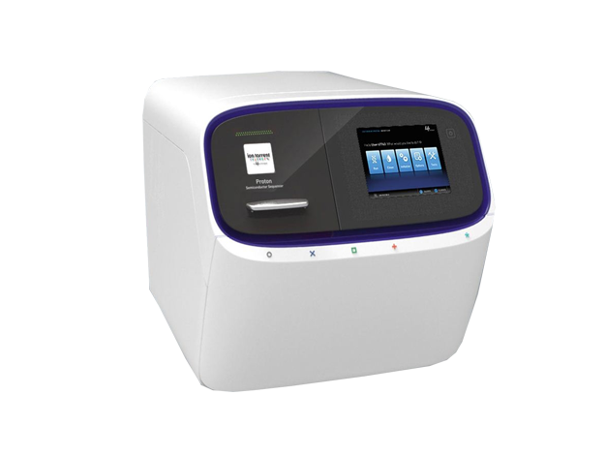
Technologies and Applications at NGI
NGS technologies
Short read NGS
Long-read NGS
Whole genome re-sequencing
RNA-seq
Exome
Targeted re-seq
Panels
Amplicons up to 600 bp
De novo genome sequencing
Whole-transcript sequencing
Structural variant resolving
Allele phasing
Targeted re-seq
Amplicons up to 13 kb
Research and development

Slide 23
NGS Technologies: SUMMARY
Development goes VERY FAST
All technologies have their PROs and CONs
One technology does not suit all the applications
In some projects, several technologies should be combined

Slide 24
Making sense of genomics data:
Understanding sequencing bias

Slide 25
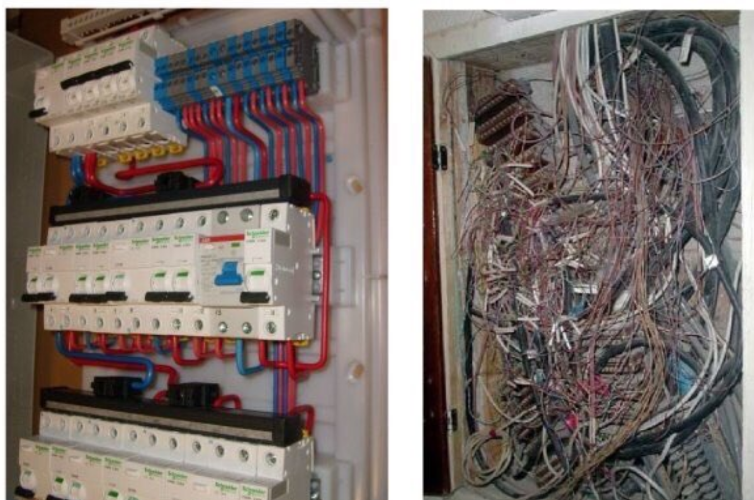
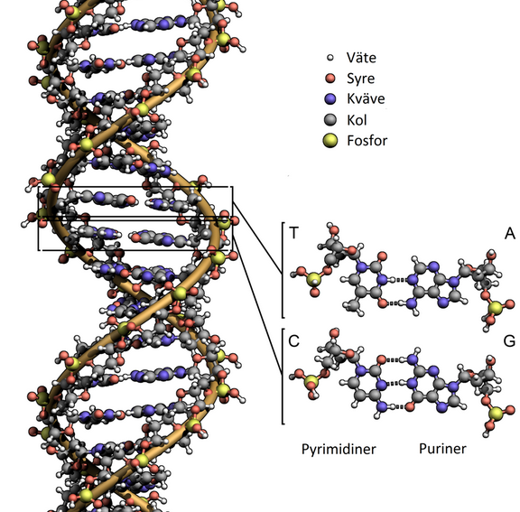
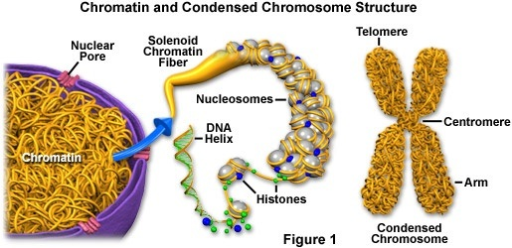
Sequencing artefacts: what are they?
Sequencing a representative, completely randomized subsample:
it starts with input material
What textbook tells you:
Brutal reality:

Slide 26
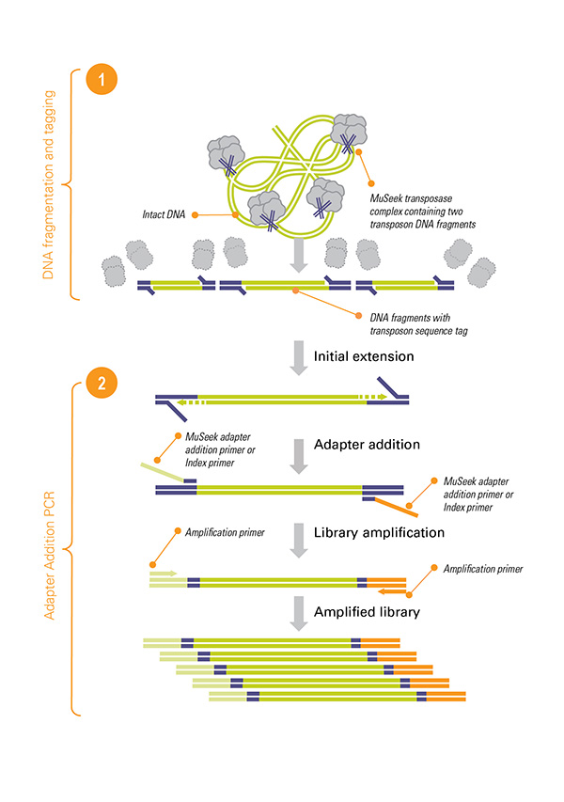
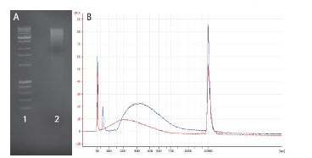
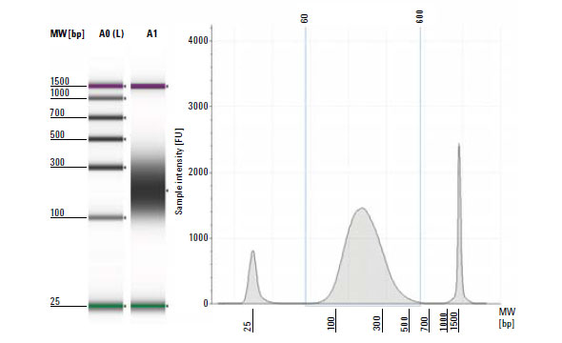
Sequencing artefacts: what are they?
Sequencing a representative, completely randomized subsample:
continues with library preparation
Input sample
Loosing molecules all the way
Shearing and size-selection
Less material -> more amplification cycles

Slide 27
Sequencing artefacts: what are they?
PCR bias – important source of sequencing artefacts
PCR steps involved in any NGS but PacBio and Oxford Nanopore:
Library amplification
Amplification during templating (Illumina – on glass; Ion – emPCR)
Main PCR bias:
1. Size: shorter fragments amplify faster -> higher sequencing signal and coverage
2. Polymerase errors
slippage in low complexity regions
incorporation of erroneous bases & indels
3. GC-bias (fragments with low GC diminish to 1/10th from initial amount)

Slide 28
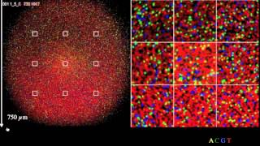
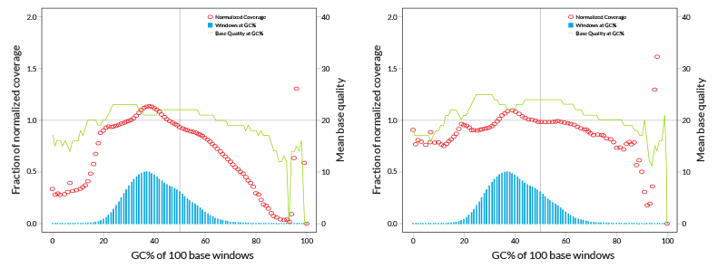
Sequencing artefacts: what are they?
PCR bias – important source of sequencing artefacts
Clusters with shorter fragments grow faster ->
quality signal from smaller clusters worsens
GC bias &
genome coverage
Heavily amplified library
PCR-free library

Slide 29
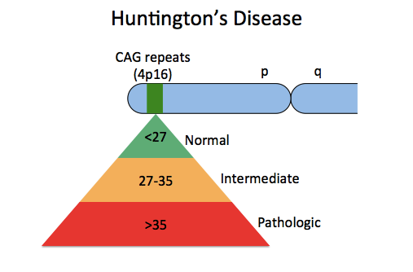
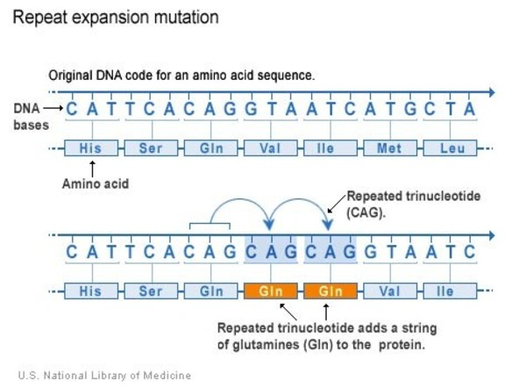
Sequencing artefacts: what are they?
PCR bias – important source of sequencing artefacts
Polymerase slippage – low complexity regions
Huntington’s disease:
Inherited disorder resulting in brain cell death
Decline of motoric and cognitive functions
Common onset: 30-50 years of age
No cure
Causative genetic variant: CAG-repeat expansion in HTT gene

Slide 30
Sequencing bias: SUMMARY
Keep in mind that they are there
Coverage varies across the genome
One technology does not suit all the applications

Slide 31
BREAK

Slide 32
SAMPLE QUALITY REQUIREMENTS

Slide 33
Garbage in – garbage out: Sequencing success always depends on the sample quality. NGS-quality DNA and PCR-quality DNA are two completely different things.

Slide 34
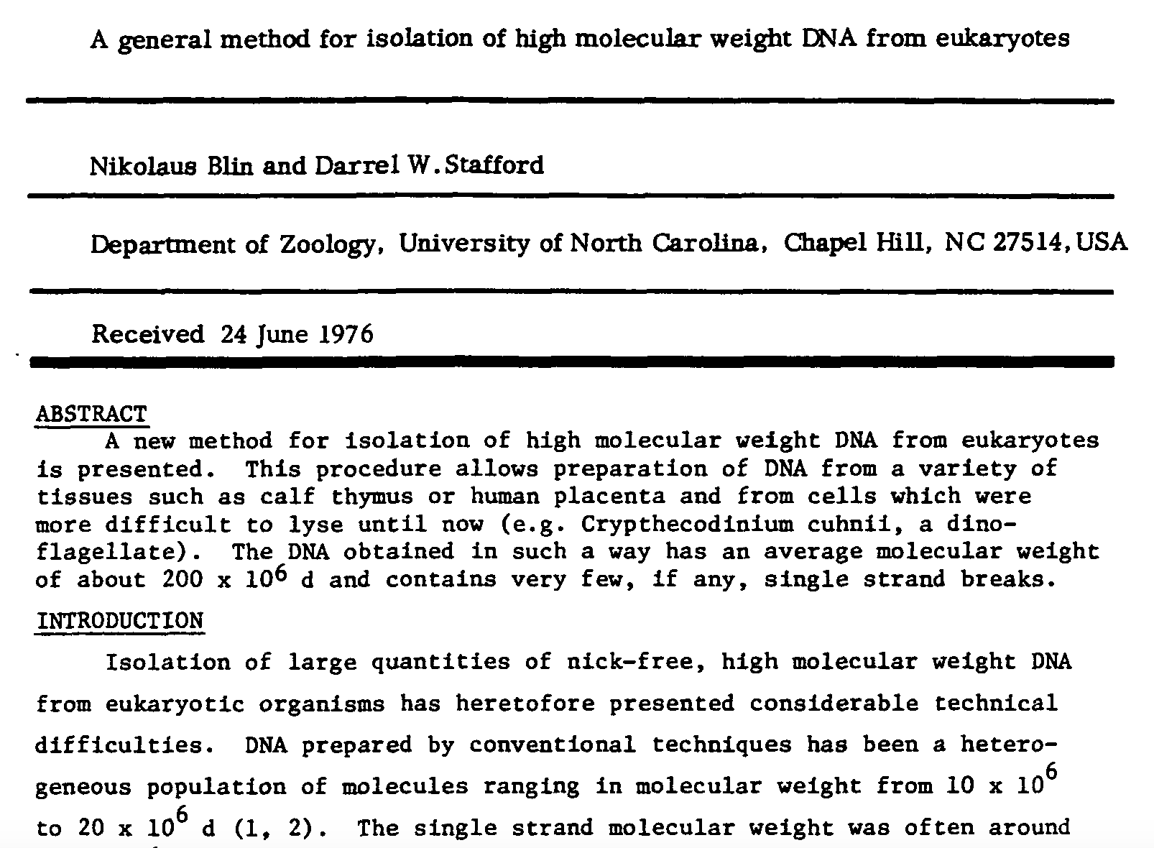

Slide 35
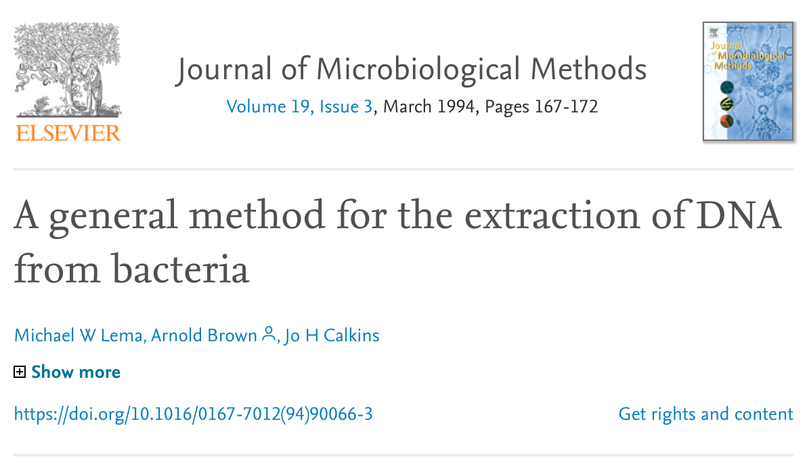
1983: P C R

Slide 36
2013: a wake-up call
For Long Reads one needs to have long and pure DNA

Slide 37
DNA quality and inhibition of sequencing
Short-read technologies: PCR inhibition
Long-read technologies are PCR-free, but one sequences native DNA “as is”.
DNA-binders:
Proteins
Polyphenols
Secondary metabolites (e.g. toxins)
Pigments
Polysaccharides
Polymerase inhibitors:
Salts
Phenol
Alcohols
Physical inhibiting factors – debris
Hamilton & Arya, Nat. Prod. Rep., 2012, 29, 134-143

Slide 38
The DNA extraction process
1
2

Slide 39
Sample prep: genomic DNA
Treat DNA as a crystal vase: it is fragile when in solution
As soon as DNA is released from the cells – it becomes vulnerable
Limit pipetting to minimum
Always use RNase!
Never vortex!
Do not heat above 65°C
Reduce amount of freeze-thaw cycles to minimum
DNA degrades even in -20°C!

Slide 40
What do absorption ratios tell us?
Pure DNA 260/280: 1.8 – 2.0
< 1.8:
Too little DNA compared to other components of the solution; presence of organic contaminants: proteins and phenol; glycogen - absorb at 280 nm.
> 2.0:
High share of RNA.
Pure DNA 260/230: 2.0 – 2.2
<2.0:
Salt contamination, humic acids, peptides, aromatic compounds, polyphenols, urea, guanidine, thiocyanates (latter three are common kit components) – absorb at 230 nm.
>2.2:
High share of RNA, very high share of phenol, high turbidity, dirty instrument, wrong blank.
Photometrically active contaminants:
phenol, polyphenols, EDTA, thiocyanate, protein,
RNA, nucleotides (fragments below 5 bp)

Slide 41
How to make a correct measurement
Thaw DNA completely
Mix gently (never vortex!)
Put the sample on a thermoblock: 37°C, 15-30 min
Mix gently
Dilute 1:100 (if HMW)
Mix gently
Make a measurement with an appropriate blank
NANODROP is Bad. Point.
Use Qubit, or PicoGreen.
LMW-DNA
HMW-DNA

Slide 42
Earth Biogenome Project: VGP sample prep group
Tissues
Collection method
Preservation
Extraction
QC
Storage
3.4.2.QV40 PHASED METRICS
NGI is collecting meta-data

Slide 43
Transcriptome sequencing (RNA-seq)
TOTAL RNA
mRNA
Dif.ex.
Annotation
Splice isoforms
Non-codingRNA
miRNA
Transcriptional regulation

Slide 44
Sample prep: RNA
mRNA degrades FAST
Freeze sample or place it in RNA-later within 30 sec (if possible)
Chose a correct kit for your particular application!
Always treat samples with DNase
Differential expression, miRNA – RIN value over 8.0
Aim for 4 biological replicates

Slide 45
Sample prep: SUMMARY
Sequencing success depends on the sample quality
DNA quality is essential for PacBio and ONT sequencing
… as well as PCR-free Illumina libraries & linked reads!
Basic understanding of biochemistry is needed

Slide 46
Now, analysis
Severe shortage of bioinformaticians

Slide 47
Making statistically-significant sense out of data
Scaling up statistics & Multiple testing correction
Microarrays: 10-100k SNPs
Bonferroni correction = 0.05/10⁴ = 5*10⁻⁶
(max p-value for SNP to be significant)
Sequencing: 1-10 mln SNP
Bonferroni correction = 0.05/(5*10⁶) = 1*10⁻⁸
=> With more information we lose statistical power
1 SNP = 1 trait
vs
100 SNPs = 1 trait

Slide 48
Never forget: Correlation vs Causation
Reduction in export of fresh lemons from Mexico causes significant reduction
of highway traffic fatality rates in the US!

Slide 49
Genome is not a linear string of bases!!
Mutations in coding regions only
Transcriptional & post-transcriptional regulation
Epigenetics
Proximity in chromosomes

Slide 50
Blind men & an elephant

Slide 51
NGS and its challenges: SUMMARY
Technologies develop VERY FAST.
Beware of sequencing bias.
Sequencing result depends on sample quality.
Consult experts when it comes to experimental design and technology choice.
Think about statistics.
Consider ethics.
Do nor forget the elephant…..

Slide 52
THANK YOU!

