Slide 1


Genome Assembly

Slide 2
Genome assembly
Illumina
  Subsample
  Summarize
  Assemble
  Polish
  Evaluate
Evaluate unpolished
Hybrid assembly
Pacbio
  Subsample
  Summarize
  Assemble
  Polish
  Evaluate
Evaluate polished
Parameter exploration
Nanopore
  Subsample
  Summarize
  Assemble
  Polish
  Evaluate
Evaluate coverage
Strategy choice

Slide 3
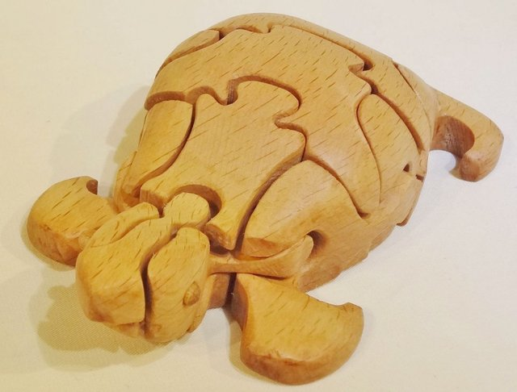
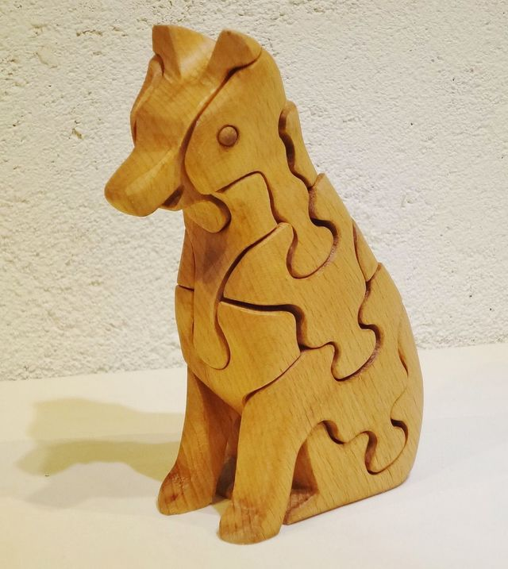
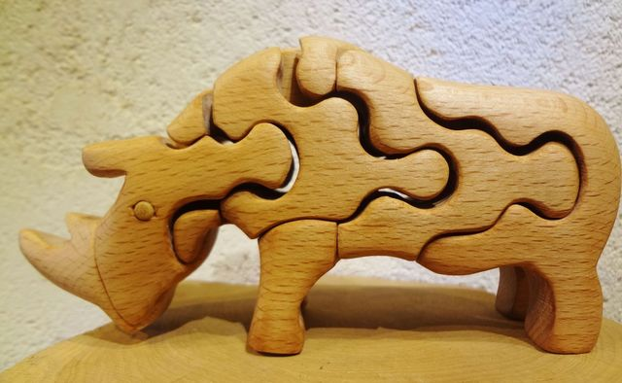
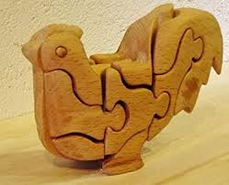
Genome assembly
Turtle
Wolf
Rhino
Rooster

