Slide 1


Sequence Quality Assessment

Slide 2
K-mer Analysis
What is a k-mer?
  A k-mer is a sequence of nucleotides of length k.
  Examples of a 6-mer
    ACGTCT
    TGACTA
    GATCCC
A read of length L has L-k+1 k-mers.
1 read:
100 bp
Kmers:
k=21bp
N= (L – k + 1)
(100bp – 21 bp + 1)
80
……..

Slide 3
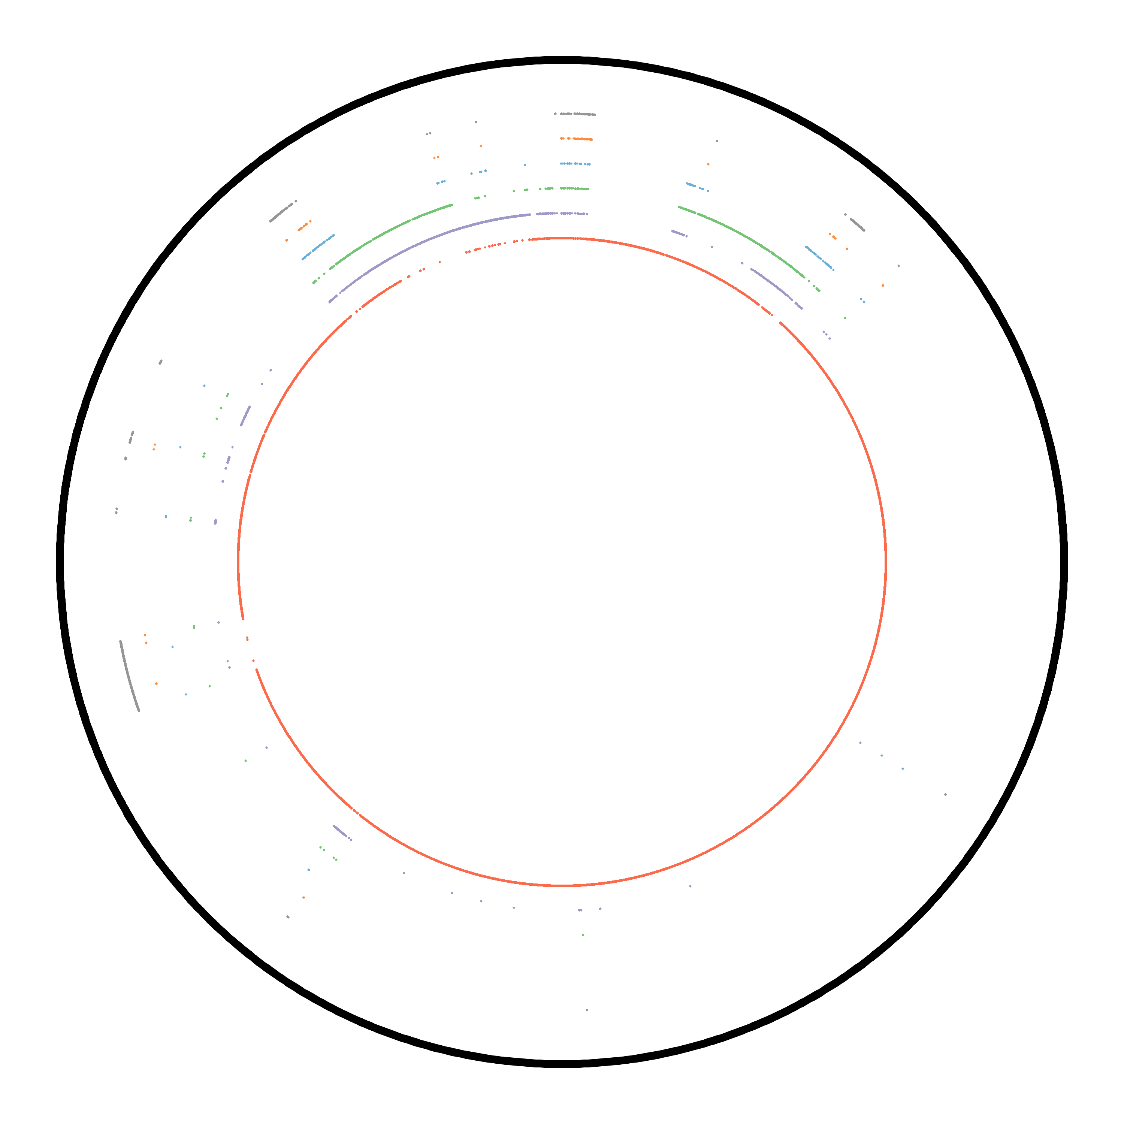
K-mer Analysis
How many k-mers are distinct in your genome?
Chr 1 of yeast strain s288c
  Haploid
  Linear, but plotted as circle
  Black: position along chromosome
  K-mer frequency in genome
    K=27
    Red: 1
    Purple: 2
    Green: 3
    Blue: 4
    Orange: 5
    Grey: 6+
  Majority of k-mers are distinct.

Slide 4
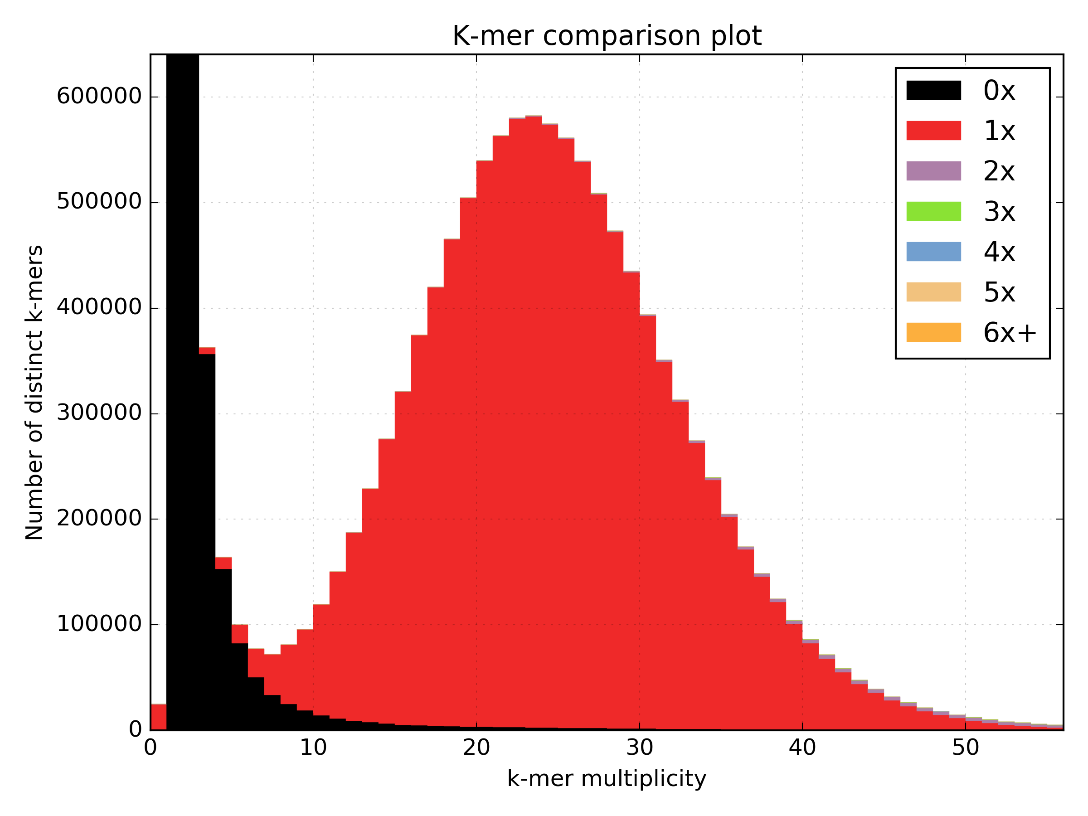
K-mer Analysis
Frequency in the genome
Haploid
Frequency of those k-mers in
the sequence data set
x-axis: Frequency of the
distinct k-mer in the data
y-axis: Count of distinct
k-mers with frequency x

Slide 5
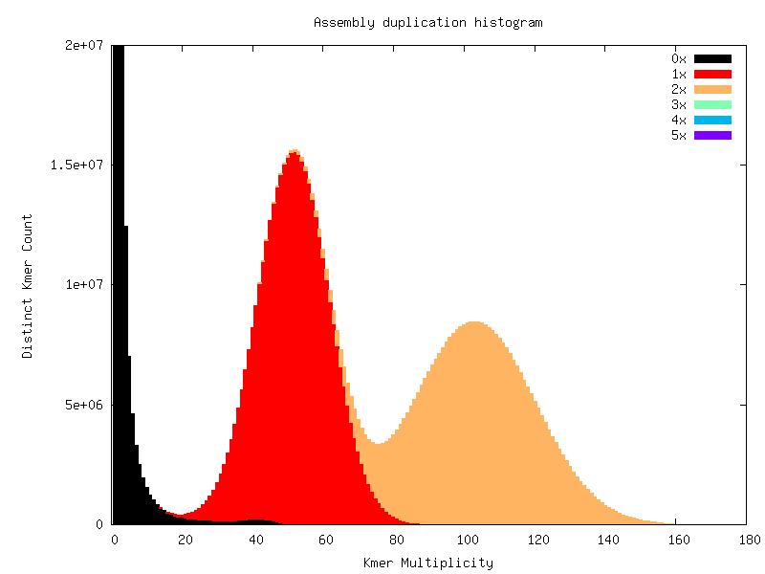
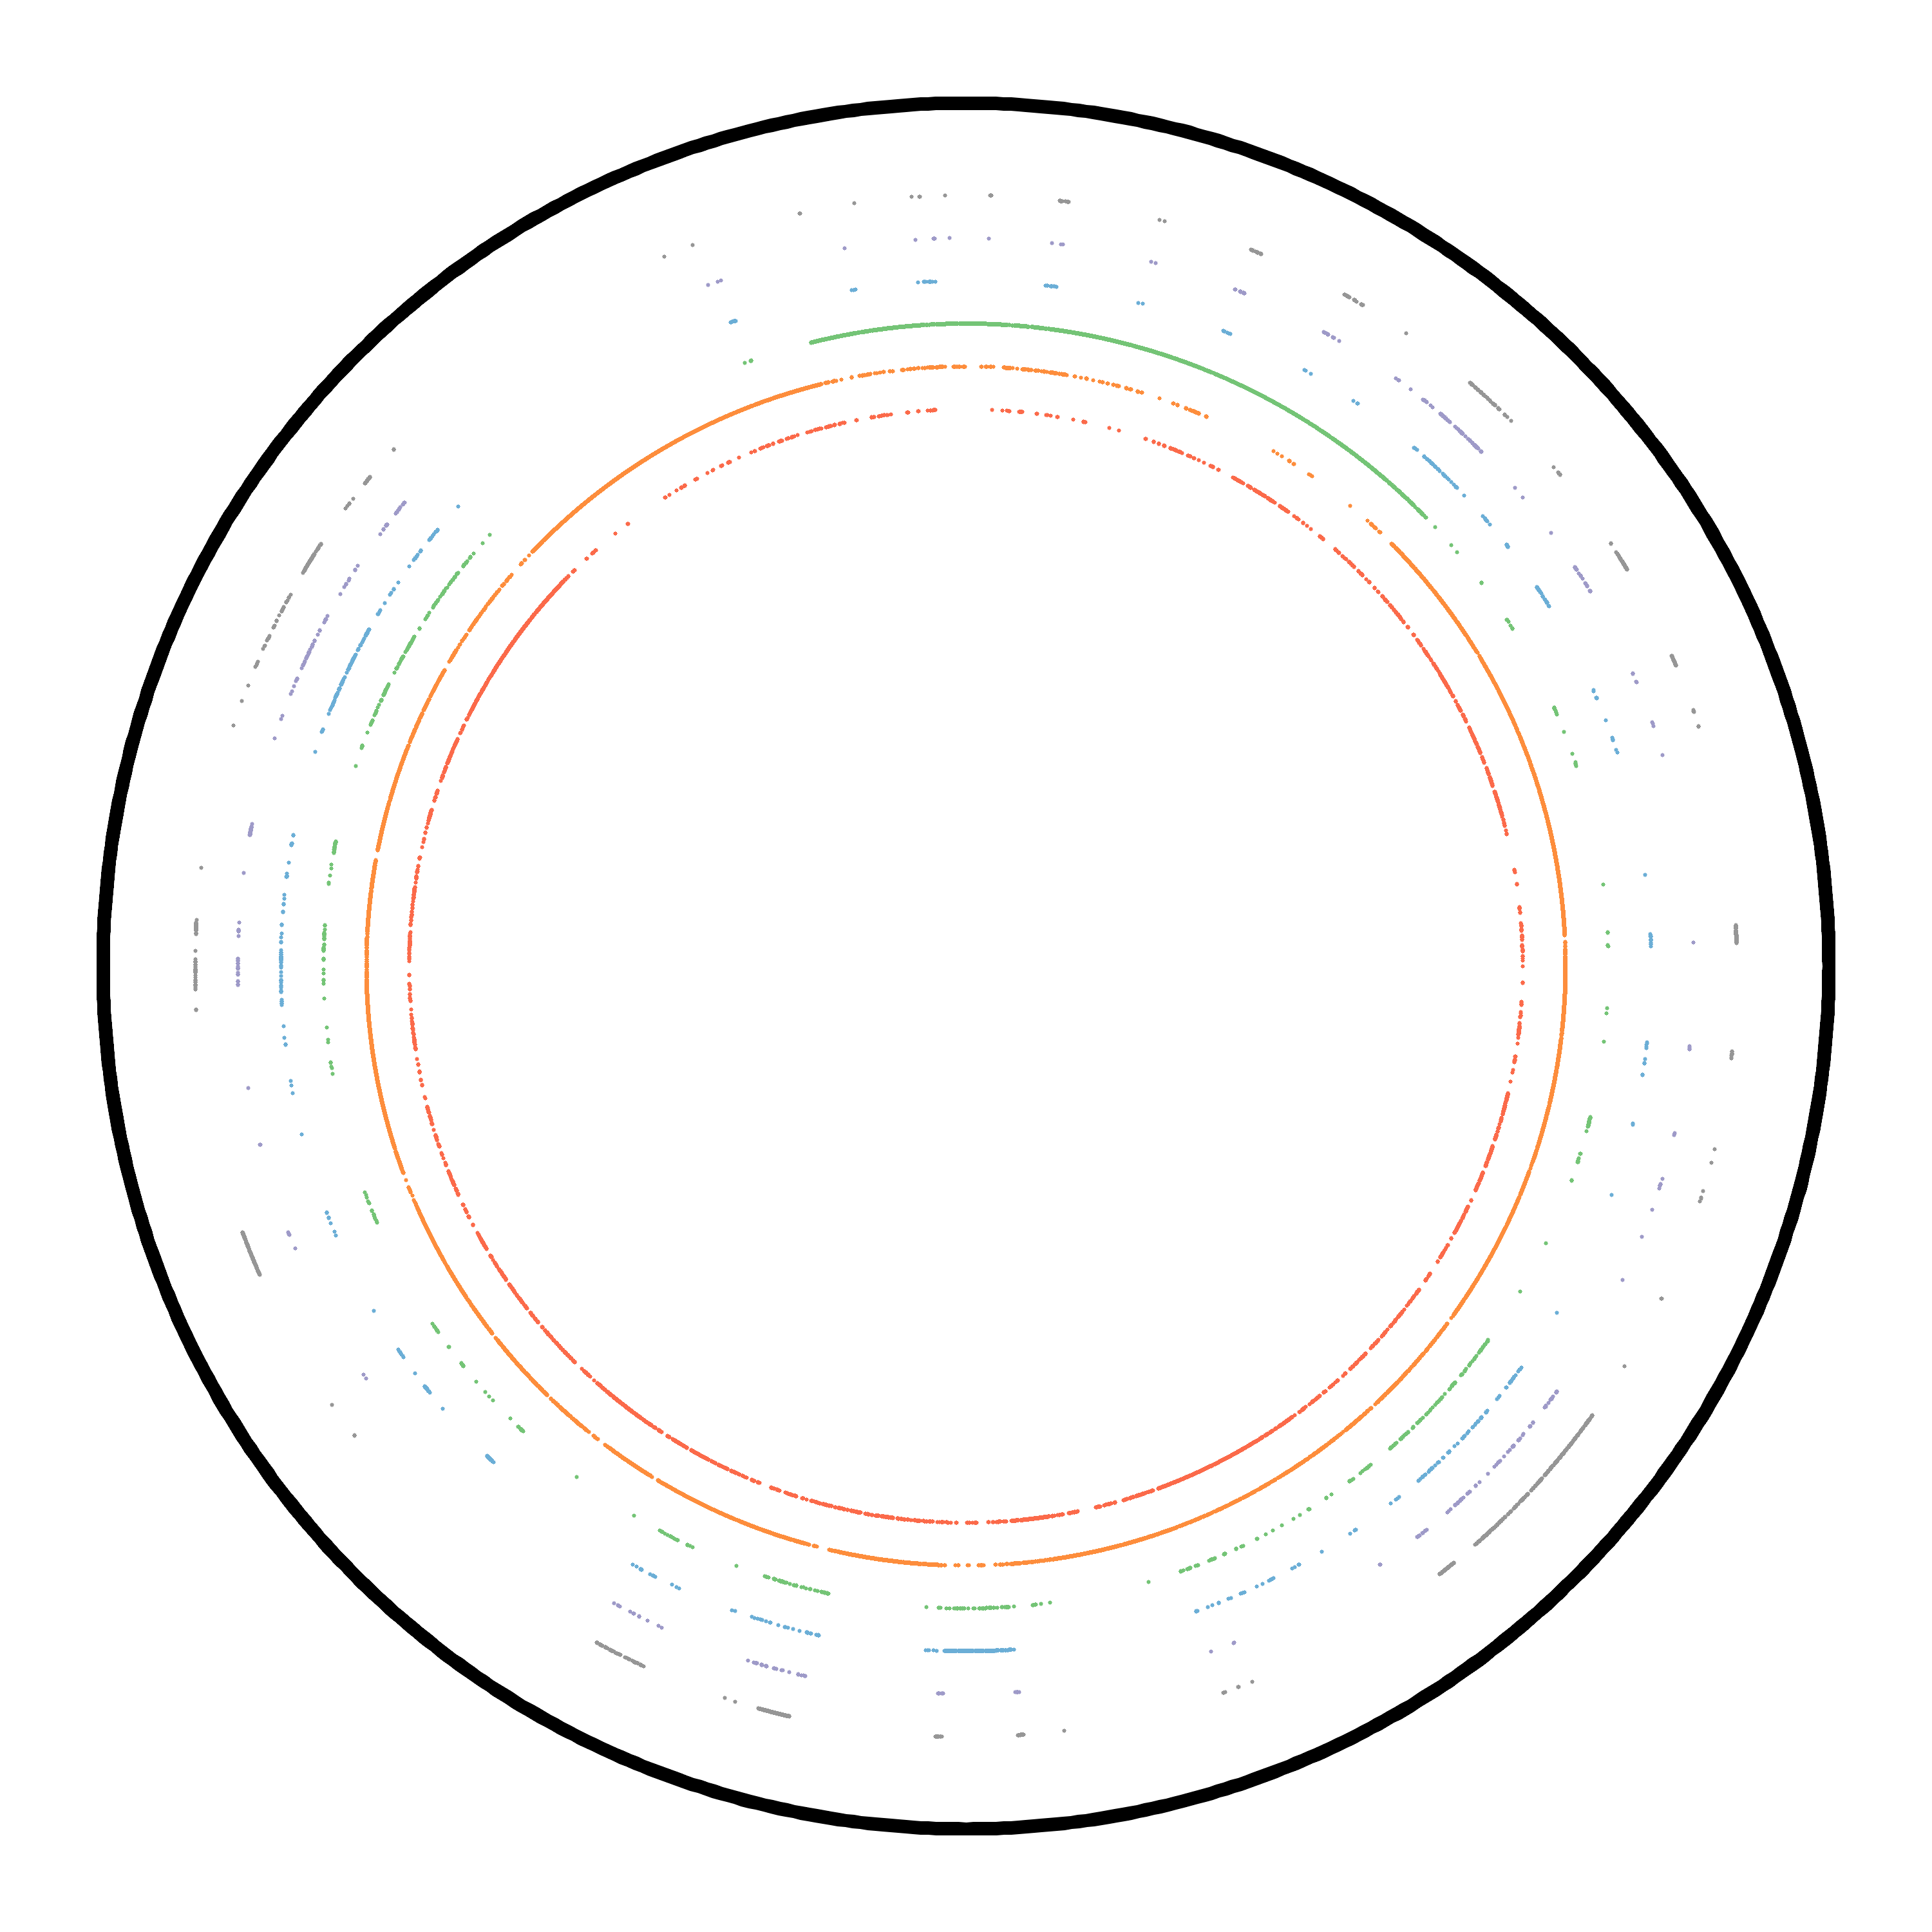
K-mer Analysis
Frequency in the genome
Diploid
Frequency of those k-mers in
the sequence data set
x-axis: Frequency of the
distinct k-mer in the data
y-axis: Count of distinct
k-mers with frequency x
Contig from A.thaliana phased genome

Slide 6
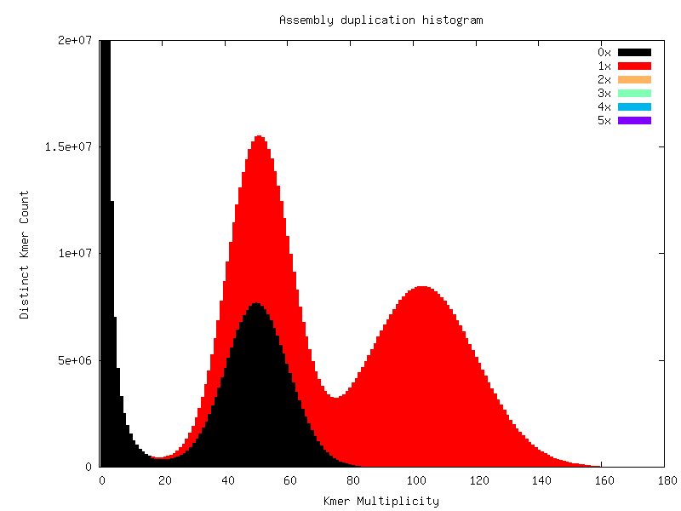
K-mer Analysis
Frequency in the genome
Diploid
Frequency of those k-mers in
the sequence data set
x-axis: Frequency of the
distinct k-mer in the data
y-axis: Count of distinct
k-mers with frequency x

Slide 7
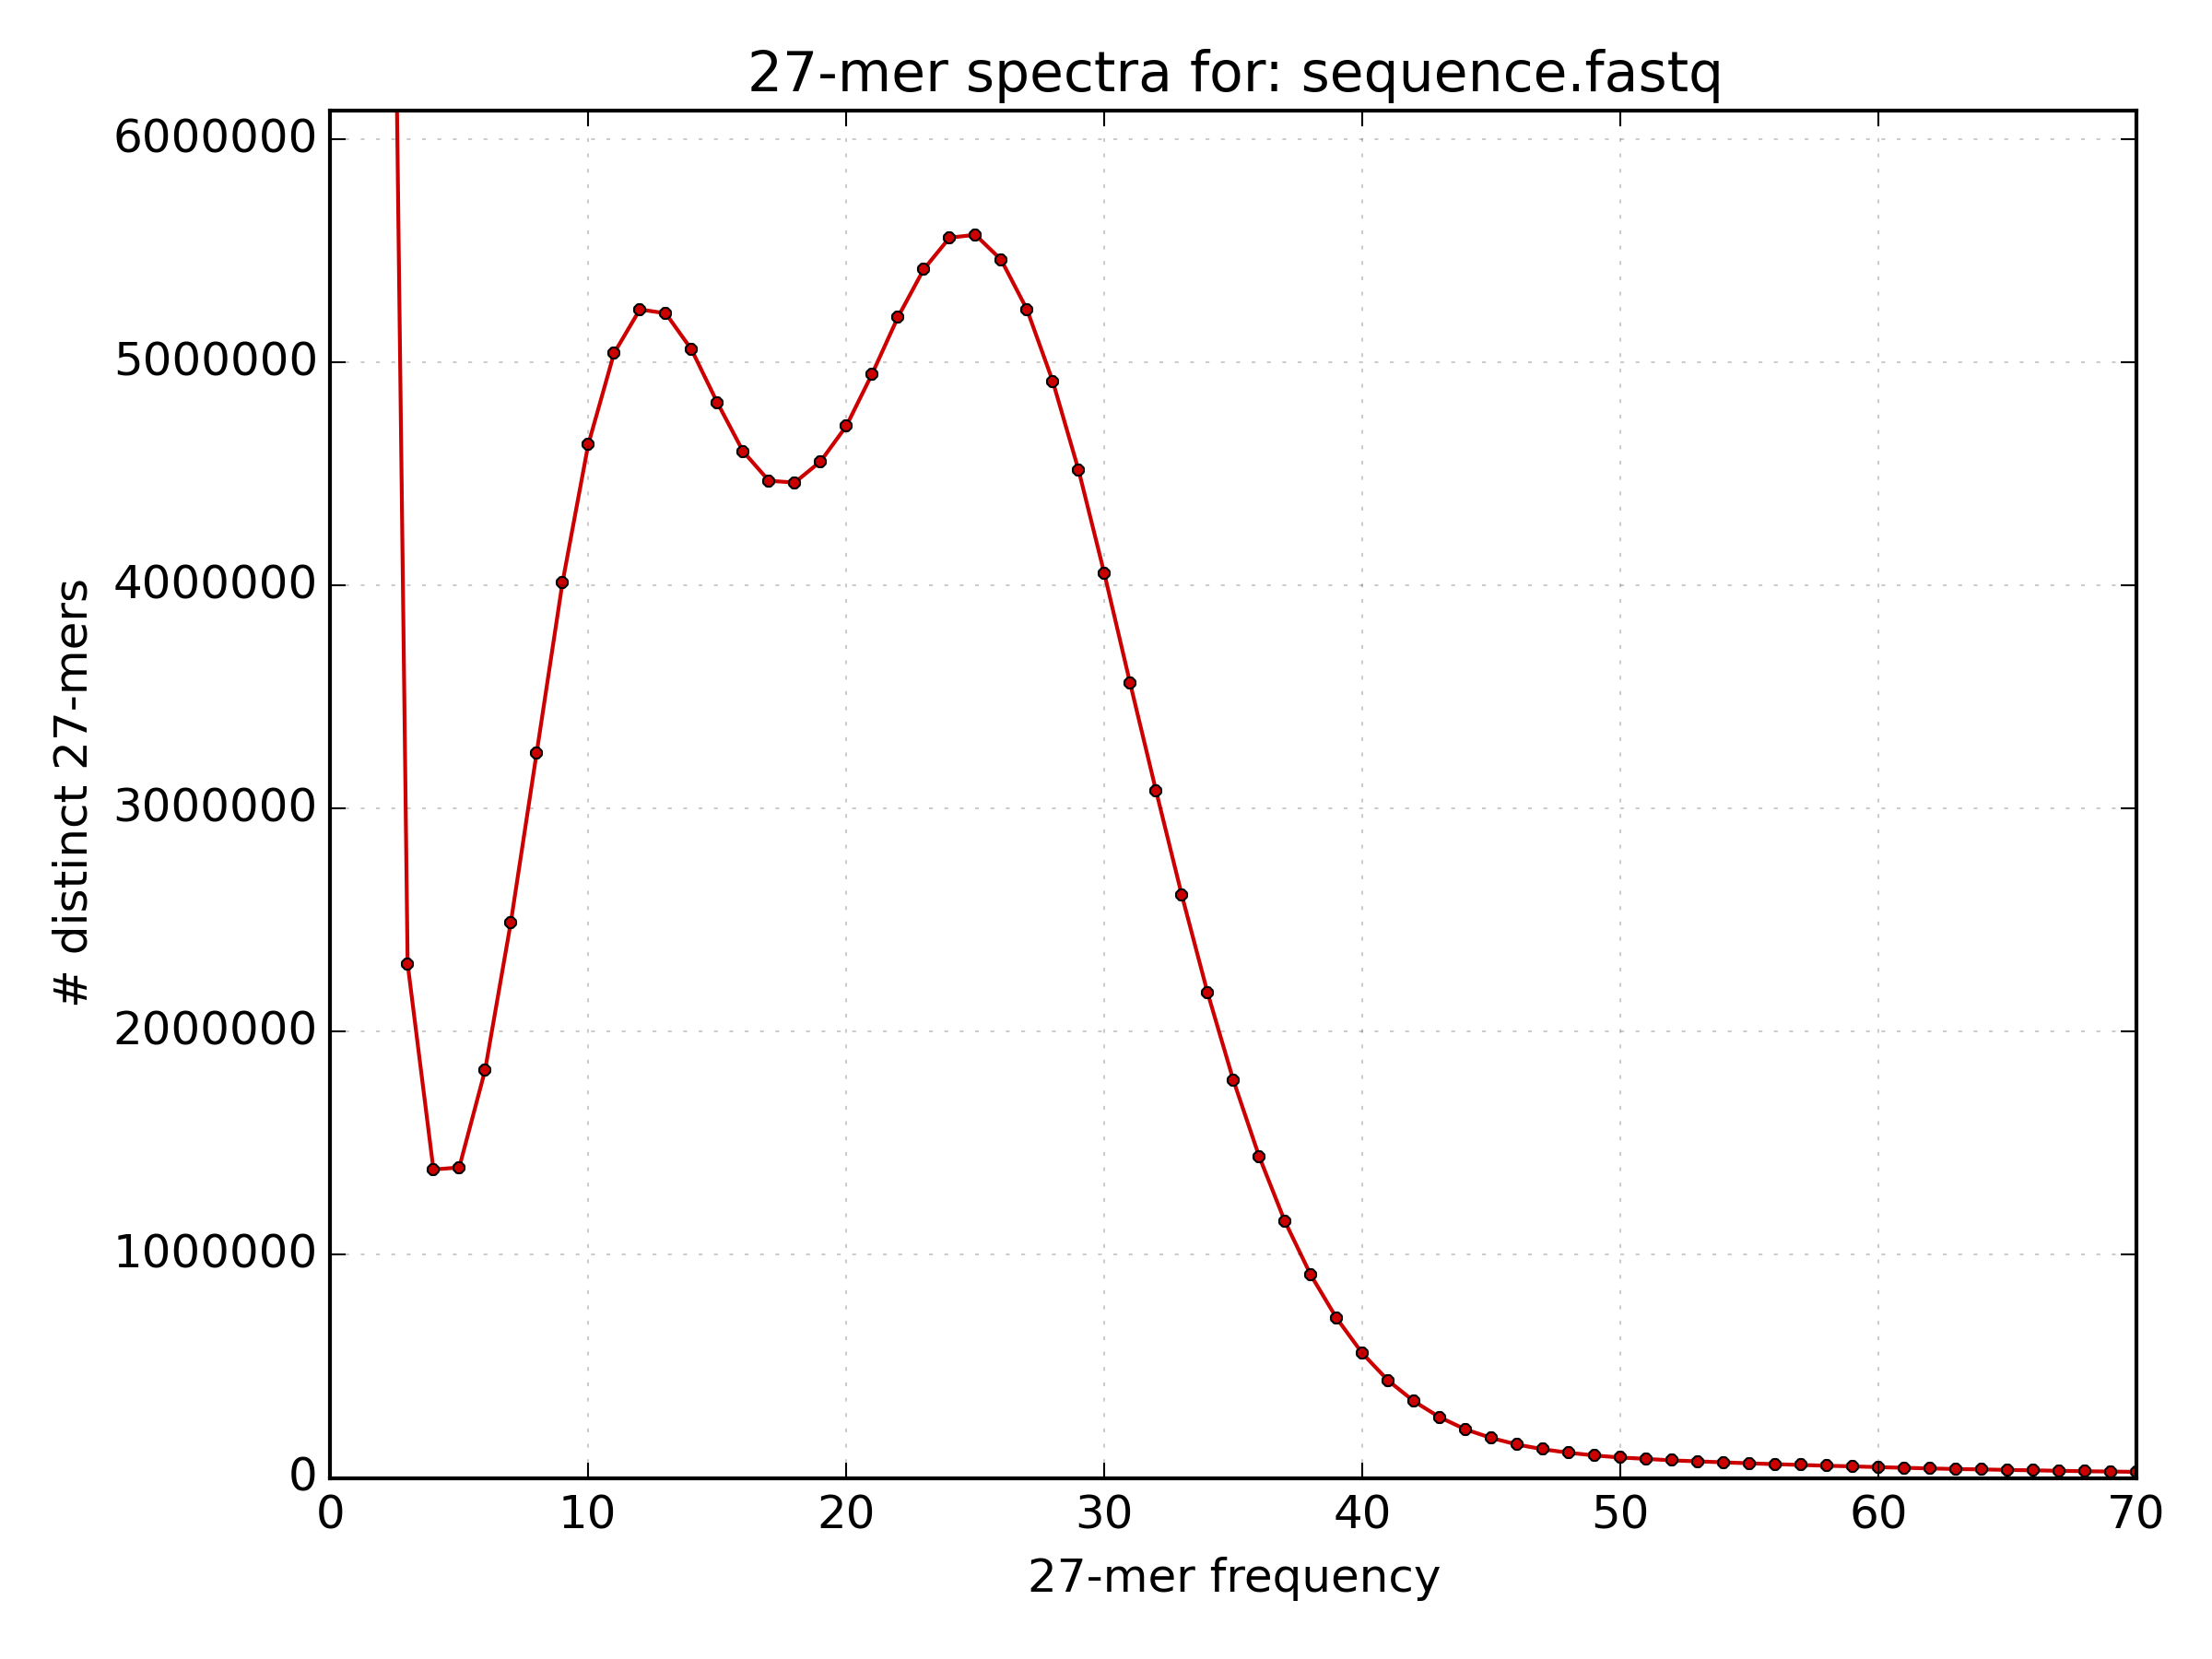
Estimating Genome Size
We can use coverage to estimate genome size
  The peak with the largest k-mer multiplicity is the mean k-mer coverage across the genome.
  N = M * L / (L - K + 1)
    N is Depth of Read Coverage
    M is mean k-mer coverage
    L is read length
    K is k-mer size
  G = T / N
    G is the genome size
    T is the total number of bases

Slide 8
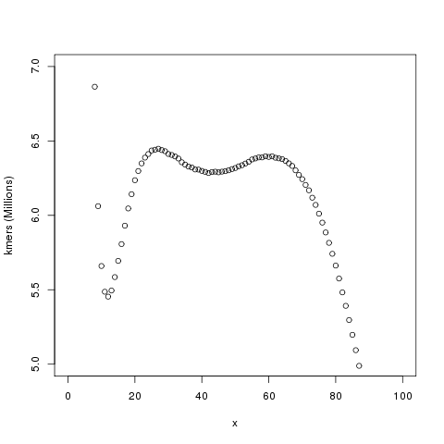
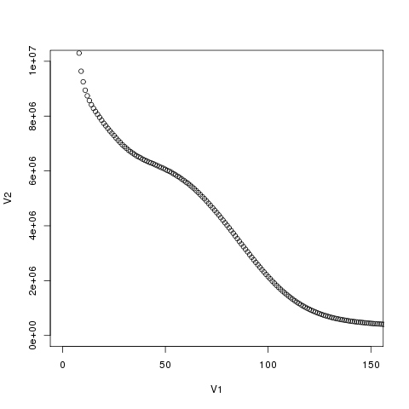
Estimating Genome Size
Not so easy: estimating complexity

Slide 9
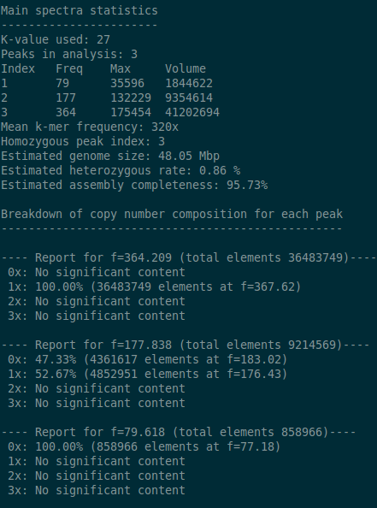
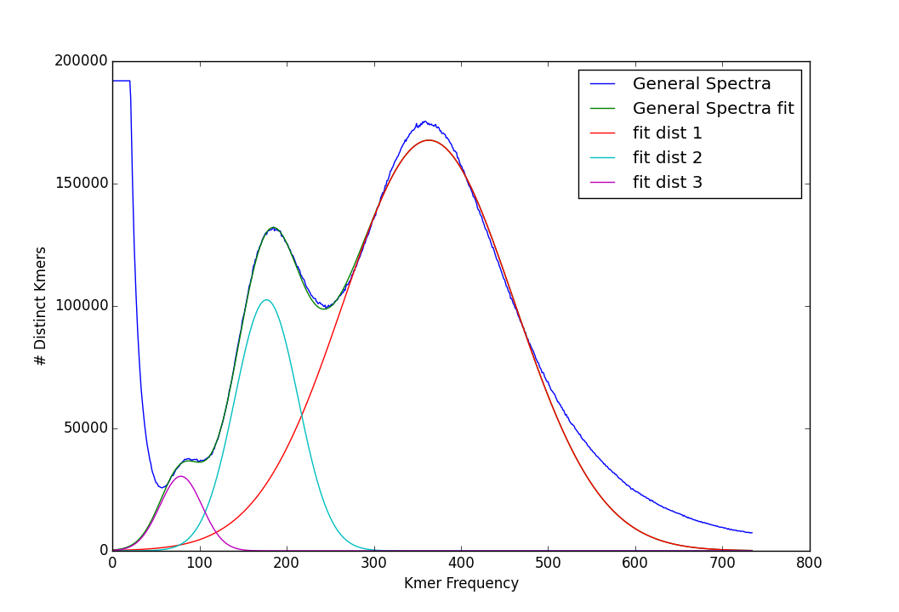
Estimating Genome Size
Distribution decomposition analysis
  kat_distanalysis.py --plot kat.hist
4x
2x
x
x
Repeats
Tetraploid genome copy number spectra

Slide 10
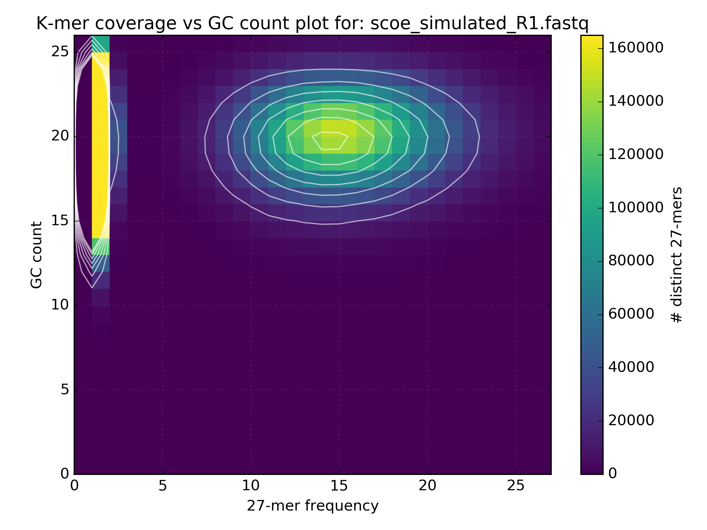
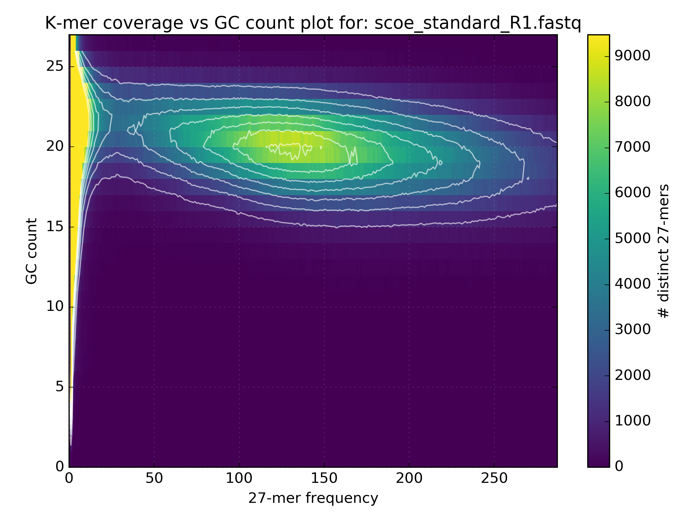
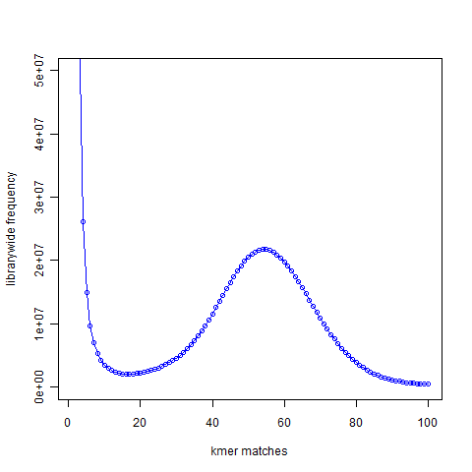
GC Content in depth
Monitor GC Bias
Simulated data
GC bias in Standard Illumina protocol
ACTCAGGATTA GC=4 Count=1
AATAGCCGGGG GC=7 Count=2

Slide 11
GC Content in depth
Monitor GC Bias
Simulated data
GC bias in Standard Illumina protocol
ACTCAGGATTA GC=4 Count=1
AATAGCCGGGG GC=7 Count=2

Slide 12
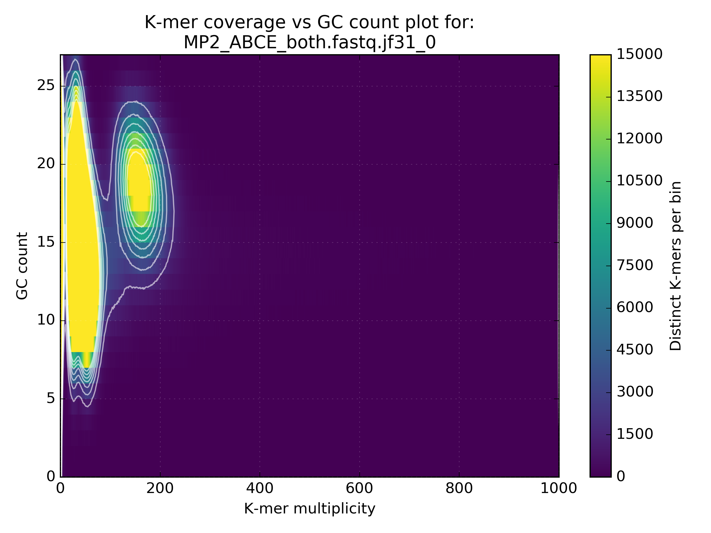
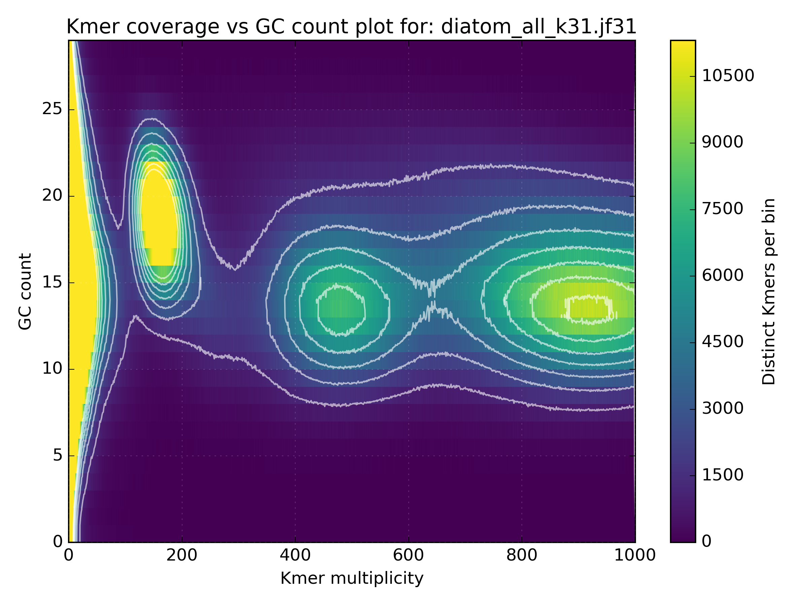
GC Content in depth
Uncover contamination
  Separate bacteria from eukaryote
  Separate organelle from nuclear genome

Slide 13
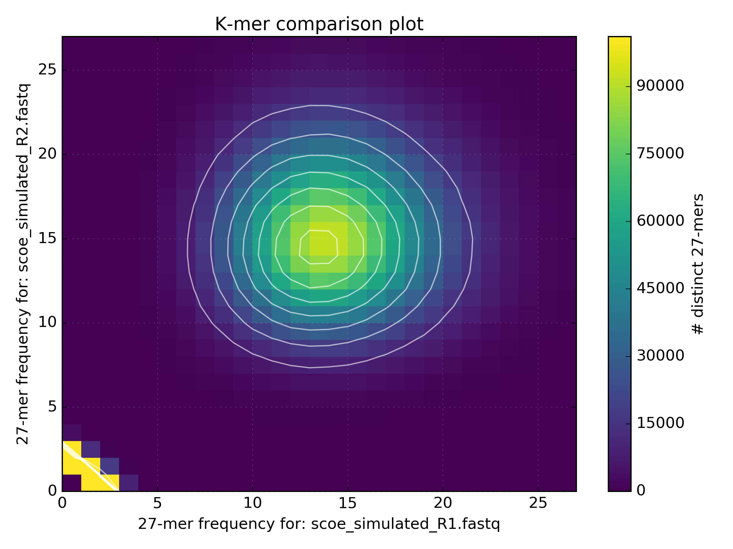
What can k-mers tell us?
Comparing k-mer counts between data reveals biases
  R1 vs R2
  Lib1 vs Lib2

Slide 14
What can k-mers tell us?
Comparing k-mer counts between data reveals biases
  R1 vs R2
  Lib1 vs Lib2

Slide 15
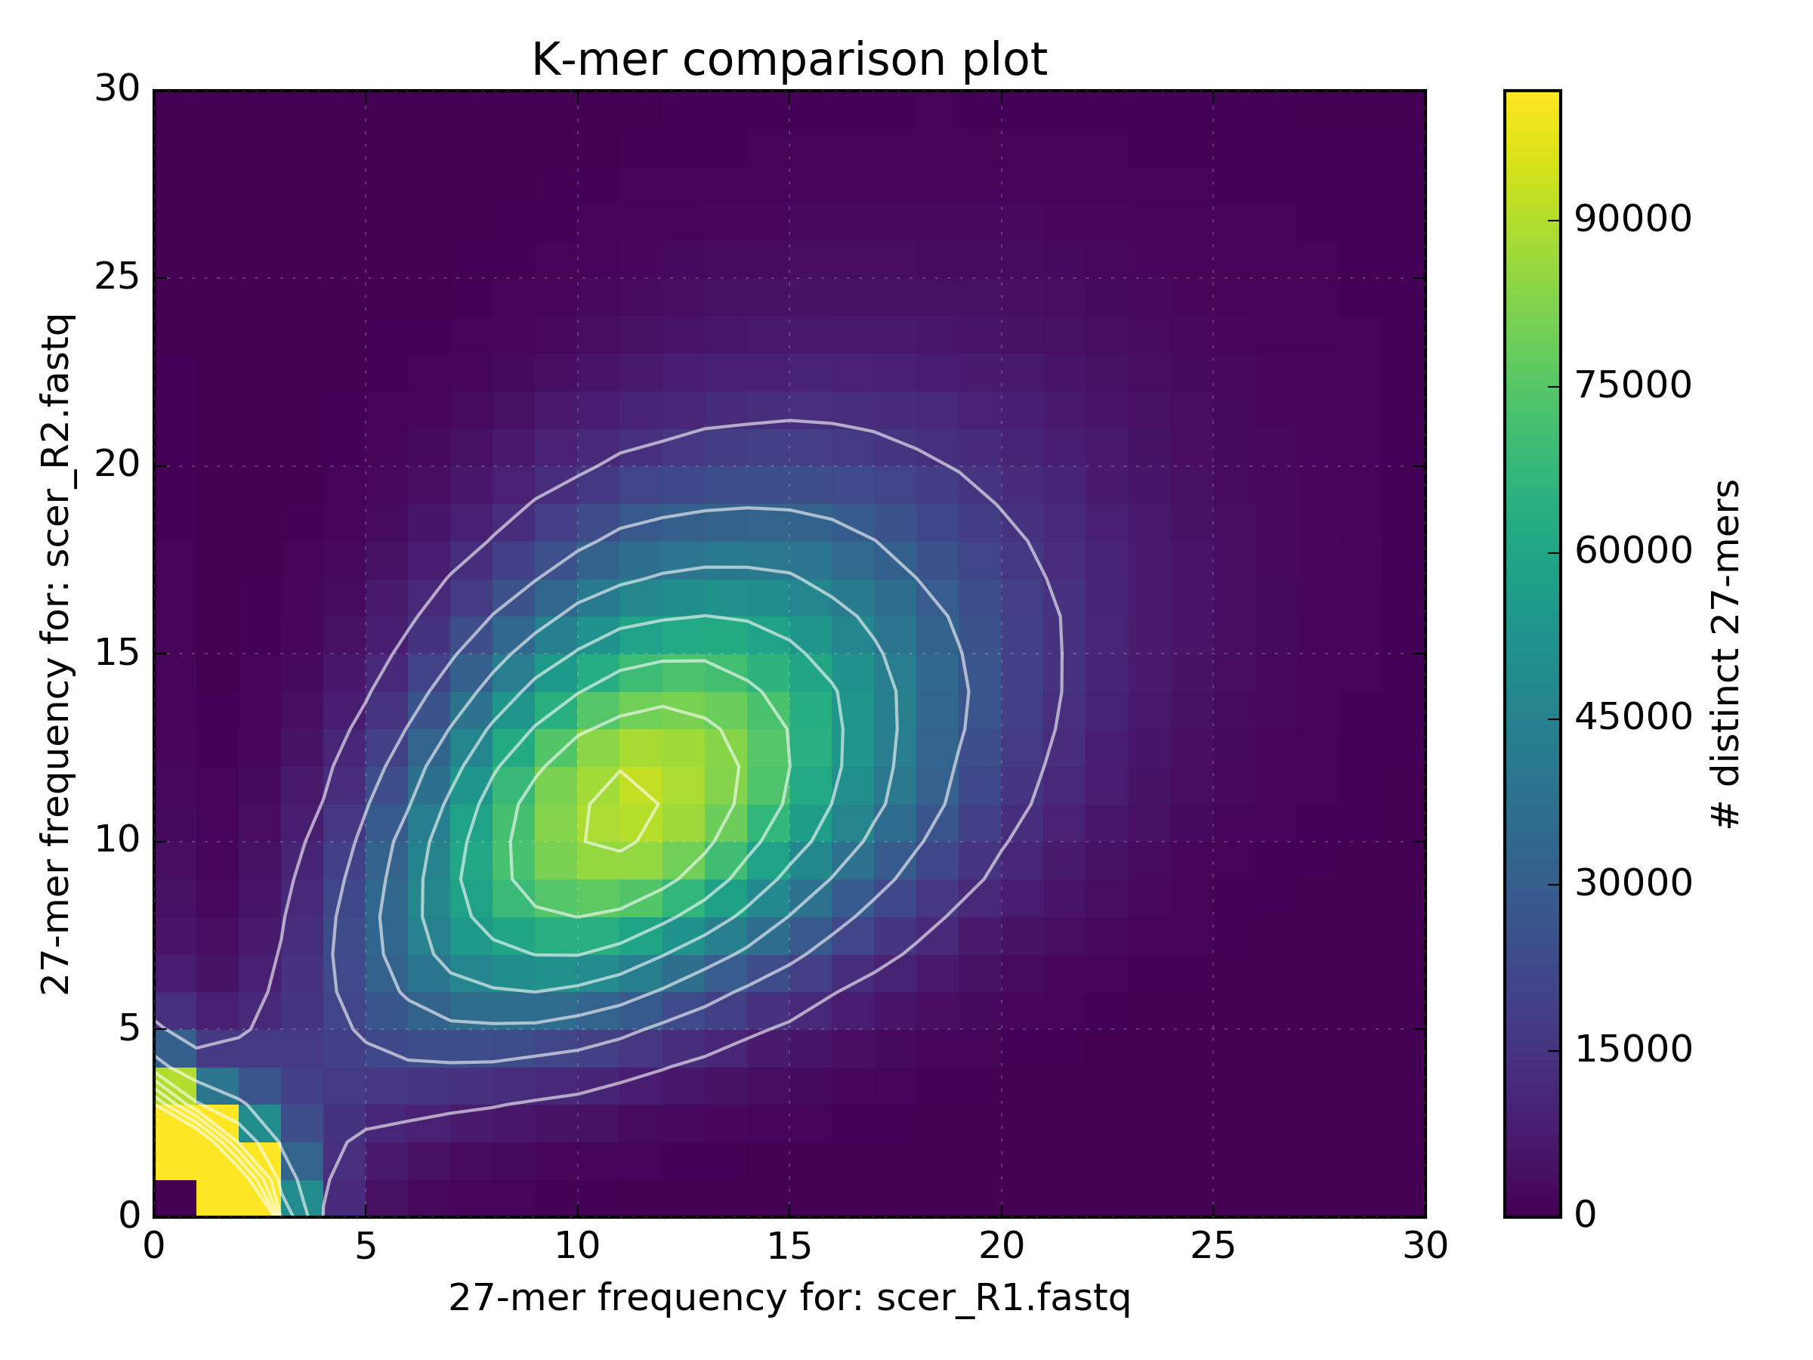
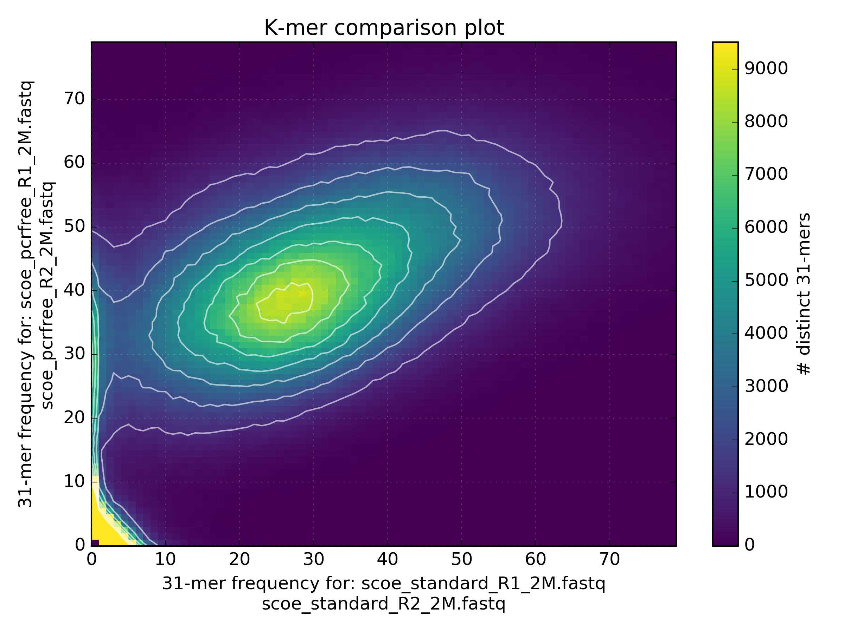
Data comparison
Standard vs PCR free
PCR free captures data missing in standard protocol
R1 vs R2

Slide 16
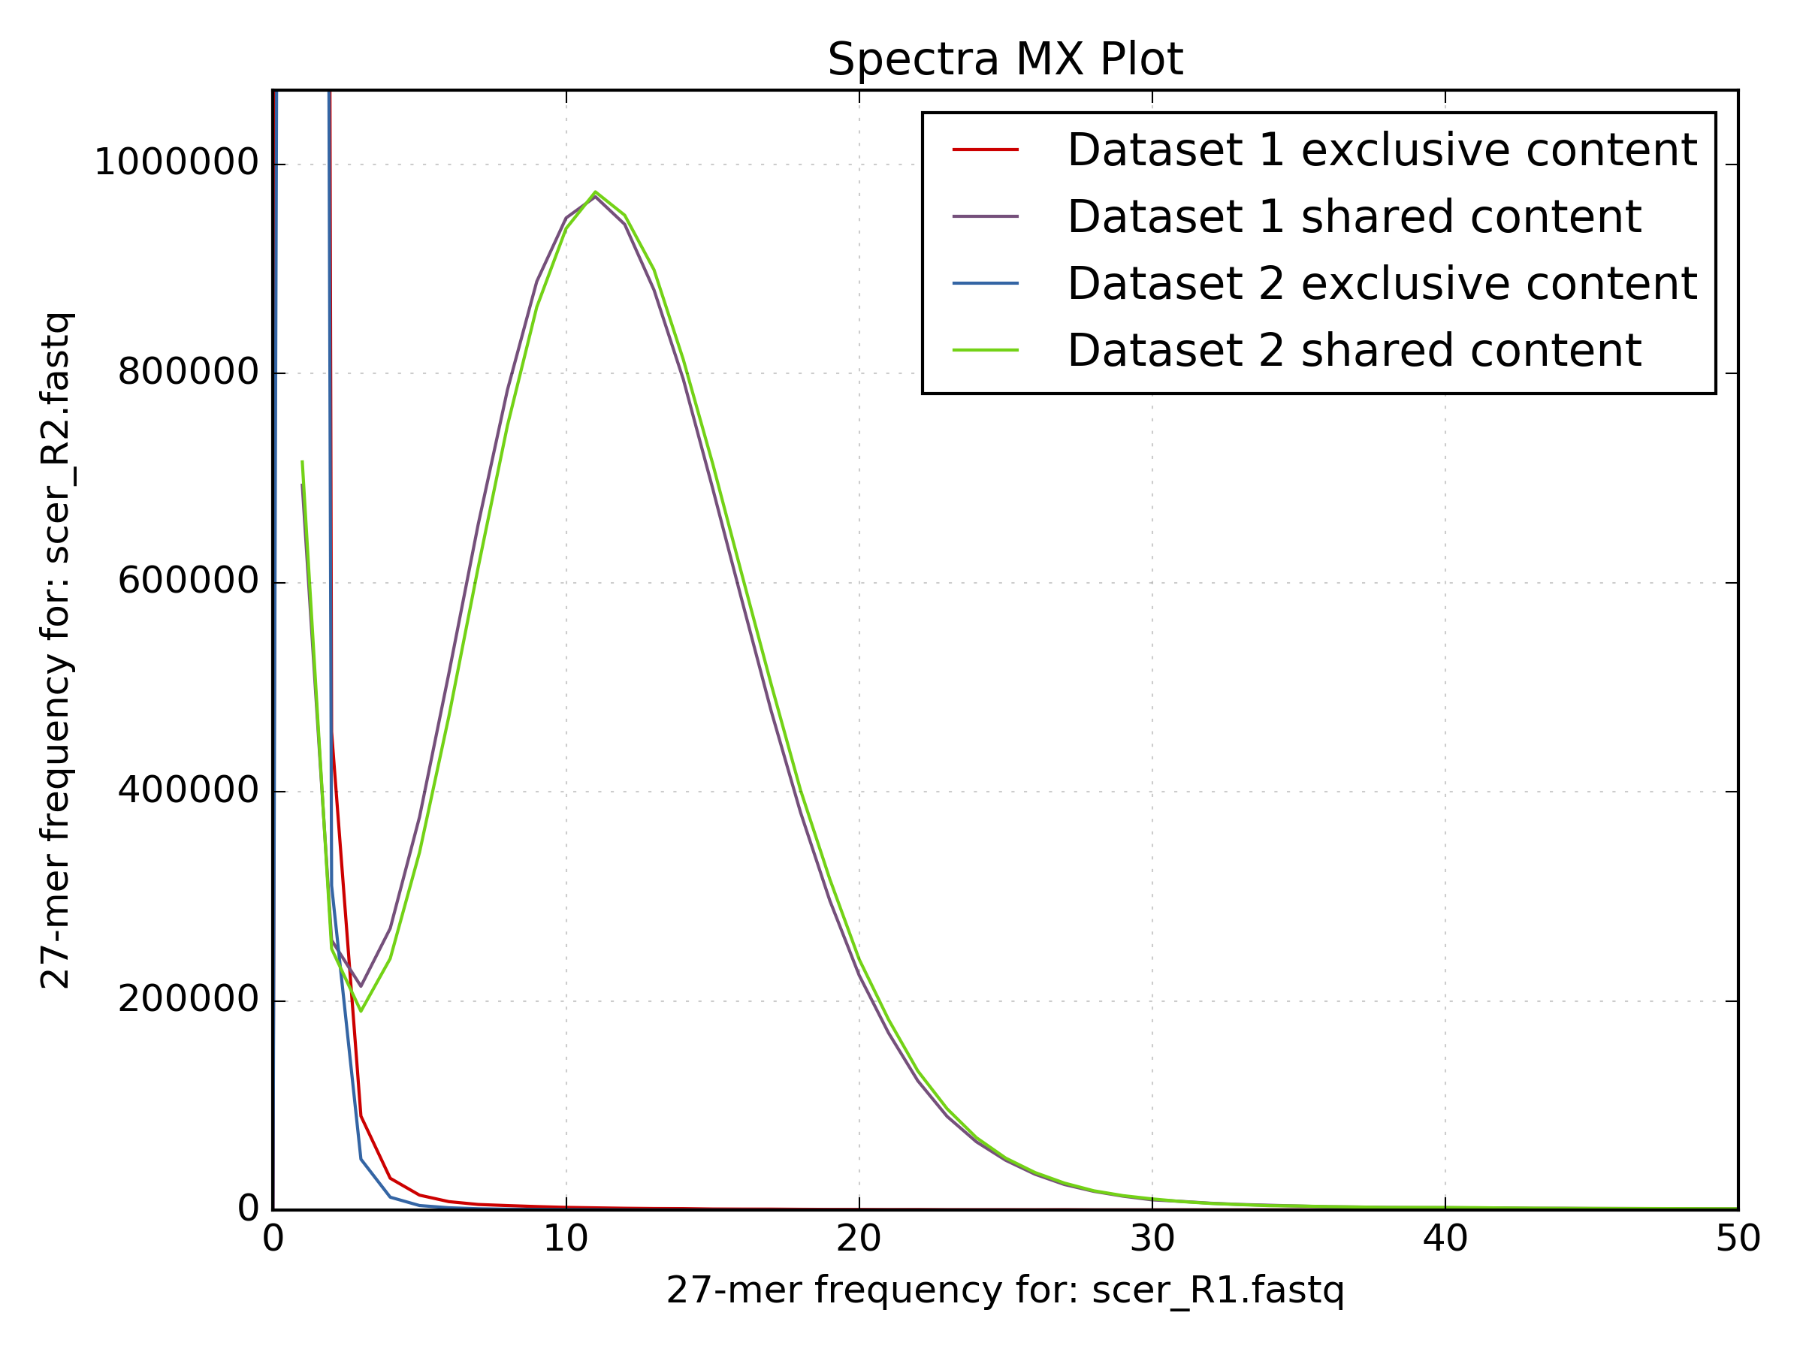
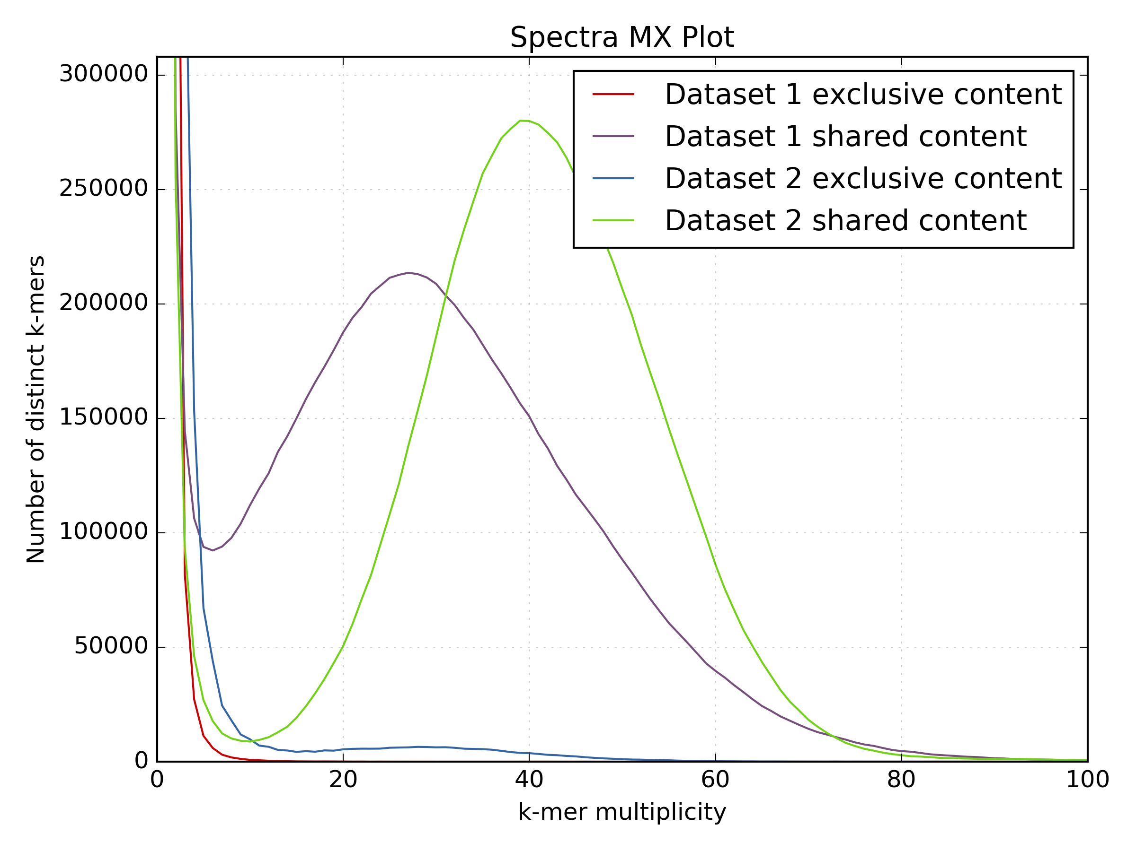
Data comparison
Low proportion of k-mers present only in dataset 2

Slide 17
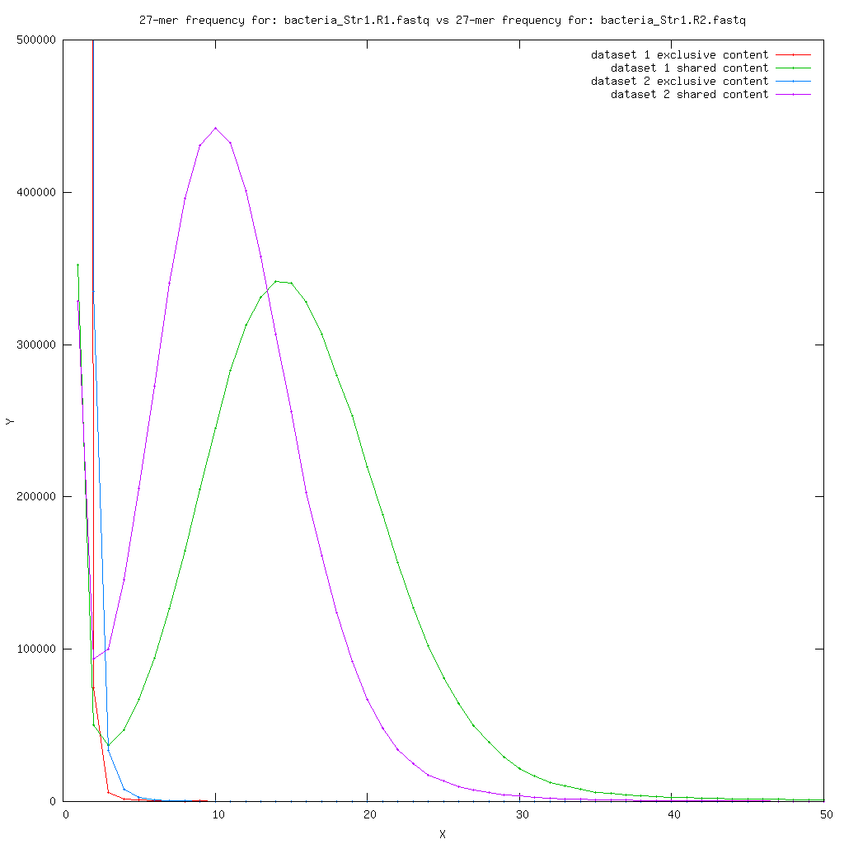
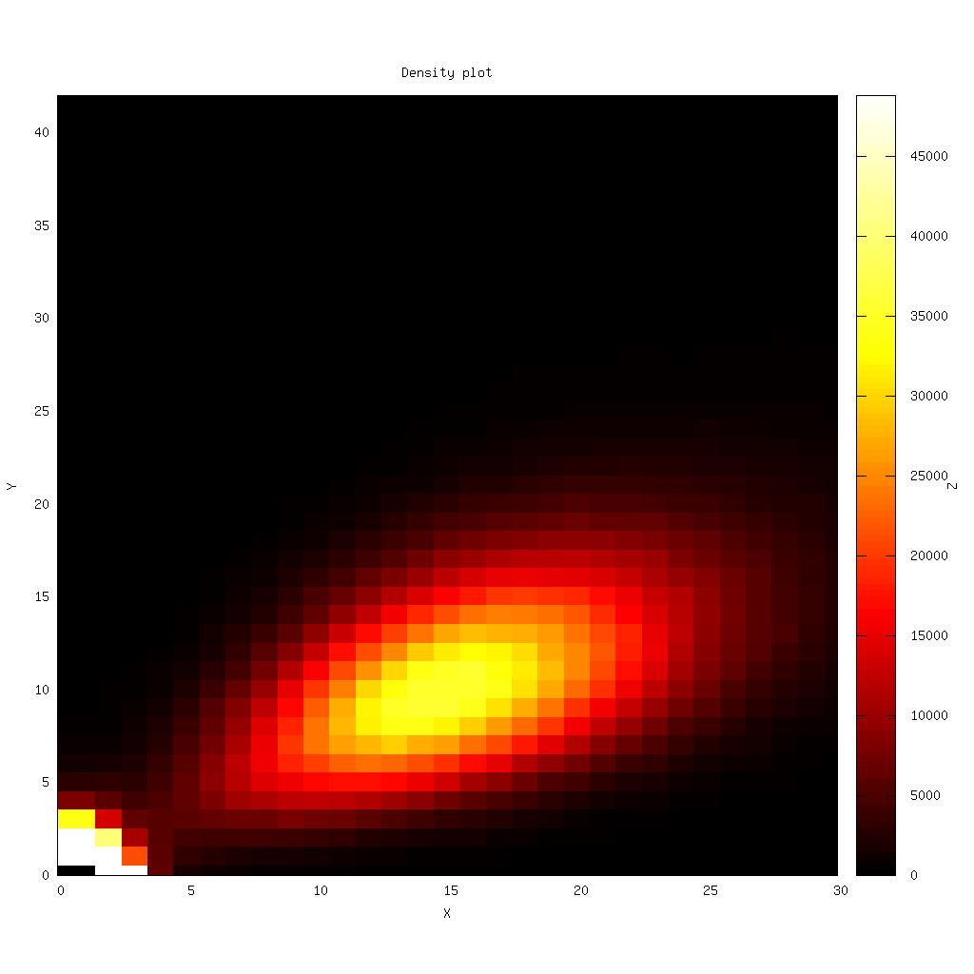
Data comparison
R1 v R2
Increased prevalence of
N’s in the sequence shift
the distribution.
These k-mers have lower
multiplicity and so increase
the frequency of lower
multiplicity k-mers. K-mers
with N should not be counted
Lower quality dataset = More N’s in the sequence

Slide 18
Summary
Illumina
  Md5sum
  Format
  Data Quantity
  Quality Scores
  GC Content
  Nucleotide bias
  Duplication
  Adapter content
  Genome complexity
  Library bias
  Contamination content
  Fragment distribution
PacBio / Nanopore
  Md5sum
  Format
  Data Quantity
  GC Content
  Adapter & Control check
  Contamination content
  Subread distribution

Slide 19
Information on sequence QC issues
Sequencing Fail
https://sequencing.qcfail.com
SEQanswers
http://seqanswers.com
BioStar
https://www.biostars.org
Bioinformatics StackExchange
https://bioinformatics.stackexchange.com

