Slide 1


Sequence Quality Assessment

Slide 2
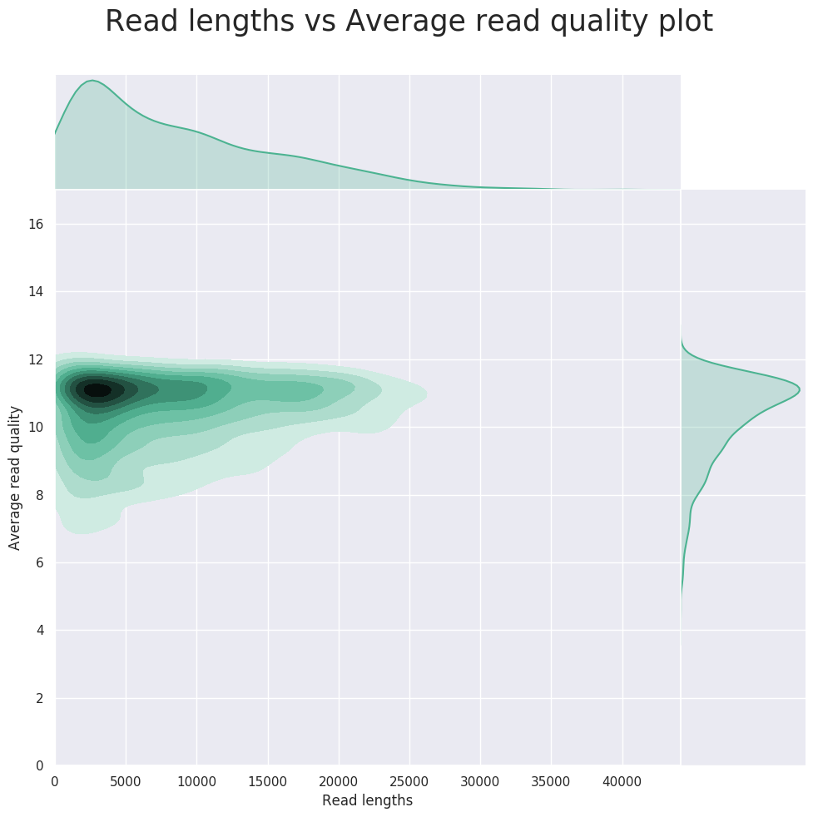
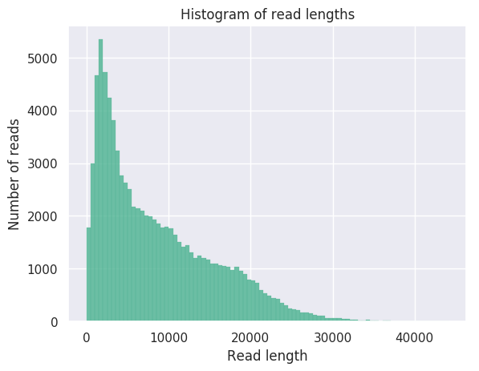
NanoPlot - Summarizing data
Designed for Iong read data (long read tools in infancy - change often).
What does it tell you?
  Total data
  Sequence length distribution
  Sequence quality distribution

Slide 3
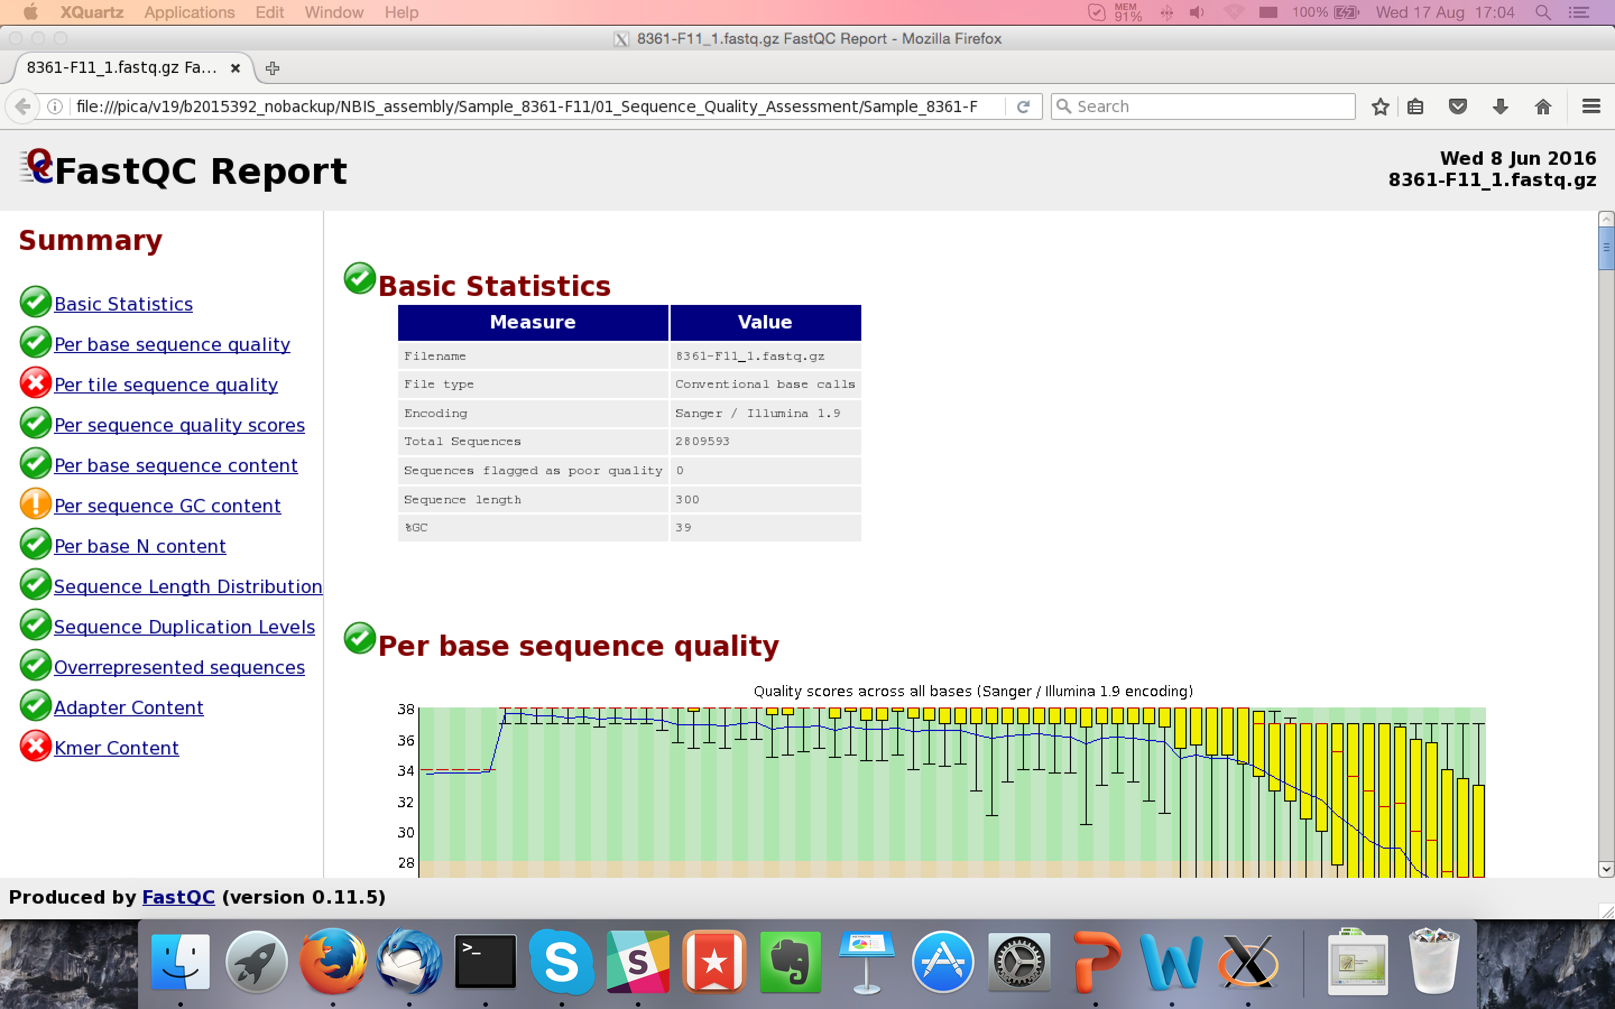
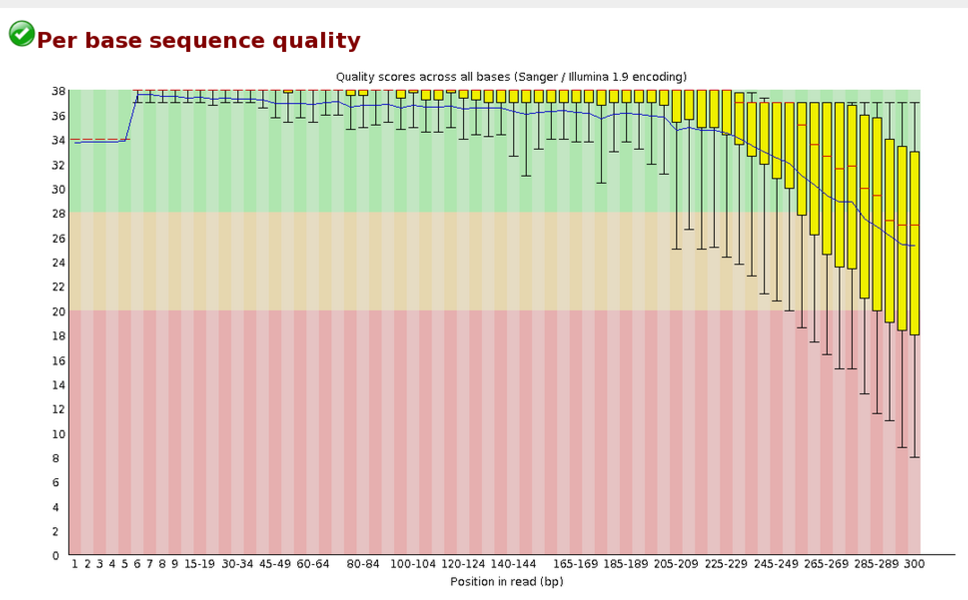
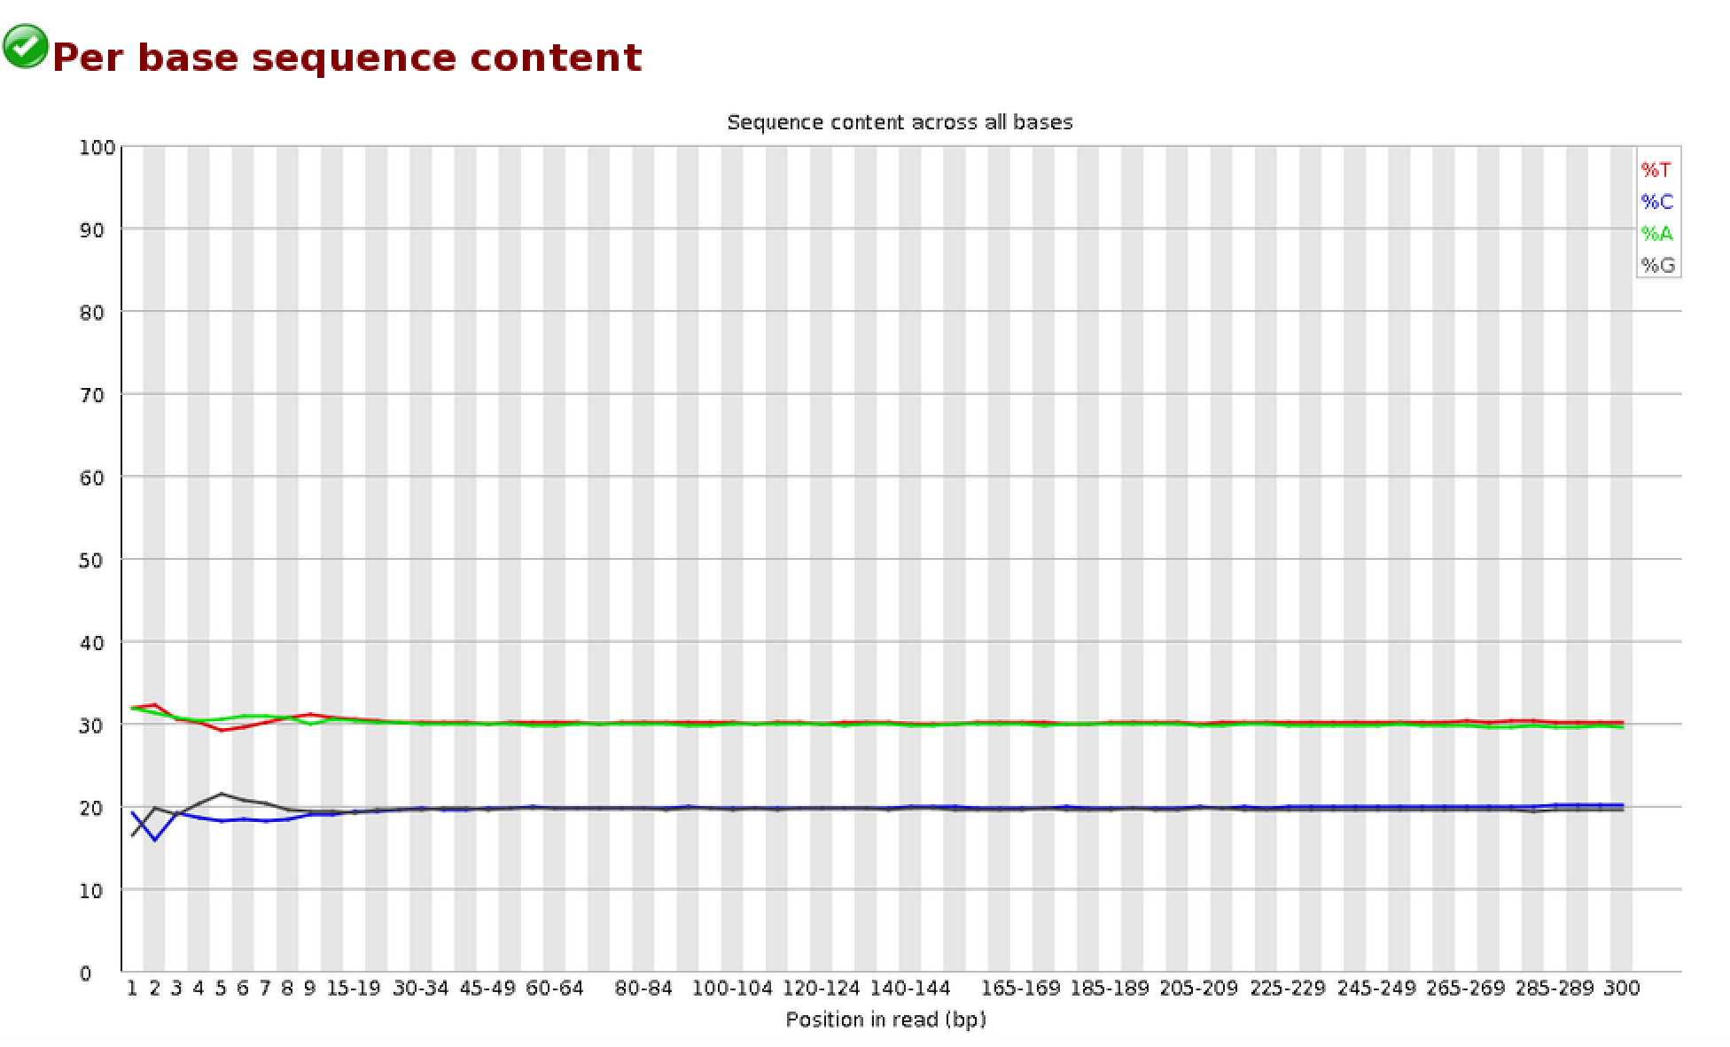
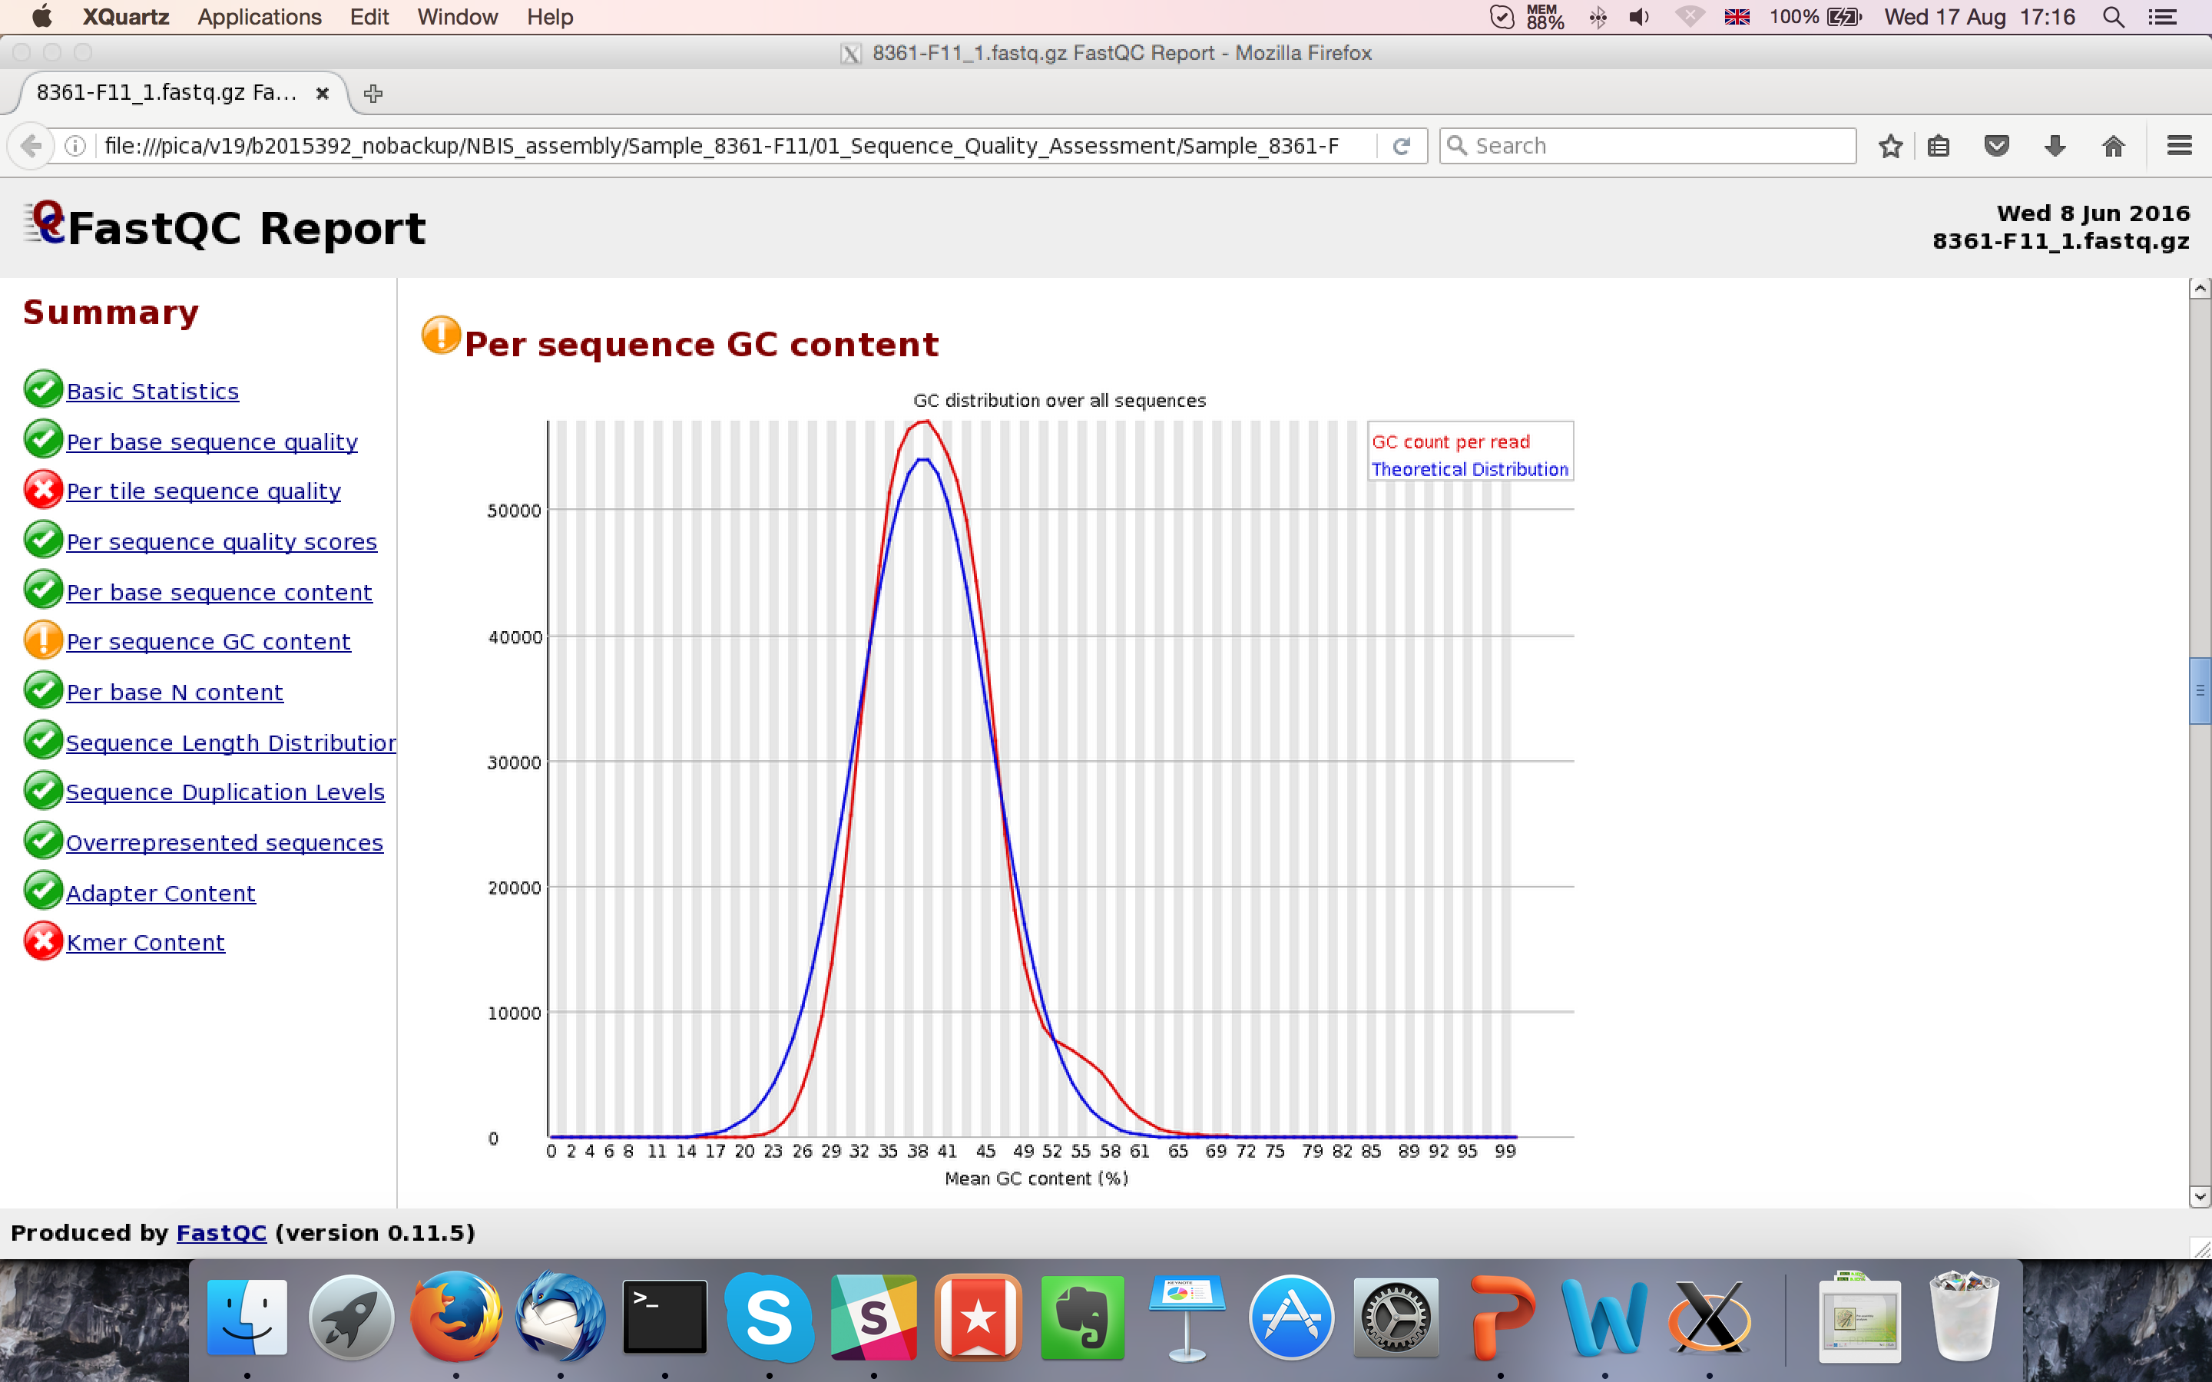
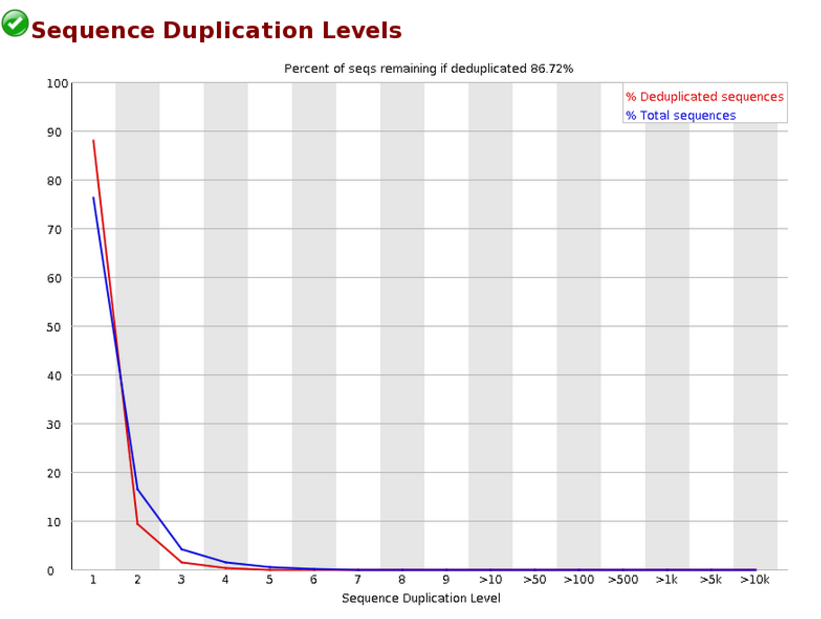
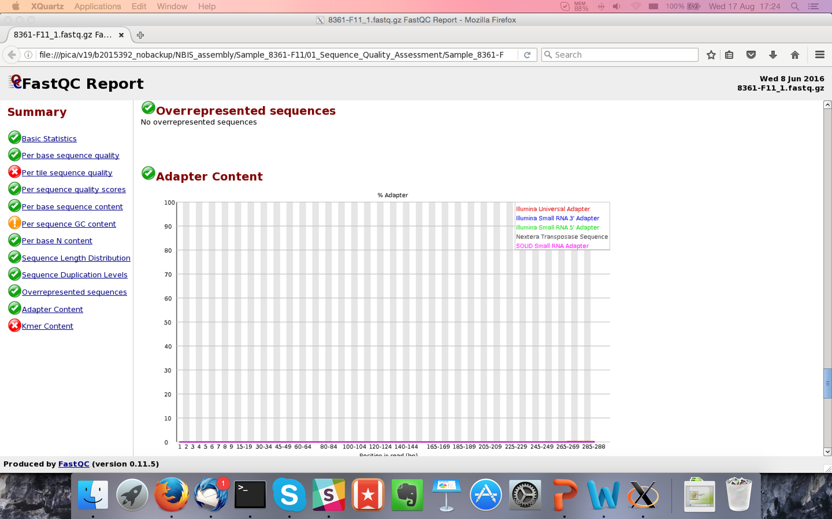
FastQC - Summarizing data
Designed for Illumina data.
What does it tell you?
  Total read pairs
  Sequence length
  Quality Score Encoding
  Average GC%
  Base quality along the read
  Nucleotide % along the read
  Sequence GC content
  Duplication %
  Adapter content
Look at MultiQC for multiple
samples

Slide 4
FastQC

Slide 5
FastQC

Slide 6
FastQC
Q(40) => Error probability = 0.0001
Blue line = mean quality
Good
Quality
Q(30) => Error probability = 0.001
Reasonable
Quality
Phred Quality Score
Q(20) => Error probability = 0.01
Normal: Quality tends to degrade
near end of read.
1st read pair file often has slightly
better scores than 2nd read pair file.
Poor
Quality
Illumina data

Slide 7
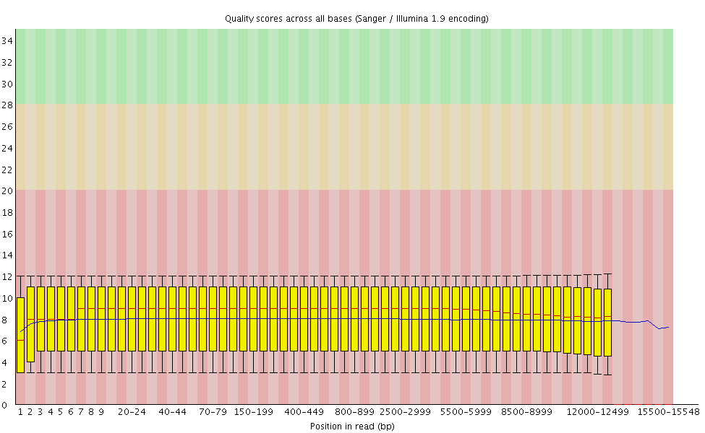
FastQC
PacBio data

Slide 8
FastQC

Slide 9
FastQC
Expected Result: First few bases are not quite uniform.
Caused by Illumina primers. Results in minor fragment
selection bias.
Note: Trimming bases hides the bias. It does not fix it.
Expected: Uniform distribution at half of AT%
Expected: Uniform distribution at half of GC%

Slide 10
FastQC

Slide 11
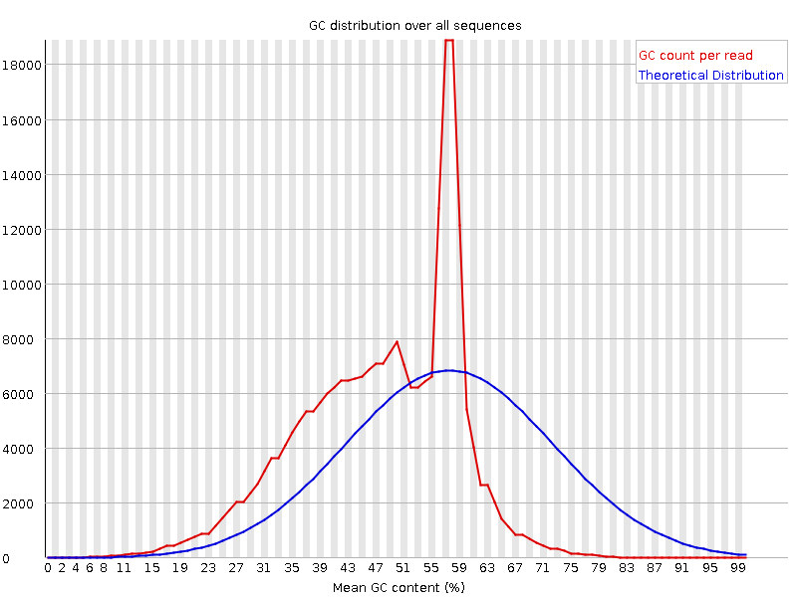
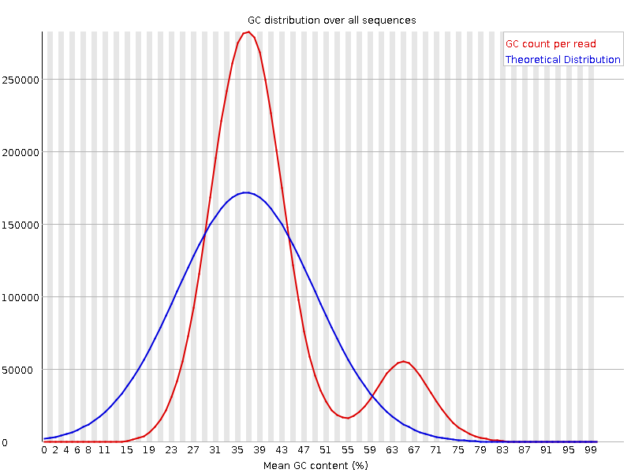
FastQC
This might be contamination
or a feature of the genome
Sharp peak indicates
specific motif. Adapters
are the usual suspect.
Wider or multiple
distributions suggest
contamination.
Expected: Normal/Gaussian Distribution

Slide 12
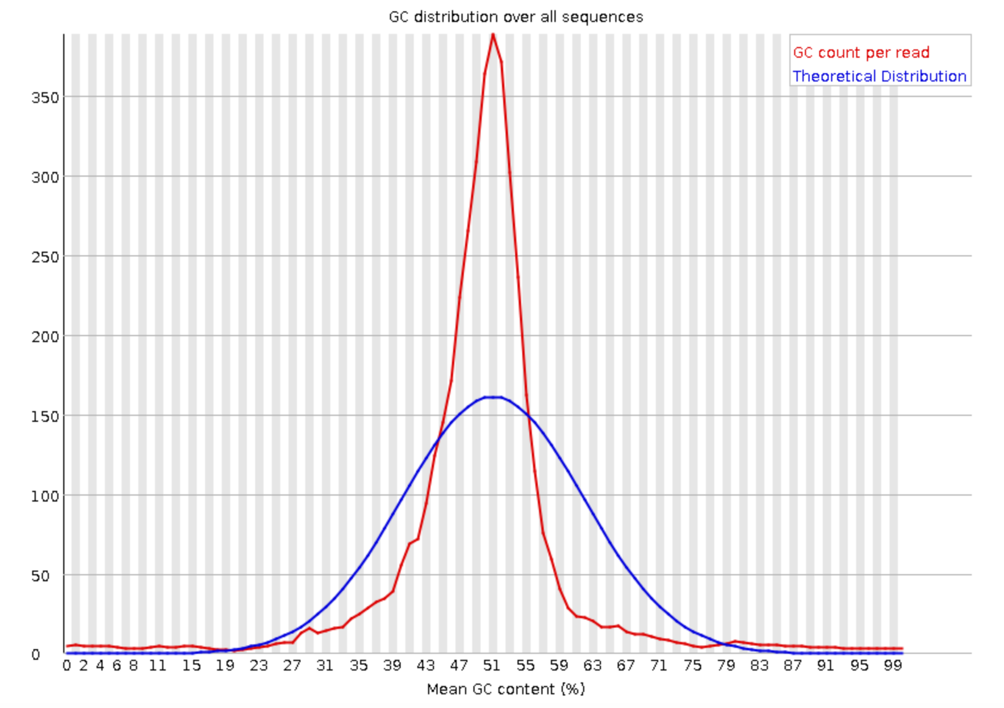
FastQC
PacBio data

Slide 13
FastQC

Slide 14
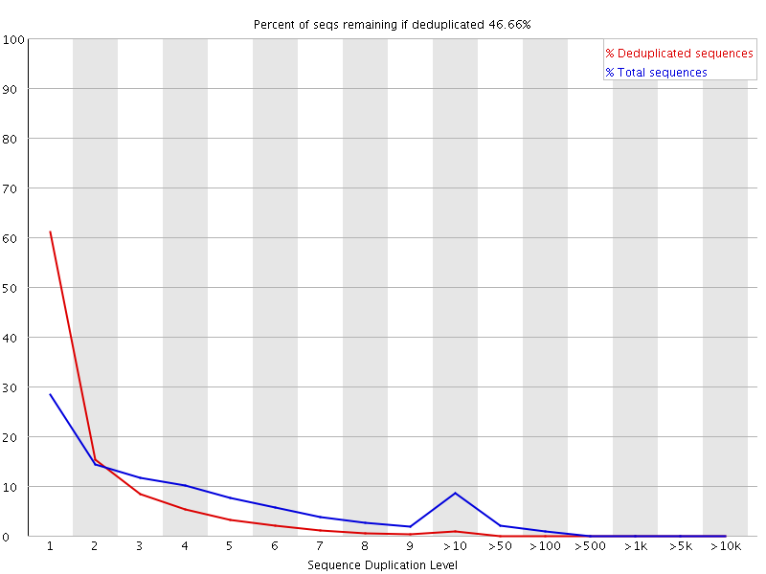
FastQC
First 100,000 sequences
tracked until end of file
Exact sequence match
How much data is left
after deduplication.
Sequences over 75bp
are truncated to 50bp
Percentage of sequences with duplication y
Red trace should show
sequences in library
are diverse. Many low
frequency sequences.
If peak persists in the red trace
then there might be severe
technical duplication or
contamination
Peak shows 10%+ sequences with high duplication levels

Slide 15
FastQC

Slide 16
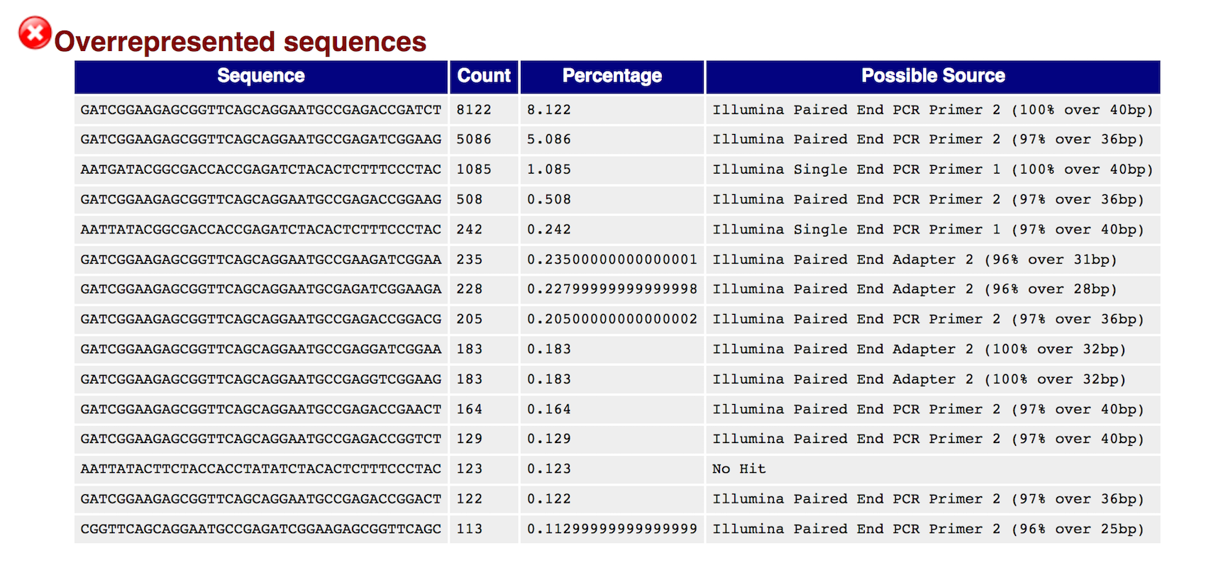
FastQC
First 100,000 sequences
tracked until end of file
Lists sequence that is more than 0.1%
Overrepresented sequences
are matched against known
contaminants.
Match hits are not conclusive,
but indicative.
Matches must be >20bp and
only 1 mismatch.
Adapter content specifically
checks k-mers for matches
to known adapter sequence.

Slide 17
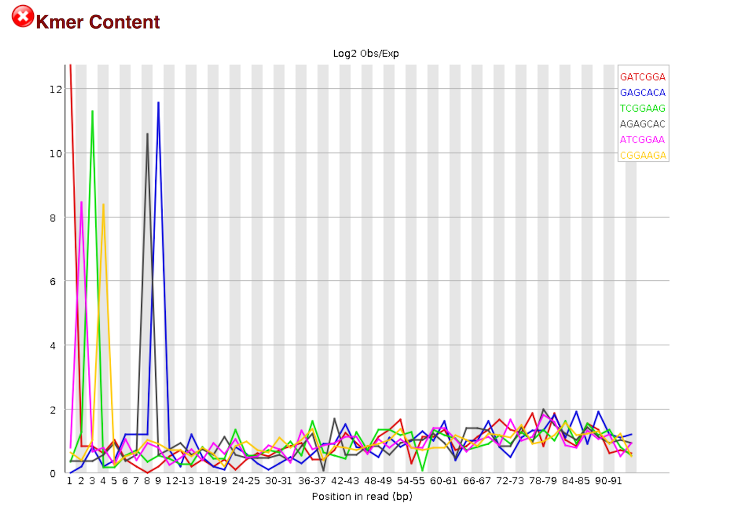
FastQC

Slide 18
FastQC
Is a k-mer over-represented along the length of a read?
All k-mers should have equal probability
of occurring at any position in the read.
K-mers are consistent
with Illumina TruSeq
adapter sequence.
Over-representation at the
beginning of the read implies
many adapters with no DNA
fragment in between.
Default k is 7. K-mer size can be increased with option -k

Slide 19
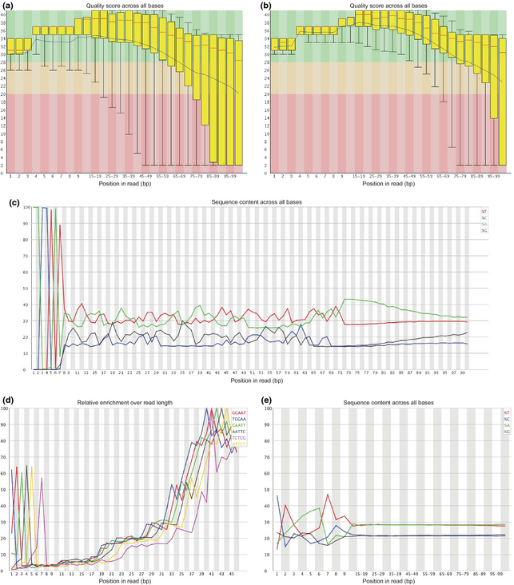
FastQC
Heavy adapter contamination
consistent with short DNA
fragments between adapters
K-mers consistent with
adapter sequences and
barcodes/indices

Slide 20
Contamination
Many sources of contamination
  Unexpected organisms
    Bad reagents
    Lab contamination
    Sample cross over
    …
  Artificial constructs
    Adapters
    Vectors
    Spike-in
Detection depends on your database.
Many software:
  Fastq Screen
  Kraken
  Kaiju
  Blast
  DeconSeq

Slide 21
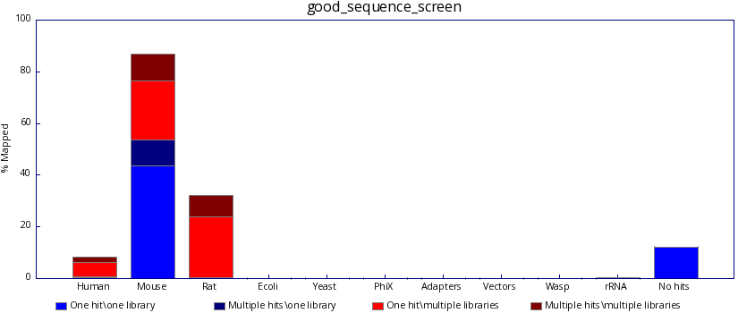
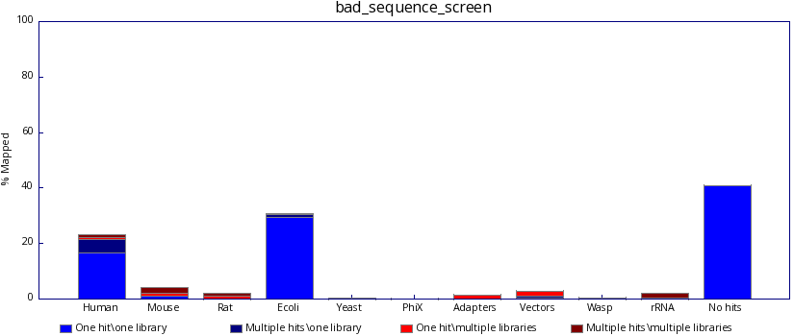
Contamination - FastQ Screen

Slide 22
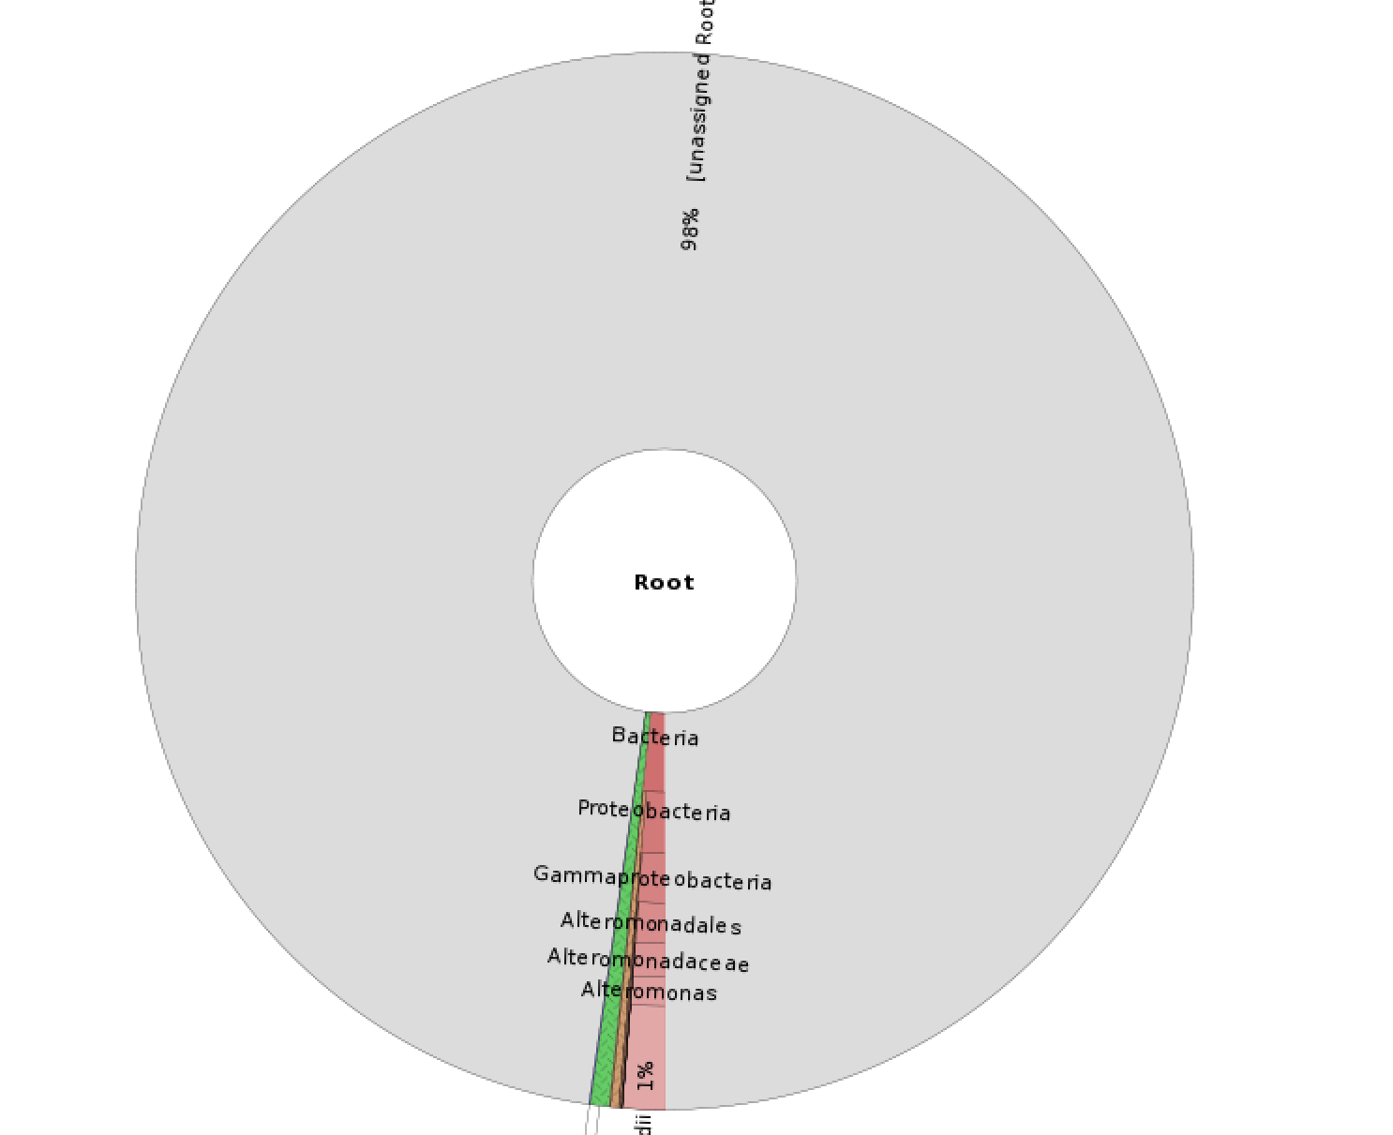
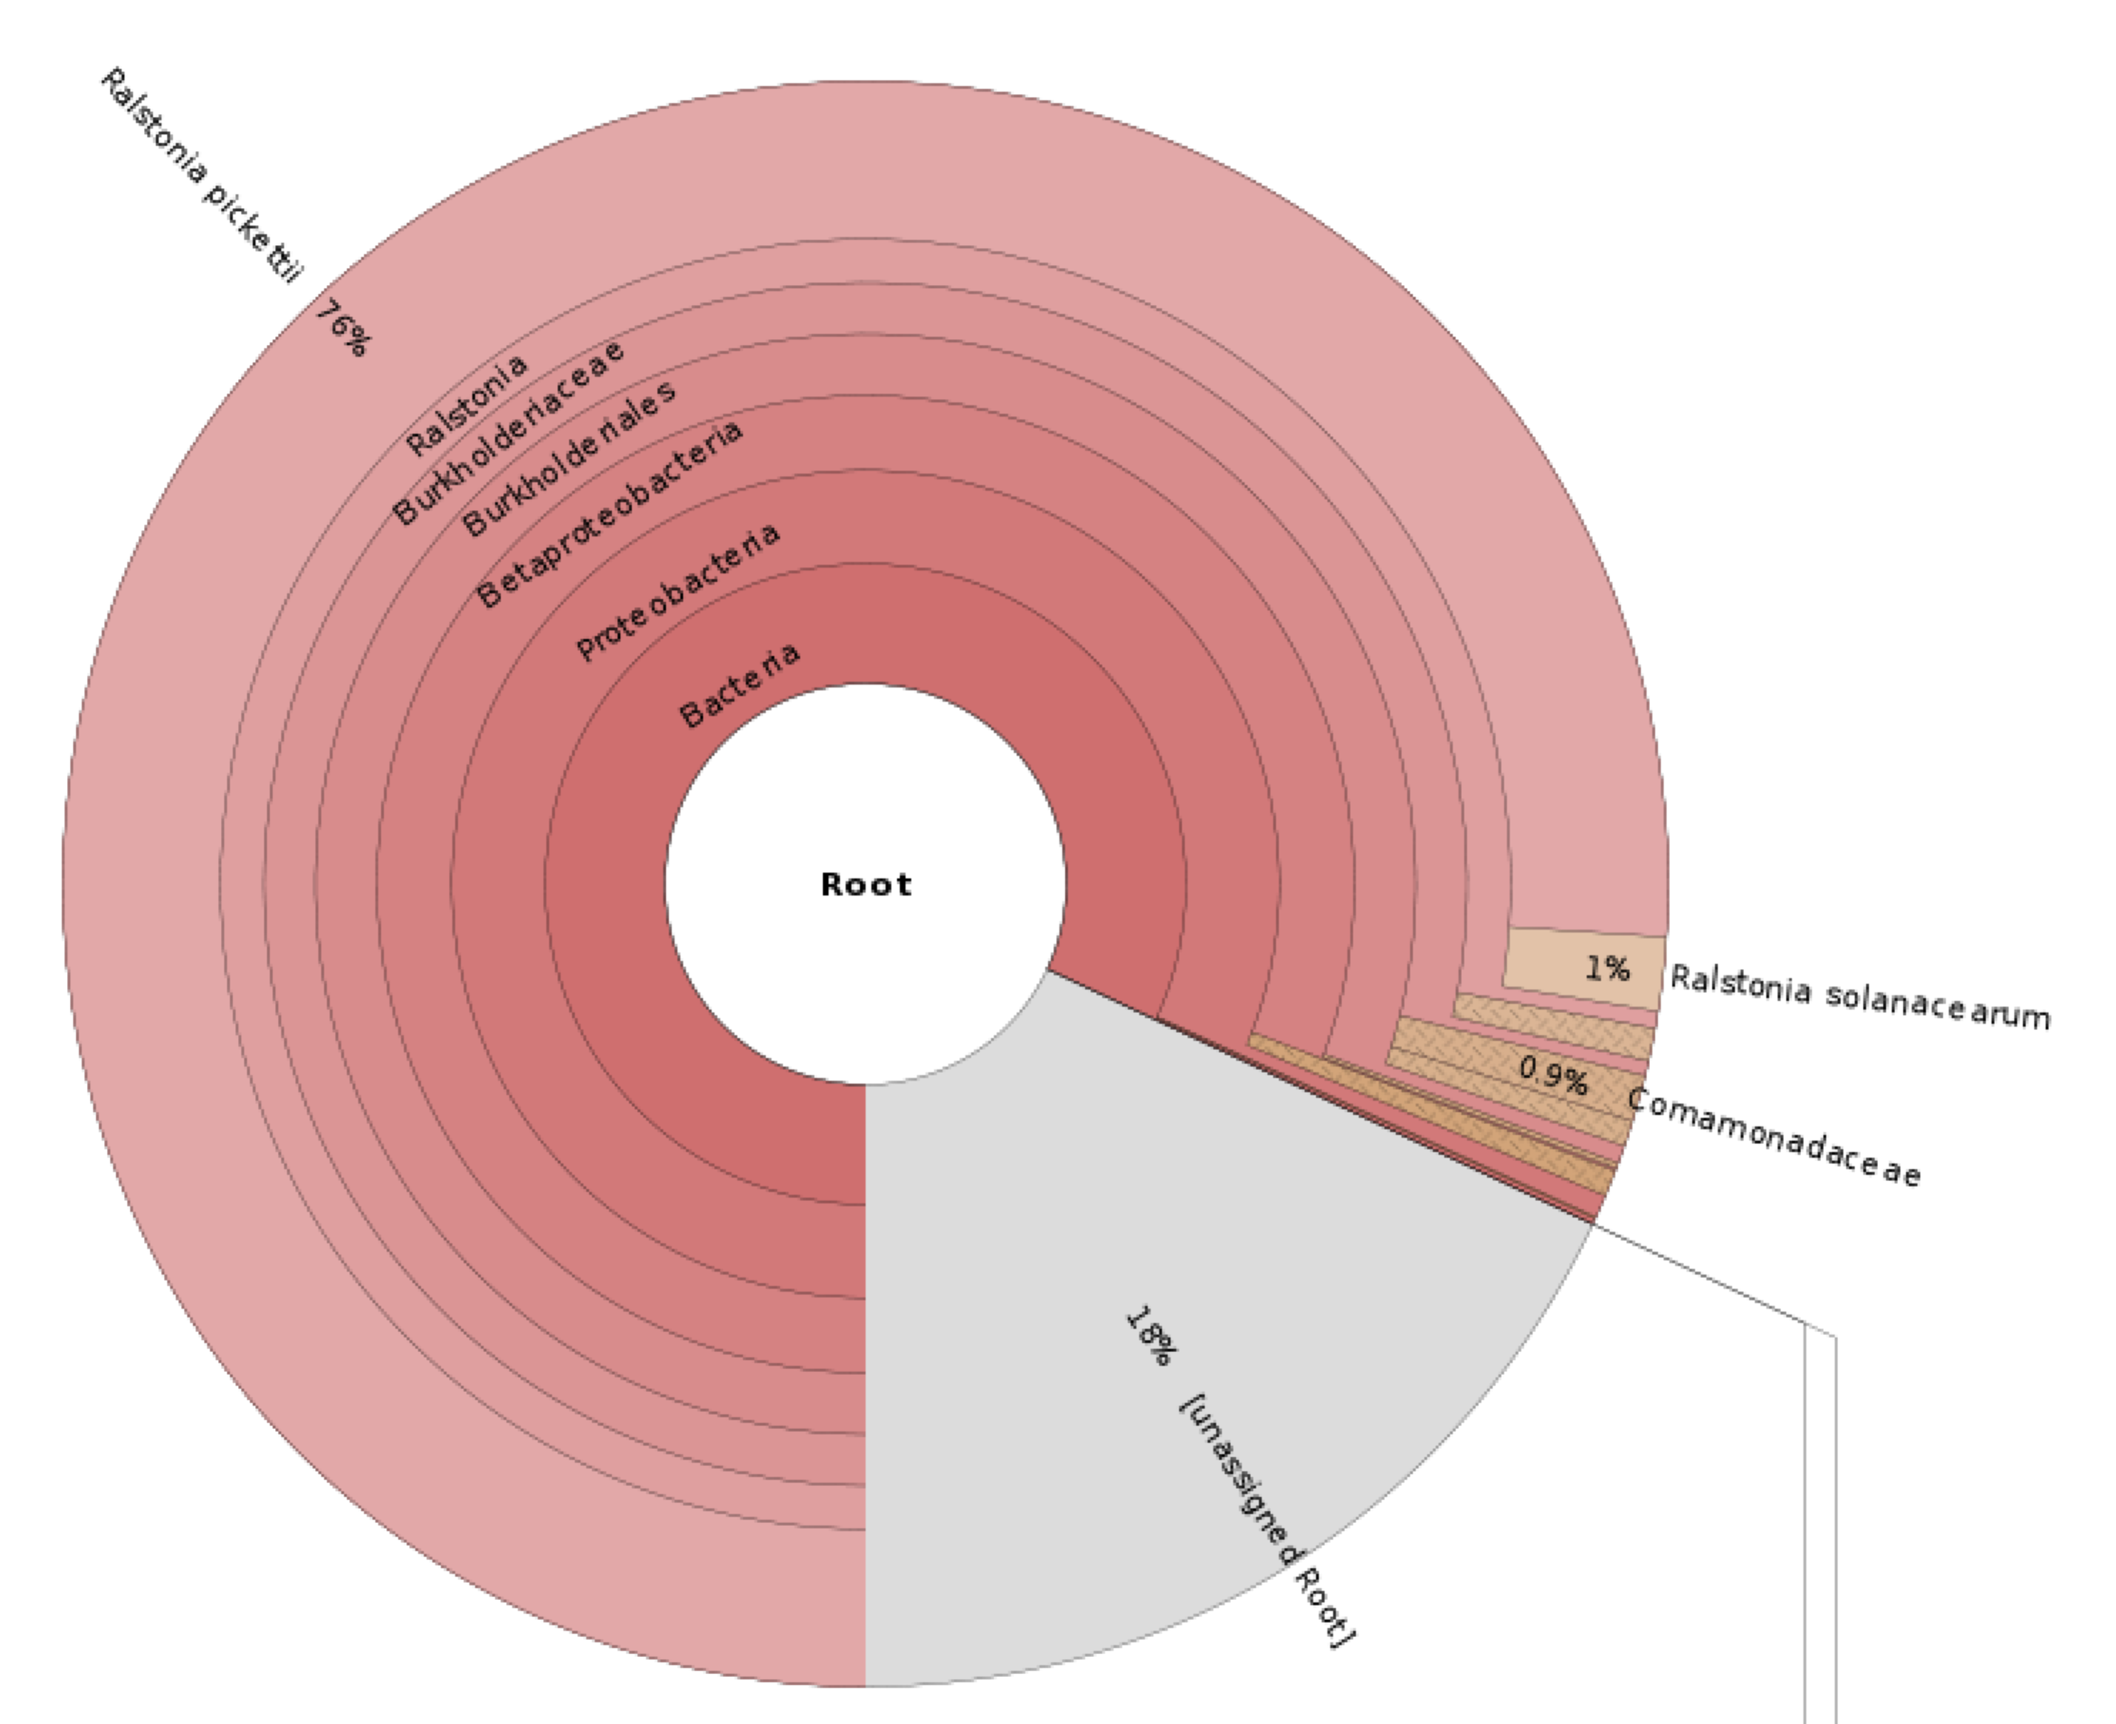
Contamination Analyses
Generalized search with Blast or Kaiju against nt/nr database
Archea, Bacteria, and Virus search with Kraken.
Kraken, Kaiju, and Blast searches can be visualized with Krona.

Slide 23
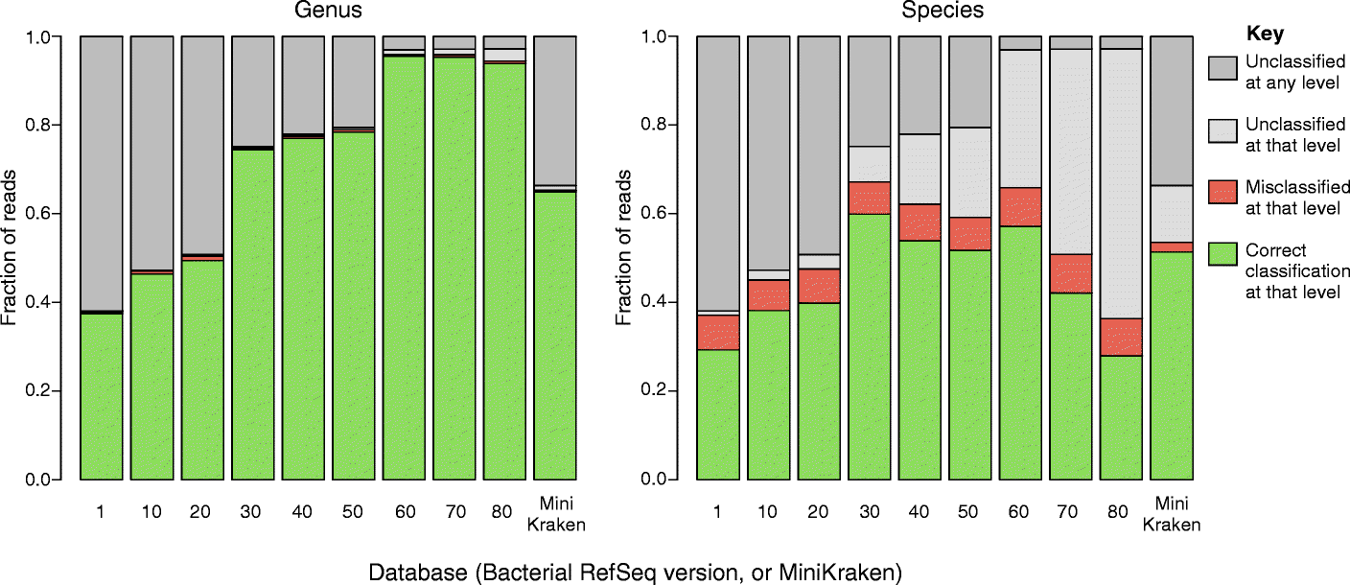
Contamination Analyses
Read based contamination analyses are tricky
  Entirely dependent on your reference database
    Published contaminated sequence increases false positives
  Short k-mer matching increases alignment to multiple targets
  Unrelated organisms can contain similar strings of nucleotides
Nasko et al. 2018

Slide 24
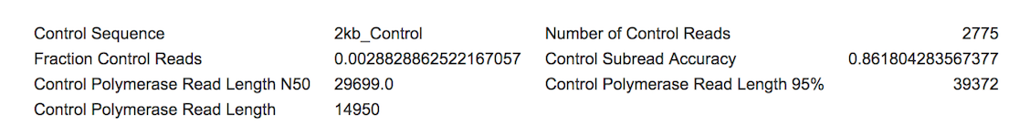
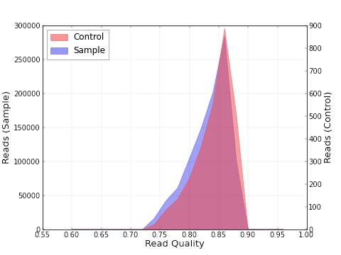
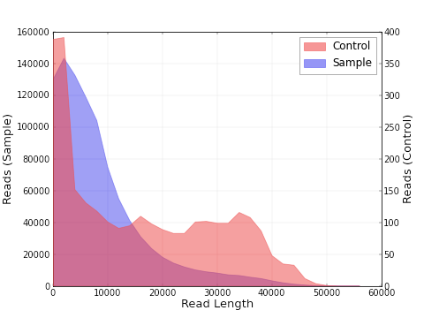
Spike-in sequence - Control reads
Spike-ins are useful for QC but are often not filtered out.
  Illumina: Modified PhiX genome.
  PacBio / ONT: Lambda phage.
Control reads are longer than Sample reads indicating good sequencing but bad Sample DNA quality

Slide 25
Filtering data
Subsampling
Normalization
Trimming
Deduplication
Alignment

Slide 26
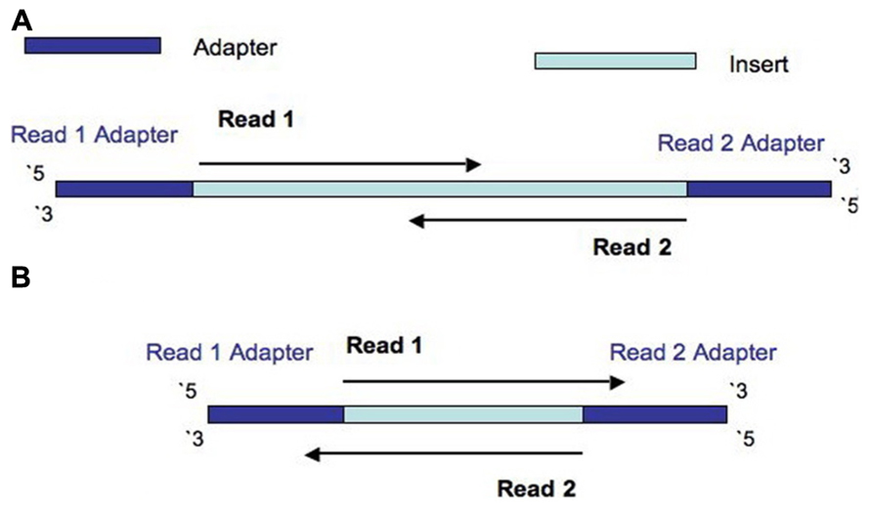
Trimming reads
Remove adapter read through.
  Update to date list of Illumina adapters:
  https://support.illumina.com/downloads/illumina-customer-sequence-letter.html

Slide 27
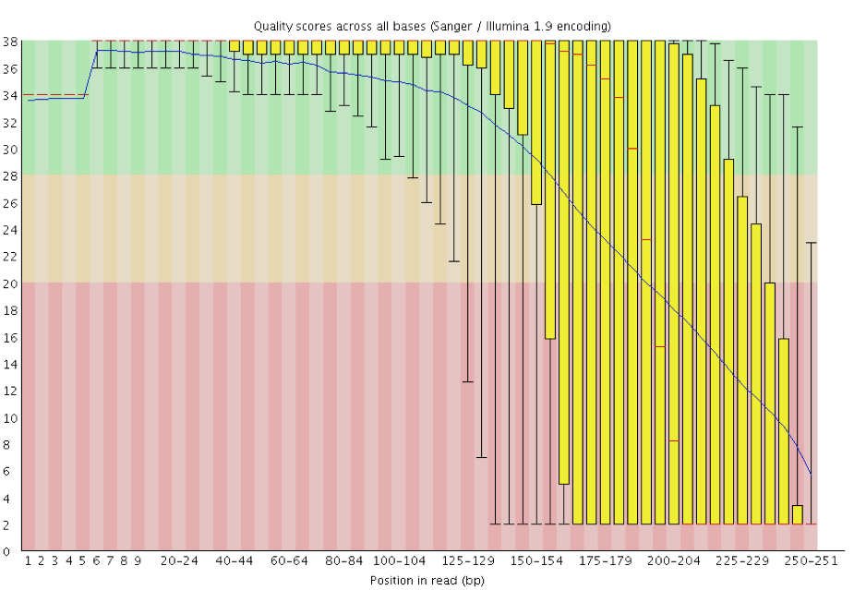
Trimming reads
Remove poor quality reads
My opinion: Don’t trim on quality. Let the assembler correction and
consensus correction deal with it.

Slide 28
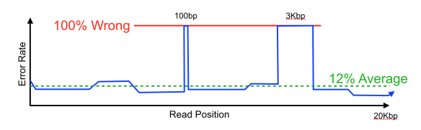
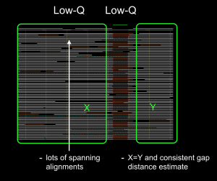
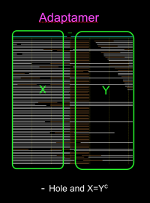
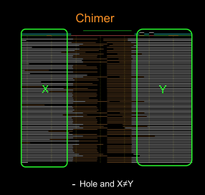
Trimming reads

Slide 29
Trimming reads
Many tools available
  Trimmomatic
  CutAdapt
  AlienTrimmer
  Sickle
  Trim Galore
  Scythe
  Prinseq
  …
Warning: Some assemblers expect untrimmed input.
  Allpaths-LG
  Mira
  Spades
BBMerge can be used to discover adapters.

Slide 30
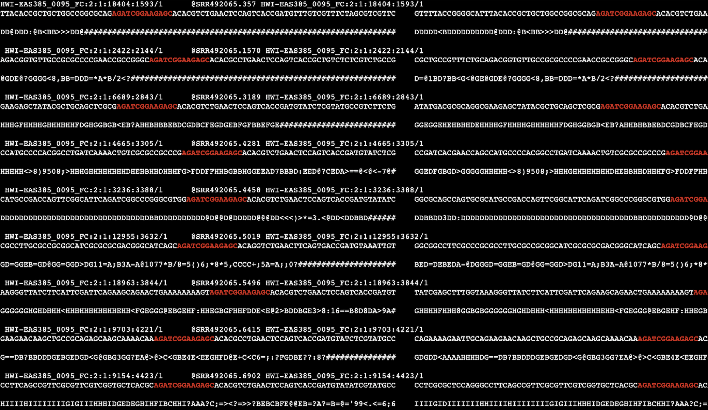
Trimming reads
Highlighted primer sequence shows the start of adapters in Illumina paired reads and the symmetric nature of the pattern (check you’re trimming correct adapter).

Slide 31
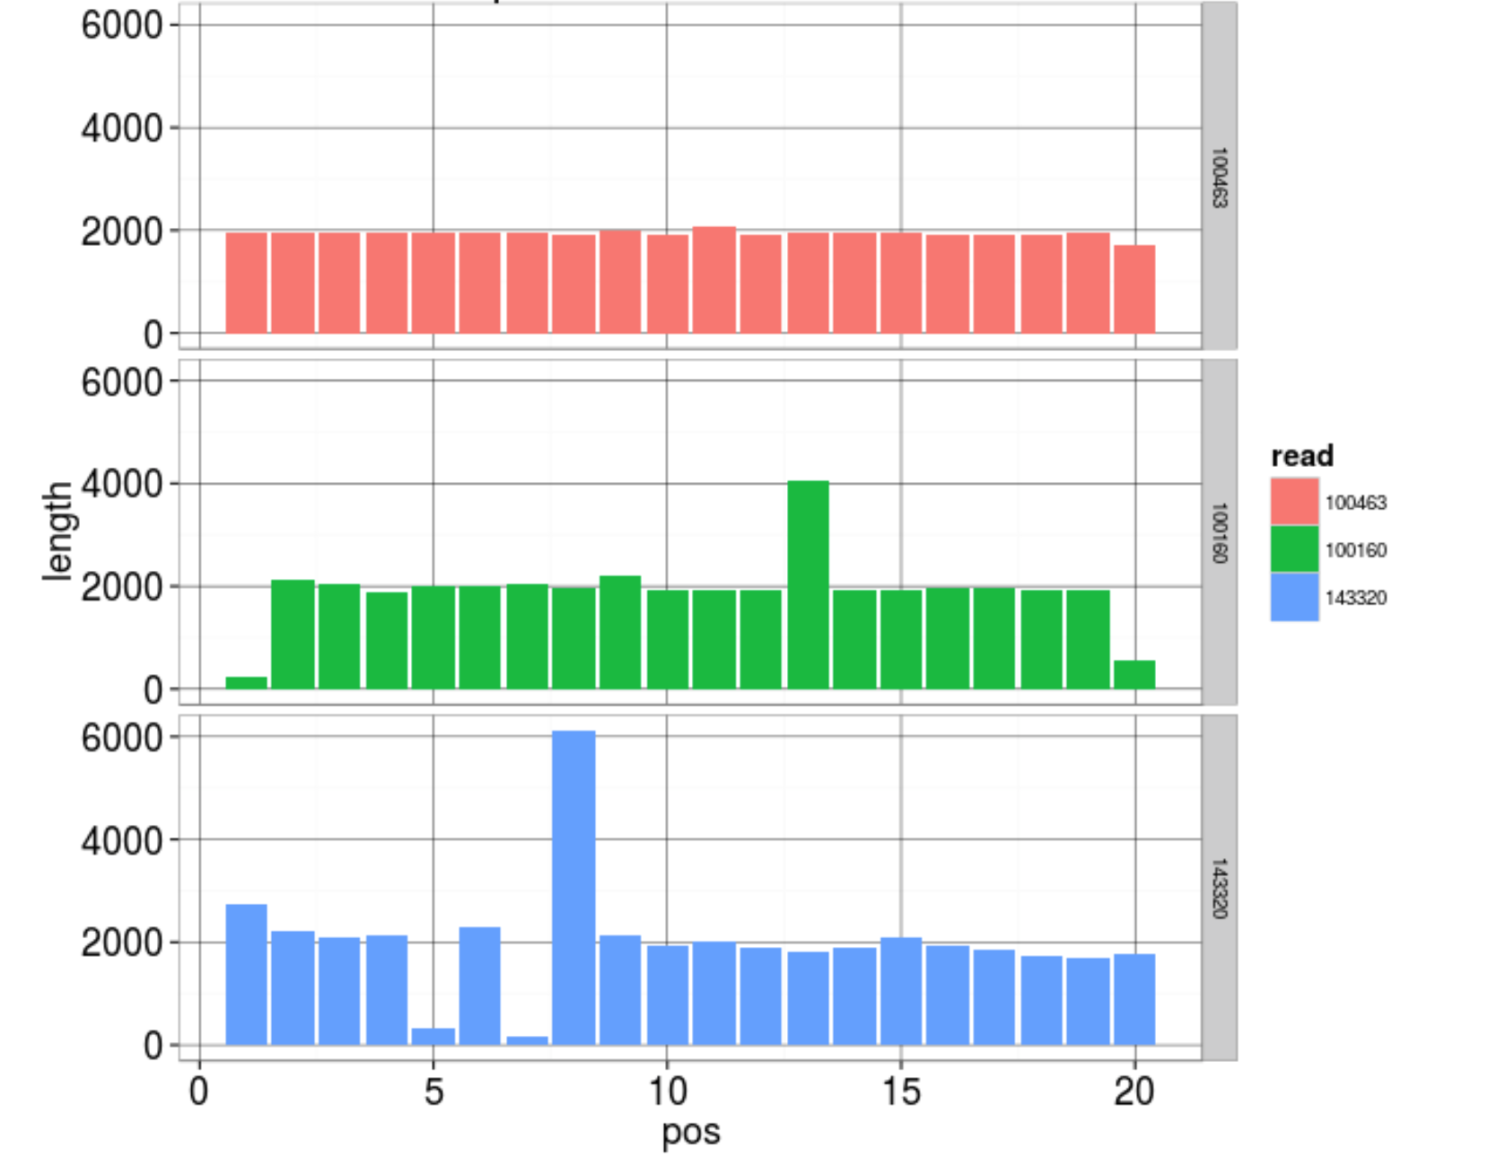
Trimming reads
SMRTbell adapter:
ATCTCTCTCTTTTCCTCCTCCTCCGTTGTTGTTGTTGAGAGAGAT

Slide 32
Duplication Removal
Why do duplicates arise?
  Optical duplicates (amplified cluster mistaken for multiple clusters)
  PCR duplicates
Why are duplicates bad?
  Often indicates library preparation error
  Poor overlap information
  Increased complexity, computation time, and resources
How to remove duplicates:
  Prinseq
  FastUniq
  ParDRe
  …

Slide 33
Reference based filtering
Contaminants identified from Blast, Kraken, Kaiju, etc imply available references.
Reads can be aligned to these sequences.
Filter out reads that align uniquely to those sequences.
  This can still over-filter.
Alternatively, filter contaminants after assembly.

Slide 34
Summary
FastQC / NanoPlot
  Diagnostic plots
Trim adapter sequence.
Remove duplicates from heavily duplicated data.
Treat early contamination analyses as suggestive.
Remove heavy contamination.

