Slide 1
Cell type identification in single-cell RNA-seq data
Philip Lijnzaad

Slide 2
Overview
Introduction
Manual methods
Existing methods
SingleR
CHETAH

Slide 3
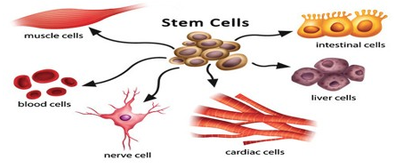
Definition of cell type?
Originally defined in terms of (tissue) function and cell morphology
later extended presence/absence of Cell Surface markers
gene expression
Currently very much less fixed
cell cycle phase
migration state
differentiation: cell state
Much more fluid than it was, perhaps impossible to define
Notes:
Mention dedifferentiation, transdifferentation

Slide 4
Cell type identification: why?
Samples often heterogeneous
Especially true for tumor samples
‘Make sense’ of your data
Find new cell types
Notes:
Mention a nice application: identify ‘interesting cells’ and if it unique expresses some gene that you can then tag fluorescently in order to cell-sort them more easily

Slide 5
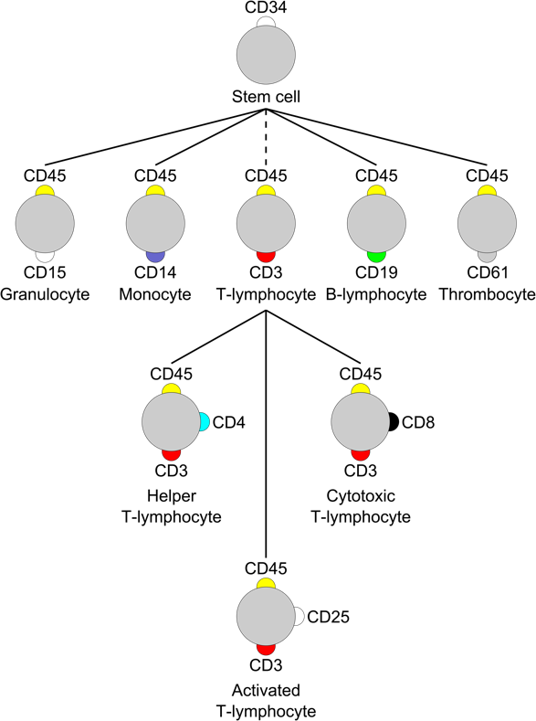
Cell surface markers
Often considered the gold standard (esp. in immunology)
mRNA of cell surface markers often lowly expressed or absent!
Use combination of such marker genes, and also use different genes
Notes:
Mention CITE-seq here

Slide 6
Manual classification
Time-consuming
Requires expert knowledge
Likely subjective and/or inaccurate
Notes:
In other words: this needs automating, to speed things up, re-use existing knowledge, and make it more objective

Slide 7
Automatic methods
Use complete cell type-specific mRNA expression profiles
based on bulk RNAseq from FACS-sorted ’pure’ populations
OR: manually curated cells picked from scRNA-seq data sets
’the reference’
Variety of approaches:
methods: ad hoc, machine learning
assign per individual cell, or per cluster of cells
All use similarity to the reference, often based on correlation
Notes:
Mention bulk microarrays also still used
Also mention that all the methods establish the similarity of a cell’s expression profile to the reference. The similarity is defined in various ways, often involving correlation

Slide 8
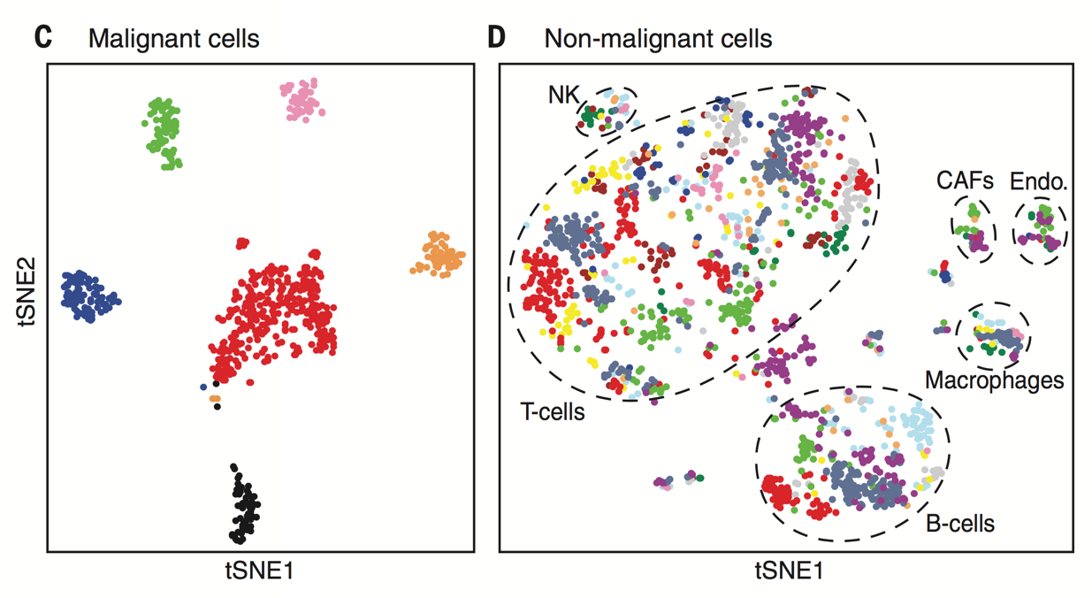
Tumor cells are very diverse
Tirosh et al. 2016

Slide 9
Identifying tumor cells
Comparing to tumor cell line expression does not work
Expression often similar to fibroblasts
Sometimes possible to detect copy-number variations in scRNA-seq data
Identify them by exclusion?

Slide 10
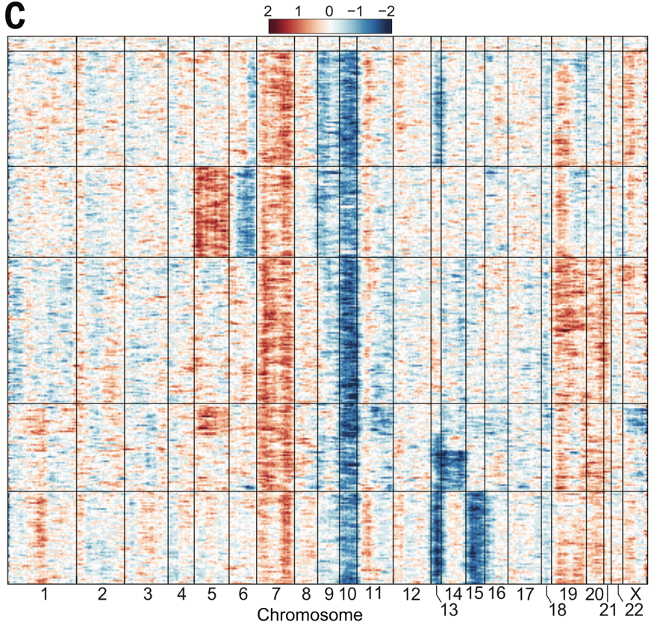
CNV detection in scRNA-seq data
inferCNV tool
(Patel et al. 2014)

Slide 11
Methods
scmap (Kiselev et al., Nature Meth. 2018)
CaSTLe (Lieberman et al., PLoS ONE 2018)
MOANA (Wagner & Yanai., BioRxiv 2018)
SingleR (Aran et al., Nature Immun. 2019)
SuperCT (Xie et al., NAR 2019)
CHETAH (de Kanter et al., BioRxiv 2019, under review)
.
.
.

Slide 12
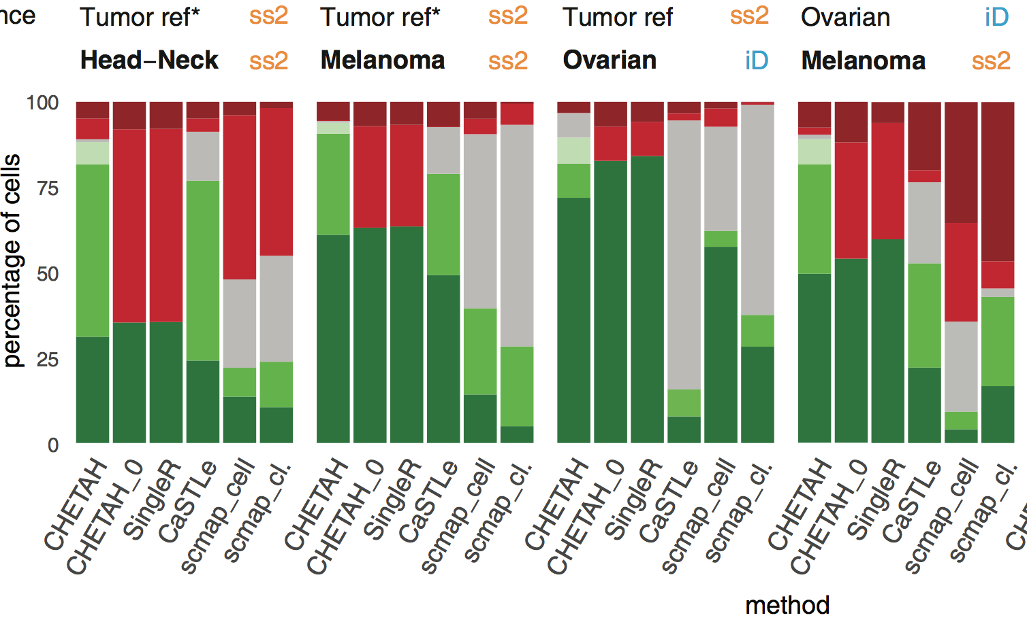
De Kanter et al., under review

Slide 13
SingleR
Very rich reference data:
HPCA: hand-annotated Human Primary Cell Atlas
37 main types, 157 subtypes, 713 samples
BluePrint + ENCODE
24 main types, 43 subtypes, 259 bulk RNAseq samples
Mouse: ImmGen and ‘mouse.rnaseq’ (brain-specific)
Classifies to both main and subtypes, and both single cell-wise and cluster-wise
Notes:
Mention that HPCA and ImmGen are microarray based

Slide 14
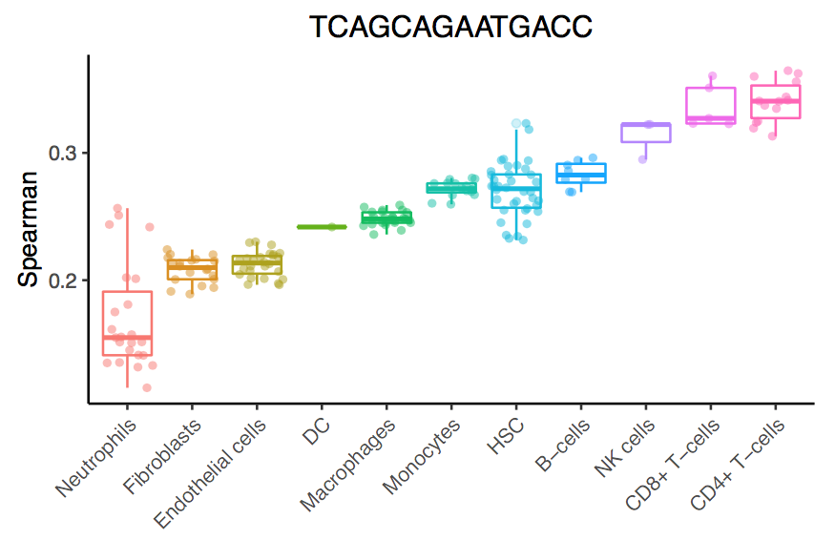
SingleR method
← one cell
Correlate each cell (or average of cluster) to each sample
← each dot is one reference sample
Main types →
Notes:
Spearman correlation

Slide 15
SingleR method
Per cell type, correlate using the top N genes that have
median(expression) > median(expression) in all other cell types
SingleR score per cell type is the 80%-ile of the correlations
Fine-tuning:
All types with score < (topscore – 0.05) are removed (if none, the worst is)
Redo correlations (top N genes will differ) until one cell type remains
N increases with decreasing number of remaining cell types
Notes:
Spearman correlation

Slide 16
← subtypes

Slide 19
CHETAH
Classify cells by shunting cells down a hierarchy of cell types
Assign the most specific type you have evidence for
Allow intermediate cell types
Evidence expressed as confidence score
uses rank-based similarities called profile scores
requires single-cell RNA-seq data as a reference
Bioconductor, BioRxiv, github.com/jdekanter/CHETAH/
Notes:
Profile score uses the 200 genes best distinguishing that cell type from all the other cell types
Profile score is based on the quantiles of the correlations
Confidence score used for a cut-off to stop classifying

Slide 20
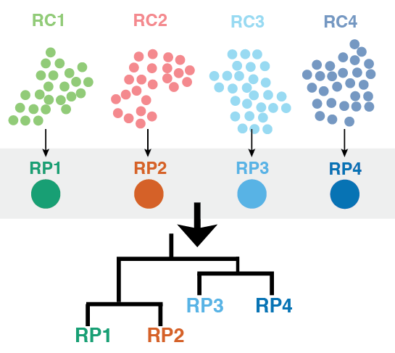
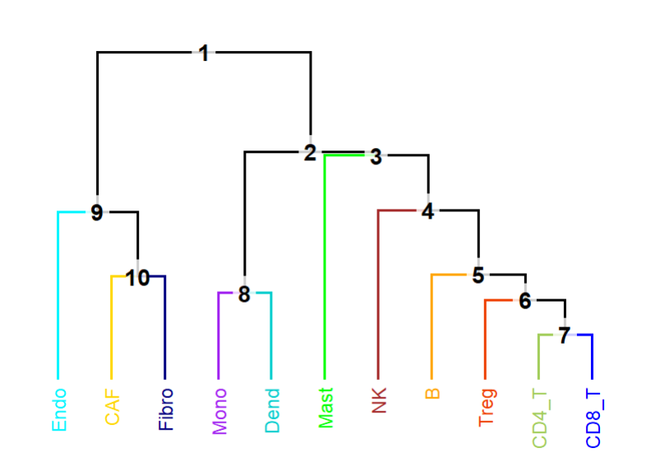
Tree of reference profiles
Example of actual tree
Notes:
So, what you need to know is that this split in a tree is a node and that the two lines emerging from this node are called branches.
(right-hand side: lymphoid, i.e. NK, T, B (and should have dendritic), middle Myeloid

Slide 21
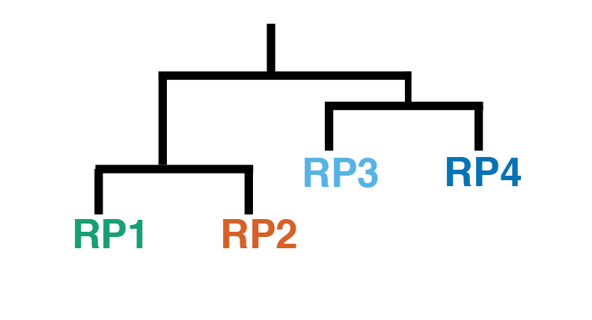
Cell shunting
At each branch point:
Calculation of scores
Assignment of cells
Right, left, stop
Next branch point
Notes:
As a recap. Different steps, like gene selections, correlations and the calculations of scores is performed in each node.
Then cells are assigned to either the right or the left branch, or classification of some other cells stops in that node. This is the case if the confidence is lower than 0.1.
Cells are first split in the highest node.
Most cells are assigned to one of the branches, but for some cells, no evidence for an assignment was present, so they stay in the highest branch.

Slide 22
Cell shunting
At each node:
Calculation of scores
Assignment of cells
Right, left, stop
Next node
Notes:
Now the cells reaching the lower nodes are split, based on the same steps being repeated for RP1 and RP2.

Slide 23
Cell shunting
At each node:
Calculation of scores
Assignment of cells
Right, left, stop
Next node
Notes:
Now the left

Slide 24
Cell shunting
At each node:
Calculation of scores
Assignment of cells
Right, left, stop
Next node
Notes:
This is the final classification, which we color for clarity

Slide 25
Done
t_SNE_2
t_SNE_1
CHETAH: CHaracterization of cEll Types Aided by Hierarchical clustering
Notes:
And put on a t-SNE map:

Slide 26
Details
← ? →
Notes:
The best branch is the one containing the cell type having the highest similarity to the cell of interest.
Similarity of a cell to a cell type is calculated by comparing its relative correlation to that in ‘the other branch’

Slide 27
Profile score
Correlation (Spearman) is over the 200 genes with maximal DE between current type and the average of types in ‘the other branch’
Notes:
The ‘other’ cumulatlve probabilities have to be flipped, because with a low average correlation (i.e. cell is prolly not ‘other’) it is easy to get a very high cumulative probability

Slide 28
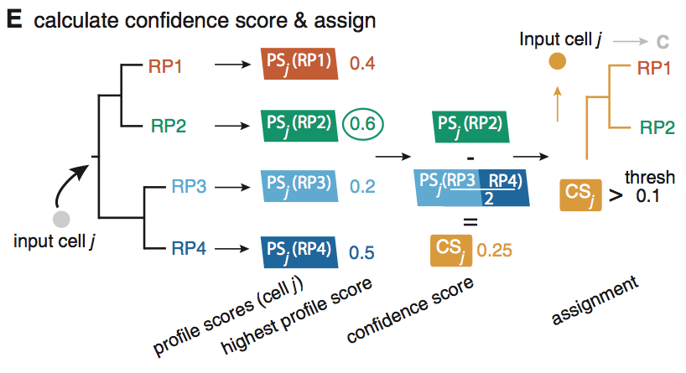
Confidence score

Slide 29
First results
CHETAH
Publication
Tirosh et al. 2016

Slide 30
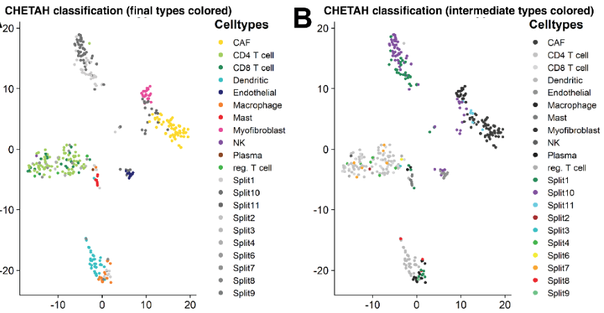
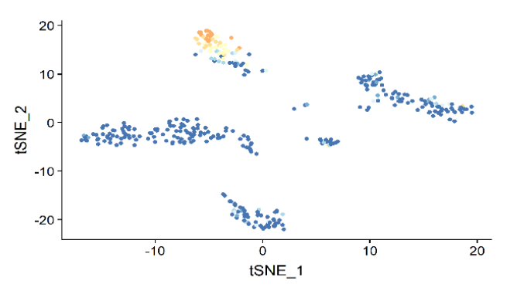
Neuroblastoma data (Kholossy & Molenaar)
colored by single-cell CNV score
Notes:
~ 370 cells, 2/3 classifying to final types
Groep topleft: high MYCN, NCAM1, PHOX2B and expression -> tumor cells
Method is based on the inferCNV method, Patel et al.

Slide 31
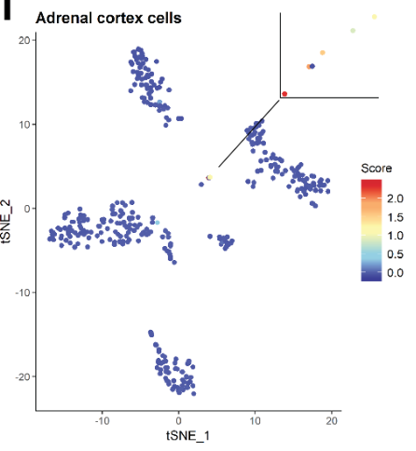
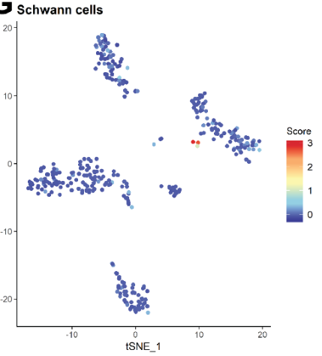
Cell types not present in the reference
Adrenal cortex cells
Schwann cells
Notes:
Normalized expression of differential markers (Seurats ‘module score) Note the inset on the right hand side
Markers: SOX10, CDH19 (cadherin), GPM6b (neuronal membrane glycoprotein), S100B (s100 calcium binding protein B), MPZ (myelin protein zero),
Less specific : NGFR (nerve growth factor receptor)

Slide 32
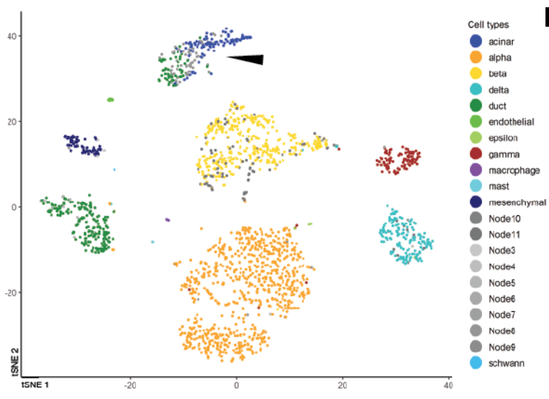
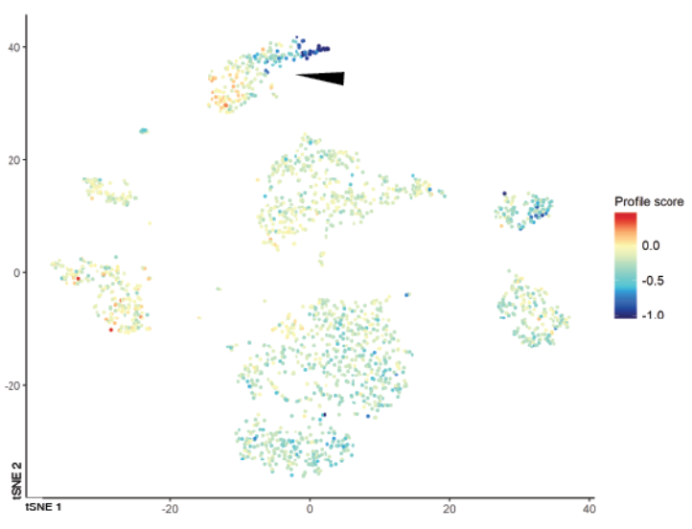
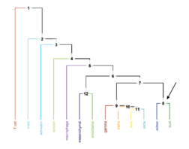
Acinar – ductal gradient in pancreas data
Baron et al. 2016; Muraro et al. 2016
Notes:
Showing the profile score for ductal cell in node 8

Slide 33
Expression of ductal and acinar markers

Slide 34
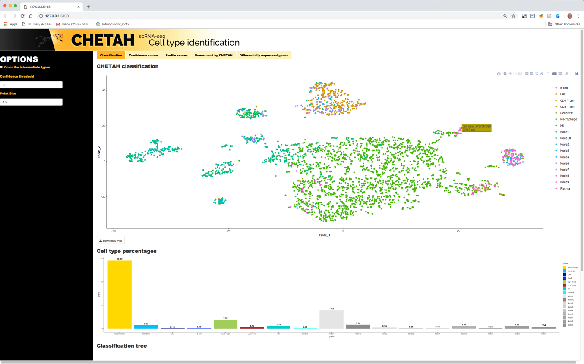

Slide 35
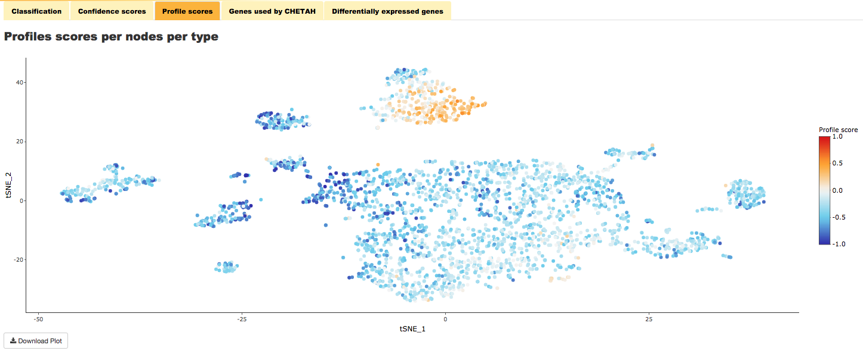

Slide 36
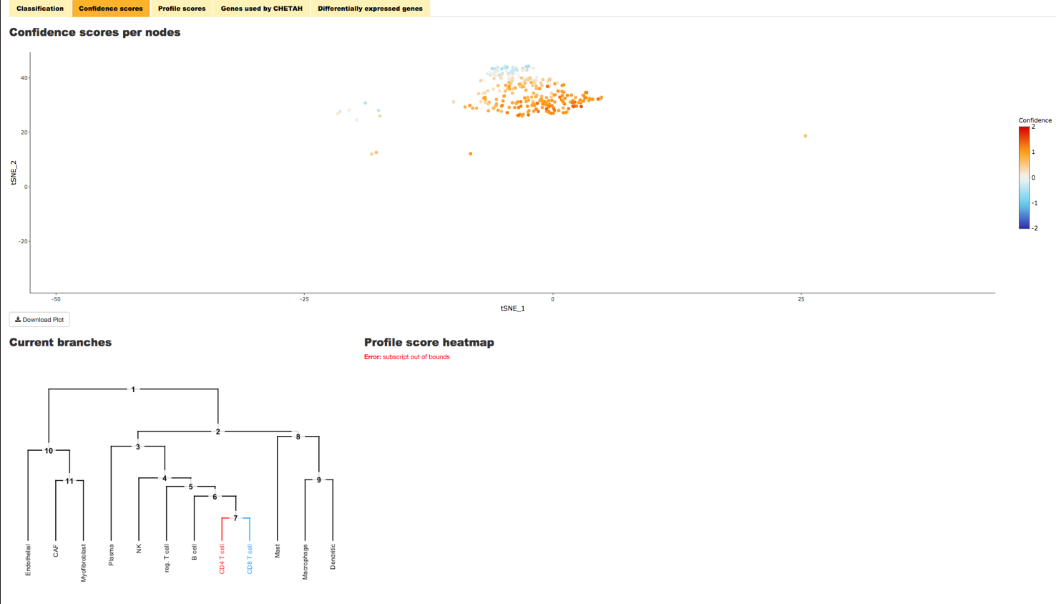

Slide 37
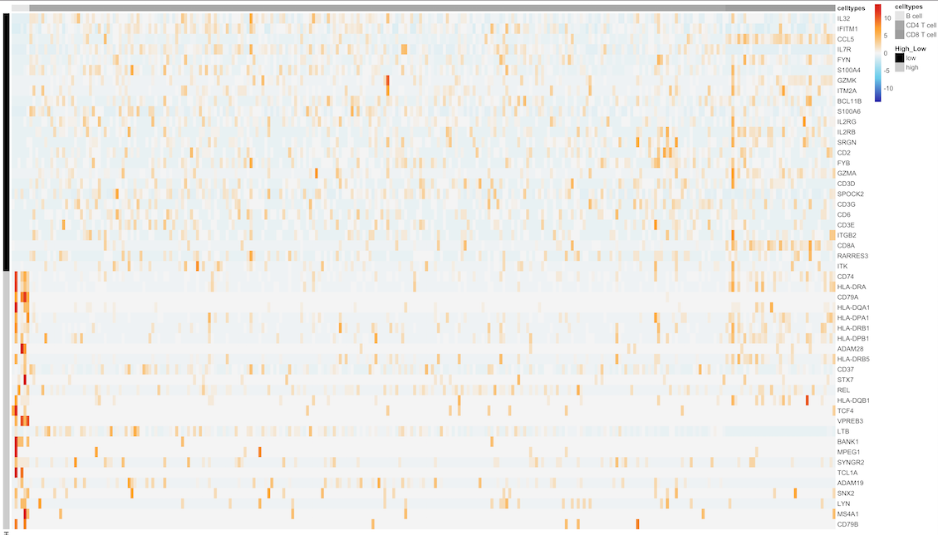
Genes used per node and cell-type

Slide 38
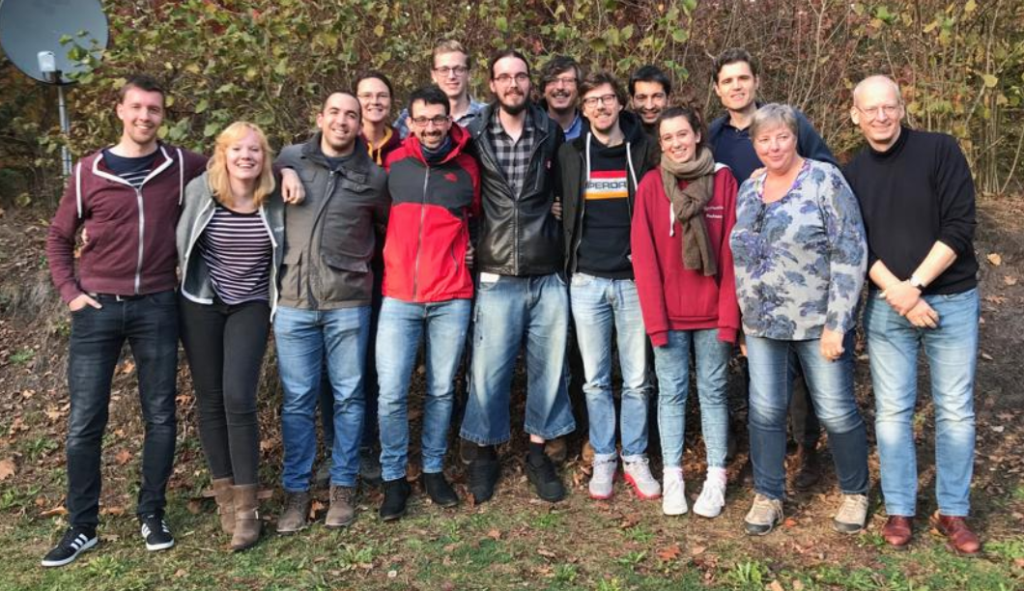
Thanks!
Jurrian de Kanter
Tito Candelli
Thanasis Margaritis
Frank Holstege
Patrick Kemmeren
Waleed Kholosy
Jan Molenaar

